Slide 1
Dietary Fiber: A Remarkably Diverse Nutrient
Edward Deehan, PhD, RDN, LMNT
Assistant Professor
Food Science & Technology Department
Nebraska Food for Health Center
University of Nebraska–Lincoln
April 25, 2024
Notes:
Thank you for that kind introduction and for inviting me to be here today.
As you can tell by the title, I am interested in dietary fibers and their effects on health.
Talk about it’s complexity, both as a diverse nutrient and it’s effects ok health.

Slide 2
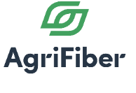
Overview of My Background
Fiber Ingredients
Nutritional Microbiology
Registered Dietitian
Notes:
Sharing my knowledge with dietitians.
Mention no financial disclosures.

Slide 3
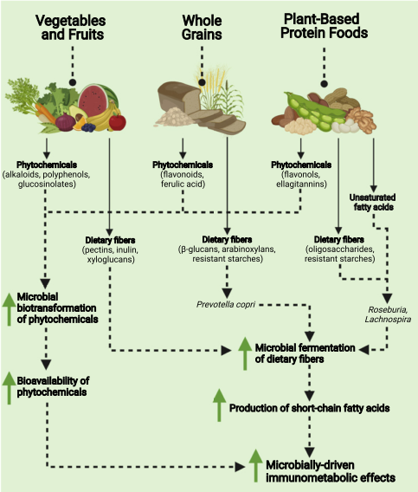
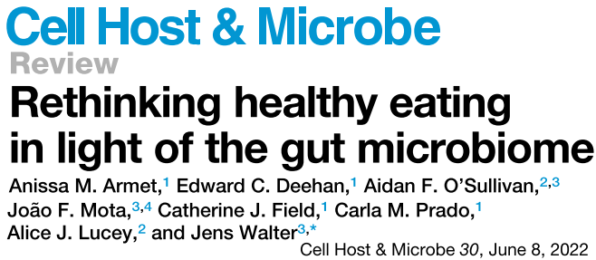
Dietary Fibers are a Very Unique Nutrient
Anissa
Armet
Dr. Jens
Walter
Dietary fibers are one of the few nutrients present in all whole plant foods where encouraged intake is likely more advantageous to health than the avoidance of harmful nutrients.
Notes:
It was during this training that I first realised just how unique dietary fibers were.
But it wasn’t until my PhD training that I really understood the benefits of fiber and the role the gut microbiome plays in these benefits.
And its this unique relationship between Fiber-Microbiome-Health that drives my interests in researching dietary fibers.
And I have even had the pleasure of discussing this inter-relationship in a previous and now more recent Cell Host Microbe review, together with my colleagues Jens Walter & Anissa Armet.

Slide 4
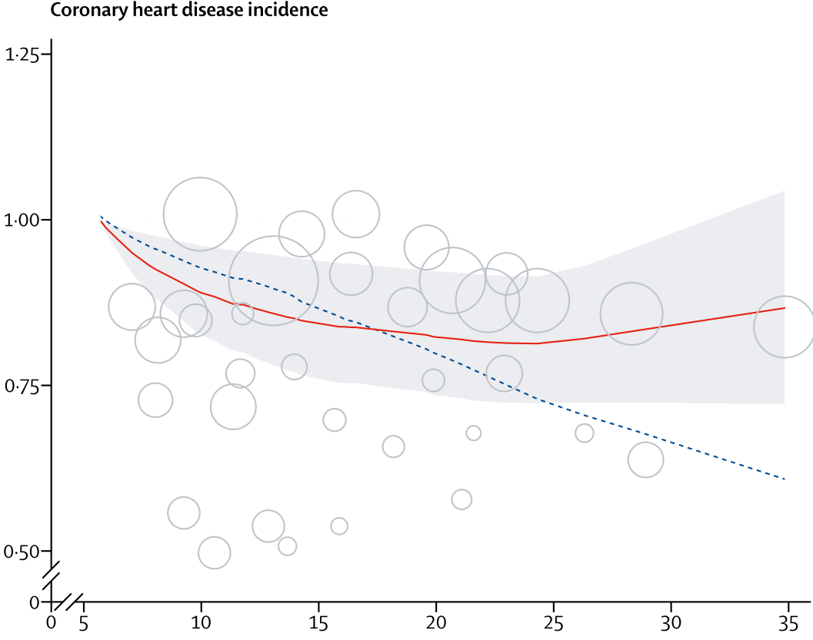
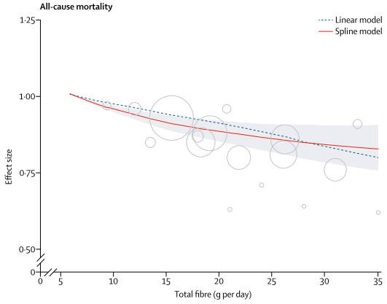
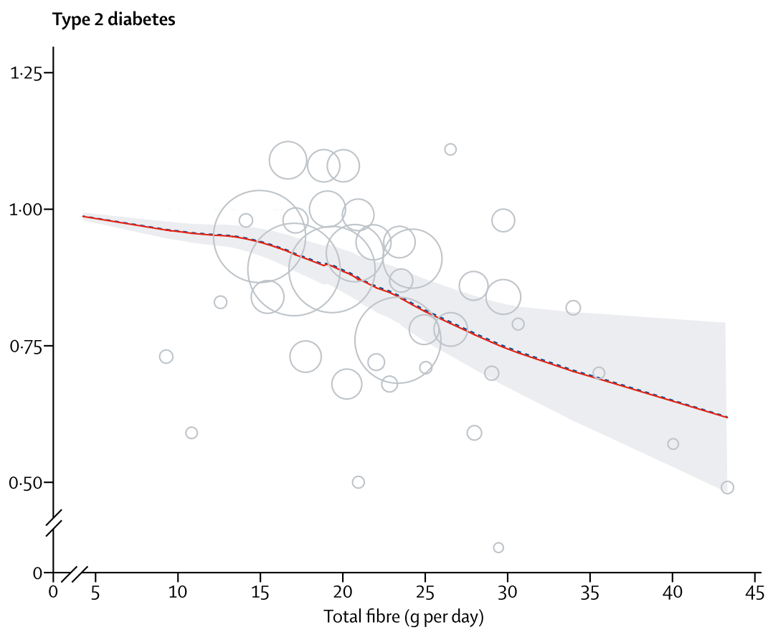
Incidence of Cardiometabolic Diseases is Linked to Dietary Fiber Intake
Incidence of Heart Disease
25
29
Incidence of Type 2 Diabetes
DV
(Reynolds et al., Lancet, 2019)
Notes:
There has been a tremendous amount of work done already showing the health benefits of fiber in humans, which is nicely summarized by a more recent landmark systemic review in Lancet.
They found that an intake between 25 & 29 g/d of fiber led to the greatest reduction of risk for all-caused mortality, and that consuming even more fiber likely reduces this risk further.

Slide 5
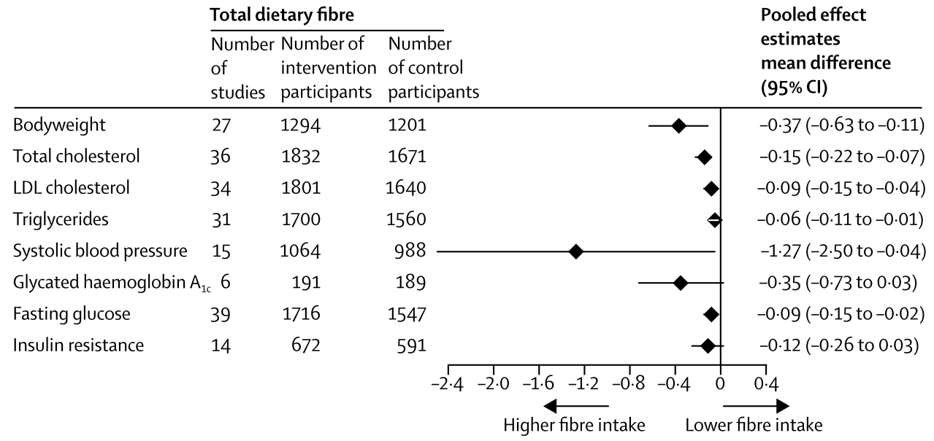
Surrogate Markers of Cardiometabolic Disease are Improved by Increase Fiber Intake
* Studies involving
dietary fibre supplements in
powder form were excluded.
(Reynolds et al., Lancet, 2019)

Slide 6
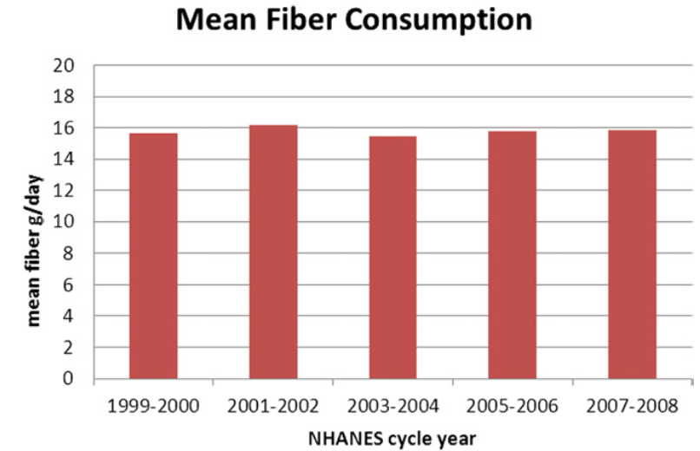
Cardiometabolic Diseases and the ‘Fiber Gap’
~15
25
29
'Fiber
Gap'
DV
(King et al., J Acad Nutr Diet, 2012; Reynolds et al., Lancet, 2019;)
Notes:
Despite this, intake levels have remained unchanged for decades at only ½ of what is typically recommended, which suggests that our recommendations for whole plant foods high in fiber aren’t changing consumer behavior. This gap between recommended and actual intake in referred to the ‘fiber gap’.

Slide 7
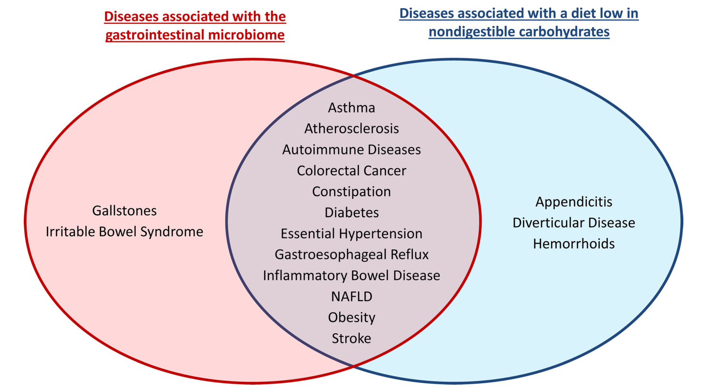
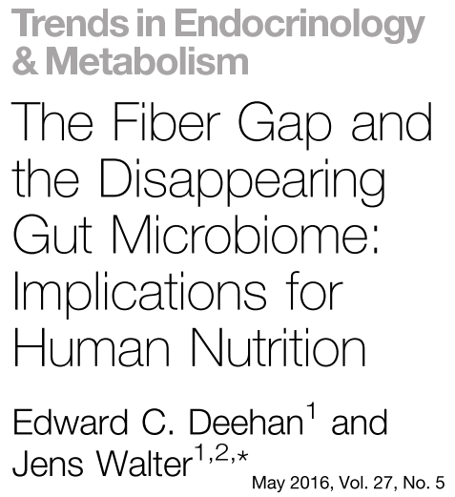
Diseases that Associate with Lower Fiber Diets also link to the Gut Microbiome
(Deehan & Walter, Trends Endocrinol Metab, 2016; Deehan et al. Microbiol Spectr; 2017)

Slide 8
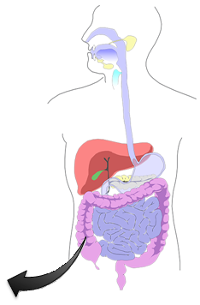
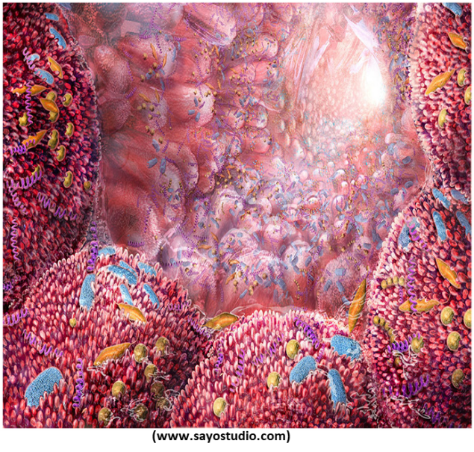
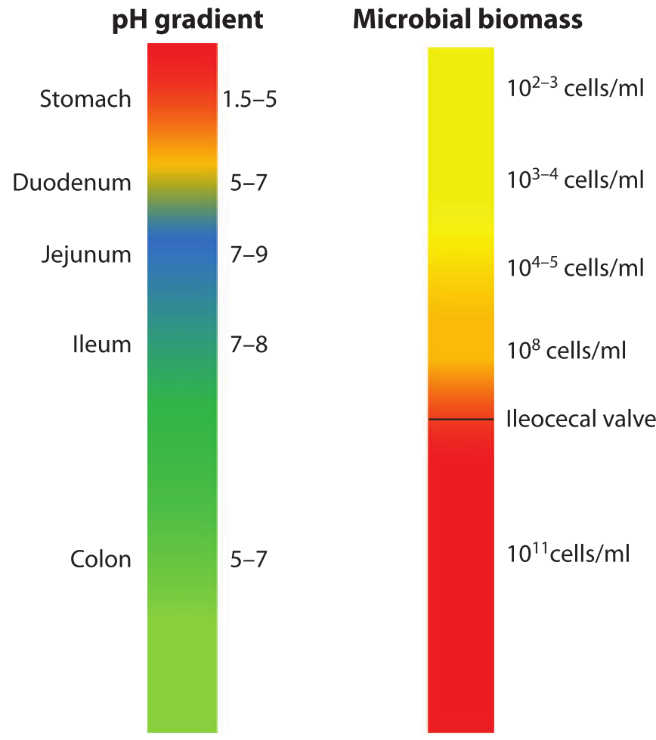
Introduction to the Gut Microbiota
Largely bacteria but also comprised of archaea, fungi, viruses, and protozoa.
Highly evolved ecosystem that is remarkably stable in healthy adults
Inter-individual differences in what microbes are present and in their response to fiber.
Functional redundancy and phylogenetic niche conservatism: unrelated species and related strains utilize the same substrate or produce the same metabolite.
Fiber degradation is the result of complex cross-feeding networks of primary degraders, secondary fermenters, & metabolite utilizers.
Individualized environmental factors influence microbial responses (e.g. pH, inflammation, nutrients).
(Walter and Ley, Annu Rev Microbiol, 2011)

Slide 9
Questions to Discuss
What are dietary fibers?
Why should dietary fibers be included in MNT for obesity and related cardiometabolic diseases?
What dietary fibers should be consumed and where to find them?

Slide 10
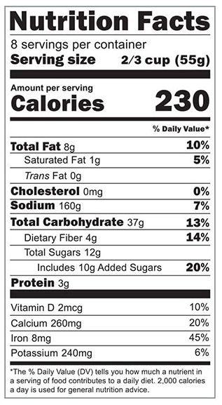
Non-Digestible Carbohydrates ≈ Dietary Fiber (From a Regulatory Standpoint)
Edible carbohydrate polymers with 3 or more units, which are not hydrolysed by the enzymes in the small intestine of humans:
Naturally occurring in food
Obtained from food material and have a physiological benefit to health
Synthetic carbohydrate polymers that have a physiological benefit to health
(Codex Alimentarius Commission, 2009)

Slide 11
Approved Fibers:
Obtained from food material or synthetic carbohydrate polymers
Mixed Plant Cell Wall Fibers
Cellulose
High Amylose RS2
Inulin & Inulin-type Fructans
β-Glucan
Psyllium Husk
Arabinoxylan
Pectin
Alginate
Acacia gum
Guar Gum
Glucomannan
Locust Bean Gum
Hydroxypropyl methylcellulose
Cross-linked Phosphorylated RS4
Resistant Maltodextrin/Dextrin
Polydextrose
Galactooligosaccharides
(https://www.fda.gov/food/food-labeling-nutrition/questions-and-answers-dietary-fiber)

Slide 12
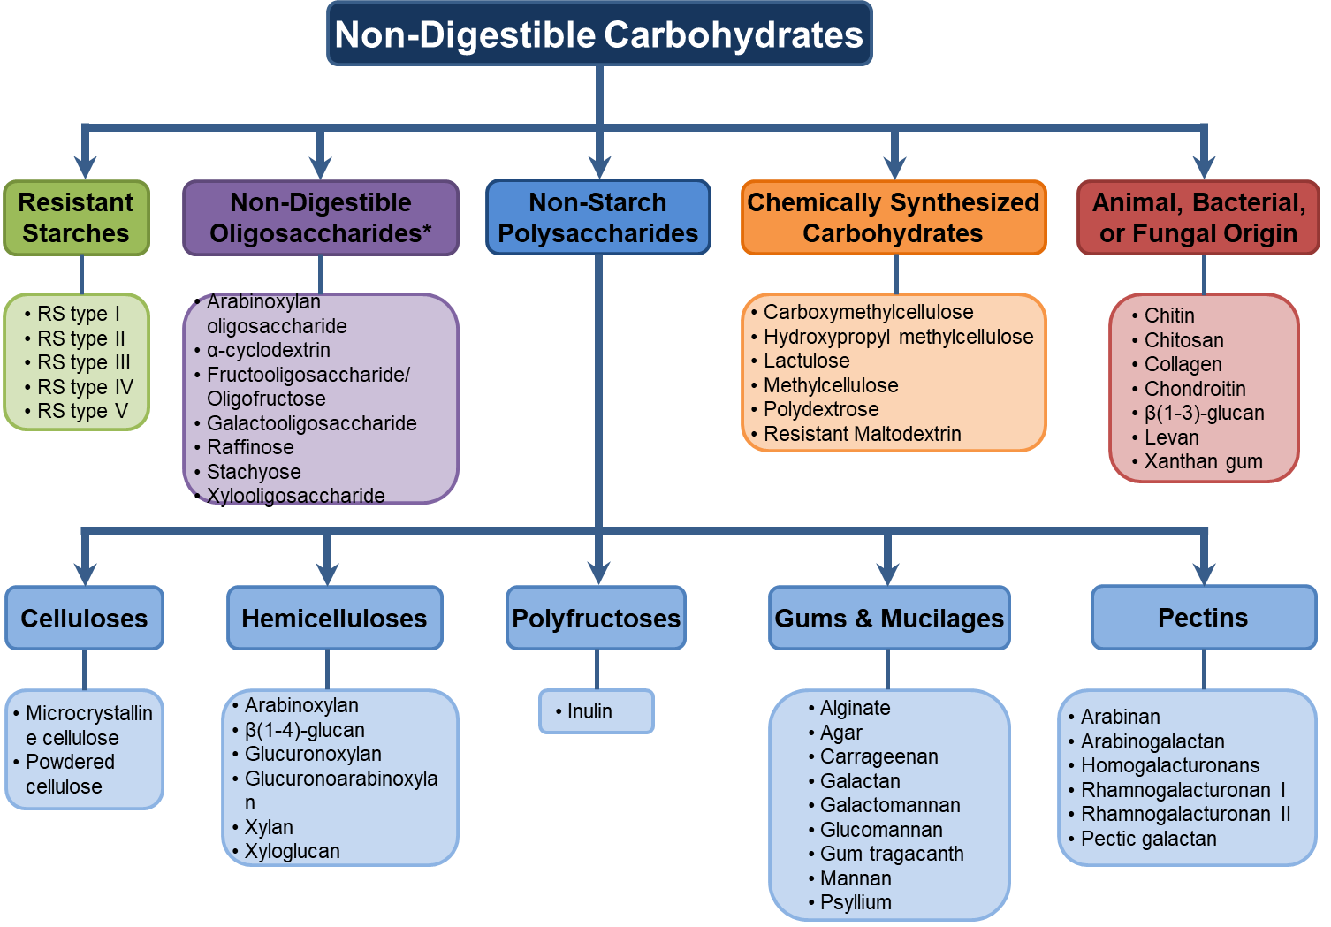
Our Diet Provides a Heterogenous Array of Fibers
Whole plant foods provide a diverse mix of different fibers.
Purified fibers generally offer less diversity.
(Deehan et al. Microbiol Spectr; 2017)
Notes:
Not just one dietary compound, but a heterogenous group of complex compounds each providing their own chemical and physical structure that uniquely physiological effects.
Whole foods will include a combination of these.
Raffinose & Stachyose – Commonly found in legumes.
-

Slide 13
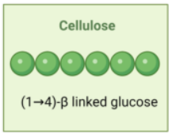
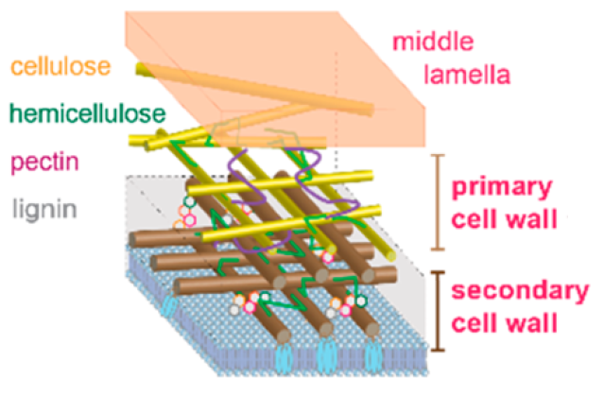
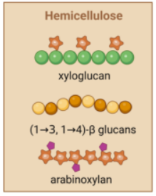
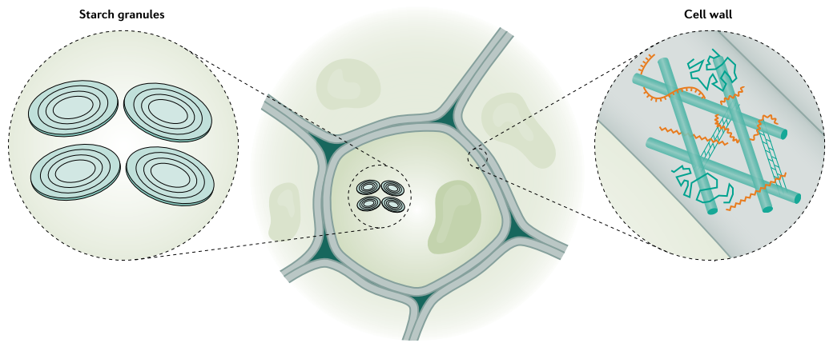
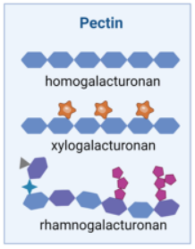
Non-Starch Polysaccharides
Whole
Plant Foods
Plant Storage Vacuole
Plant
Cell Wall
Provides strength & flexibility while allowing the passage of water & nutrients
(Gill et al, Nat Rev Gastroenterol Hepatol, 2020; Ghassemi et al, Chem Rev, 2022; Puhlmann & de Vos, Front Immunol, 2022)
Notes:
Definition: All plant polysaccharides other than starch.

Slide 14
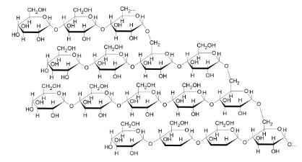
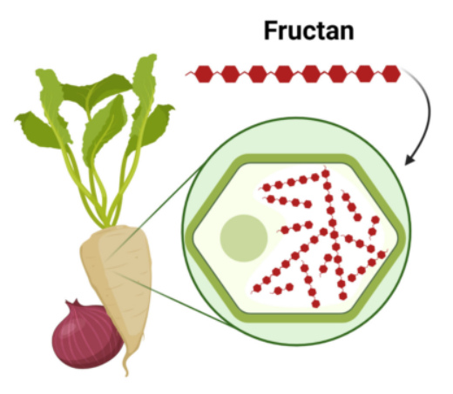
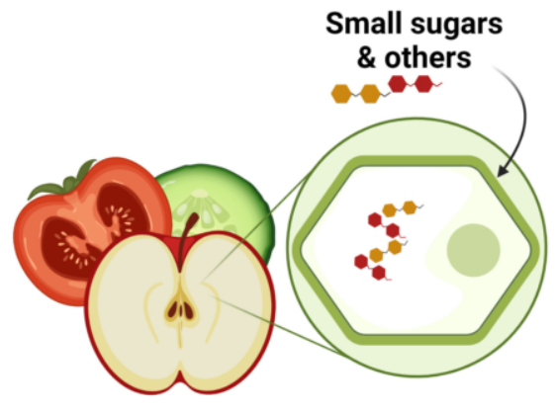
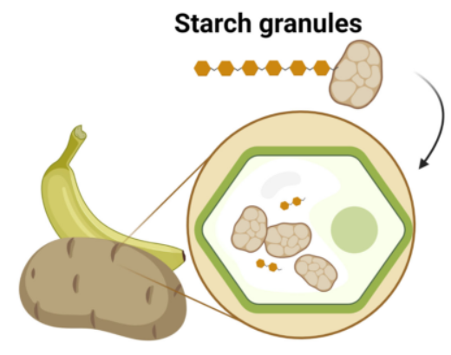
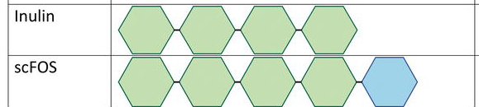
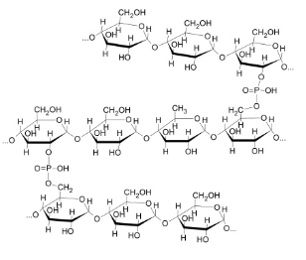
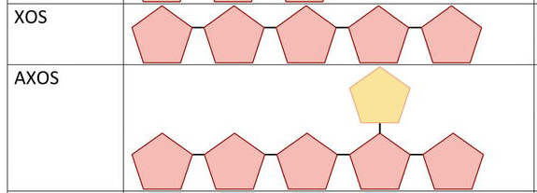
Resistant Oligosaccharides and Starches
Non-Starch
Polysaccharides
Digestible Starch
Whole
Plant Foods
Plant Storage Vacuole
Plant
Cell Wall
Partial Hydrolysis
Chemical Modifications
Stores energy for the plant
Resistant Oligosaccharides
Resistant Starch
(Saville & Saville, Prebiotics and Probiotics, 2019; Gill et al, Nat Rev Gastroenterol Hepatol, 2020; Puhlmann & de Vos, Front Immunol, 2022)

Slide 15
Physicochemical Properties are Structure Dependent
Source
Sugar
Types
Continuum
The structure of purified fibers is very important to consider.
Linkage
Types
Degree of Polymerization
Discrete Structures & Physicochemical Properties
Branching Structure
Particle
Size
Fermentability
Solubility
Viscosity
Water Holding Capacity
Binding Capacity
Phenolic Compounds
Fiber
Processing
Notes:
Differences in the source … can all lead to discrete fiber structures, and unique physiochemical properties that …

Slide 16
Dietary Fiber Structures Determine Health Benefits
Source
Reduced Nutrient Absorption Through Viscosity
Reduced Energy Density
Sugar
Types
Linkage
Types
Degree of Polymerization
Discrete Structures & Physicochemical Properties
Health Effects
Fermentation by the Gut Microbiota
Altered
Bile Acid Pool &
Reabsorption
Branching Structure
Particle
Size
Fermentability
Solubility
Viscosity
Water Holding Capacity
Binding Capacity
Phenolic Compounds
Stool Bulking & Dilution of Toxic Metabolites
Fiber
Processing
Notes:
Differences in the source … can all lead to discrete fiber structures, and unique physiochemical properties that …
Therefore, one should really appreciate fiber structures when targeting the microbiota dependent and independent mechanism that underlie the health benefits of fiber.
Discrete fiber structures are particularly important when targeting microbiota fermentation, as by changing the substrate you can alter its effect on gut microbiota composition and the production of health-relevant metabolites.

Slide 17
Questions to Discuss
What are dietary fibers?
Why should dietary fibers be included in MNT for obesity and related cardiometabolic diseases?
What dietary fibers should be consumed and where to find them?

Slide 18
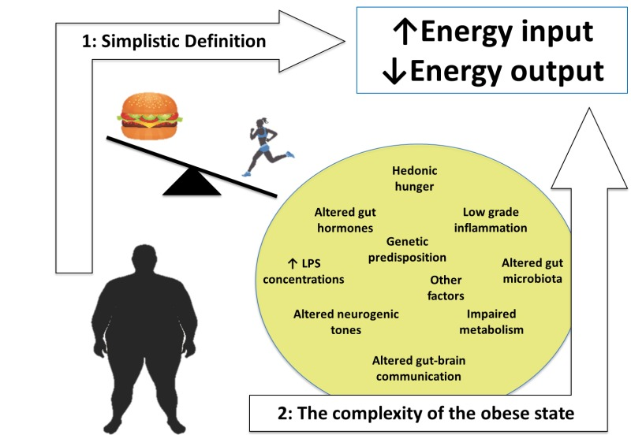
The Physiopathology of Obesity is Complex
(Pucci and Batterham, Endotext, 2020)

Slide 19
How do different dietary fibers influence the complex physiopathology of obesity?

Slide 20
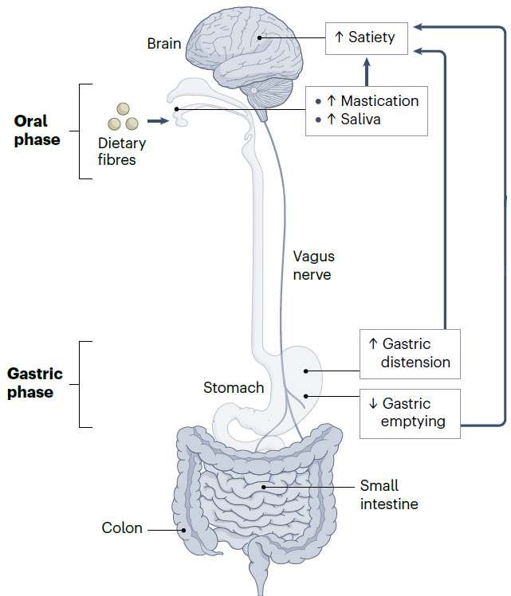
Effects of Fibers Along the Gastrointestinal Tract:
Oral Phase
Large fiber particules
Viscous & water holding fibers
Alter Texture
↑ chewing & saliva production
Mimic mouthfeel of fats
Mimic taste of sugars
Satiety effects are concentration & property dependent
(Modified from Deehan et al., Nat Rev Gastroenterol Hepatol, 2024)
Notes:
salivary amylase and lingual lipase

Slide 21
Effects of Fibers Along the Gastrointestinal Tract:
Gastric Phase
Viscous & water holding fibers
Higher-molecular weight
Mixed-linked, branched, or microfibrillated
↑ Gastric distension (bulking)
Satiety
↓ Gastric emptying (viscosity)
Satiety & metabolism
(Modified from Deehan et al., Nat Rev Gastroenterol Hepatol, 2024)
Notes:
salivary amylase and lingual lipase

Slide 22
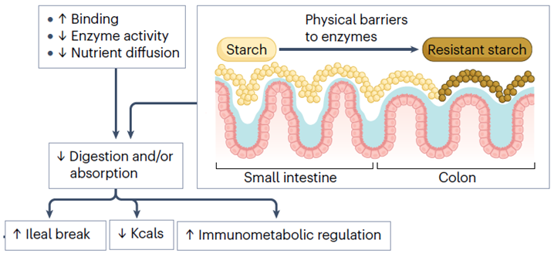
Effects of Fibers Along the Gastrointestinal Tract:
Small Intestinal Phase
↑ Digesta Viscosity
Reduced Energy Density
Reduced Nutrient Absorption
Altered
Bile Acid
Reabsorption
(Modified from Deehan et al., Nat Rev Gastroenterol Hepatol, 2024)
Notes:
Increased digesta viscosity within the small intestinal lumen further delays nutrient absorption by limiting nutrient diffusion towards the mucosa the activity of endogenous digestive enzymes and, which further slows proximal gastrointestinal transit by triggering the ileal break.

Slide 23
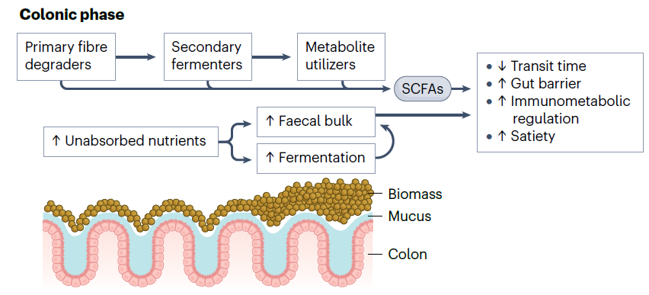
Effects of Fibers Along the Gastrointestinal Tract:
Colonic Phase
Fermentable:
↑ saccharolytic bacteria, biomass, SCFAs, & gases
Gut Microbiota Fermentation
Reduced Energy Density
Poorly fermented:
↑ bulk & softens stool
Stool Bulking
(Modified from Deehan et al., Nat Rev Gastroenterol Hepatol, 2024)
Notes:
Chemical and physical structures that are slowly or poorly fermented by gut microbiota, such as large fibre particles, cellulose or psyllium, serve other gastrointestinal benefits by stimulating peristalsis, mucosal secretions and resisting the reabsorption of entrapped water, which has been shown to add bulk and softens stool in humans.

Slide 24
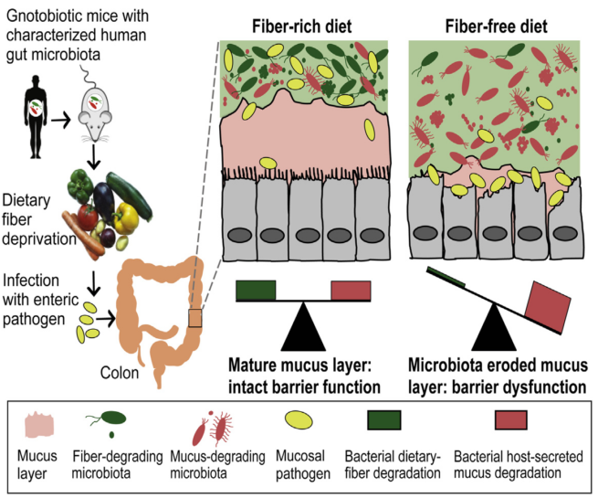
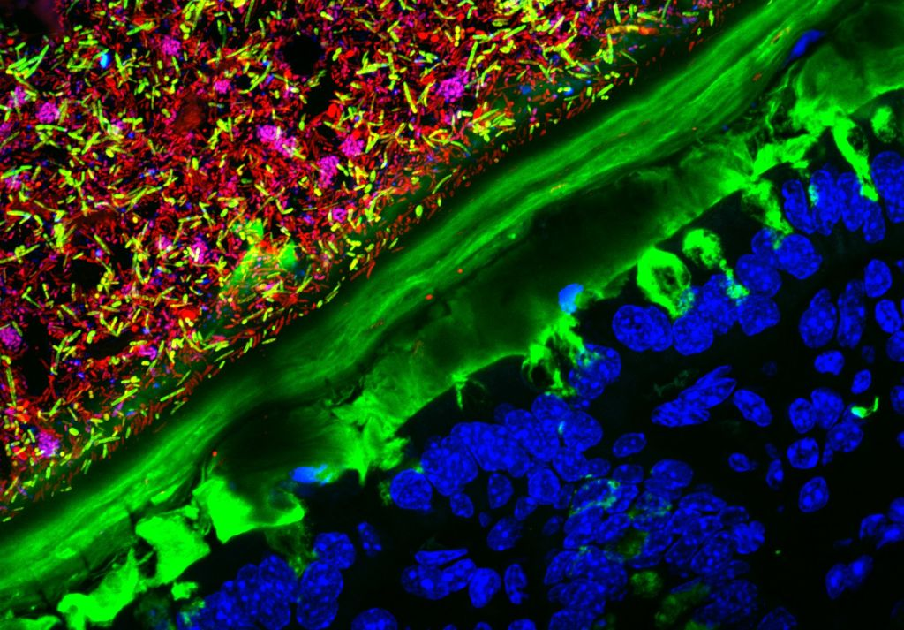
Consequence of a Diet Low in Fermentable Fibers:
↓ Gut Barrier Function
Microbiome
Host
(Desai et al., Cell, 2016; qz.com/525407/prize-winning-microscopic-photography-captures-the-marvels-of-what-we-cant-see)
Notes:
An important component of this framework is to align the discrete fiber structures with the polysaccharide utilization loci of the target microbes.
When you consider the gut microbiome, there is extensive genetic variation between microbes. For instance, the polysaccharide utilization loci of two closely related species can different.
This is to some degree possible because PULs can be unique from microbe to microbe.
These difference open the possibility for precision microbiome modulation

Slide 25
Dysregulated Gut Barrier Function in Obesity
(Modified from Deehan et al., Nat Rev Gastroenterol Hepatol, 2024)
Notes:
An important component of this framework is to align the discrete fiber structures with the polysaccharide utilization loci of the target microbes.
When you consider the gut microbiome, there is extensive genetic variation between microbes. For instance, the polysaccharide utilization loci of two closely related species can different.
This is to some degree possible because PULs can be unique from microbe to microbe.
These difference open the possibility for precision microbiome modulation

Slide 26
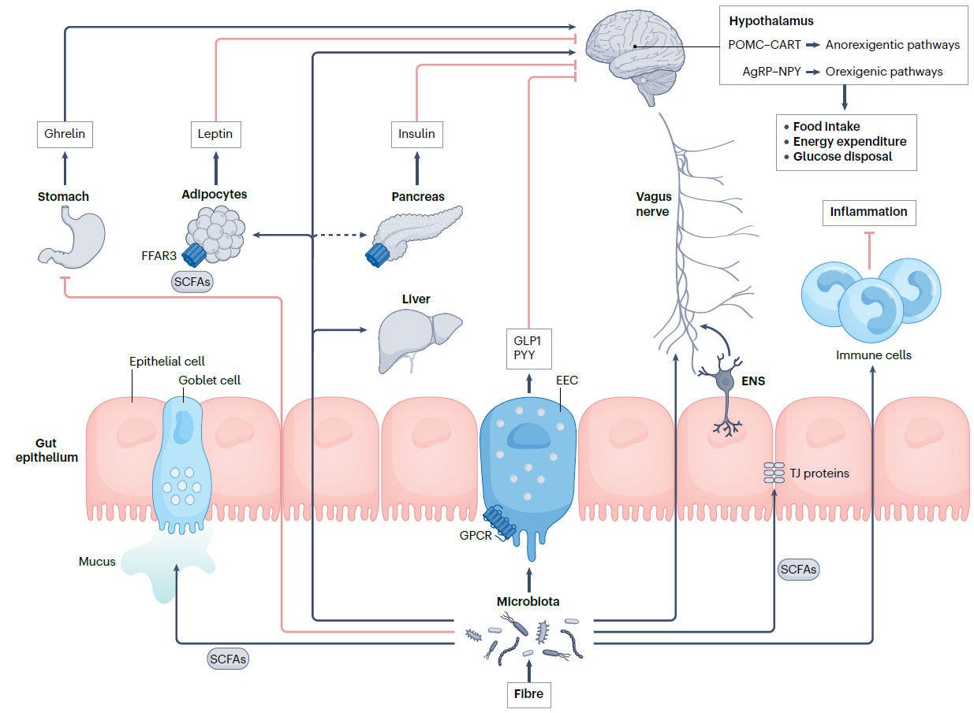
Benefits of Fiber Fermentation by the Gut Microbiota
Source
Sugar
Types
Linkage
Types
Degree of Polymerization
Branching Structure
Particle
Size
Phenolic Compounds
Fiber
Processing
(Modified from Deehan et al., Nat Rev Gastroenterol Hepatol, 2024)
Notes:
Increasing evidence suggests that the gut microbiome plays an important role in health & disease.
Interactions between the microbial community and host health are driven by metabolites.
Production of these metabolites is directly dependent by substrate presence & community composition.
This is exciting as it means we can change health effects by selectively changing the substrates.

Slide 27
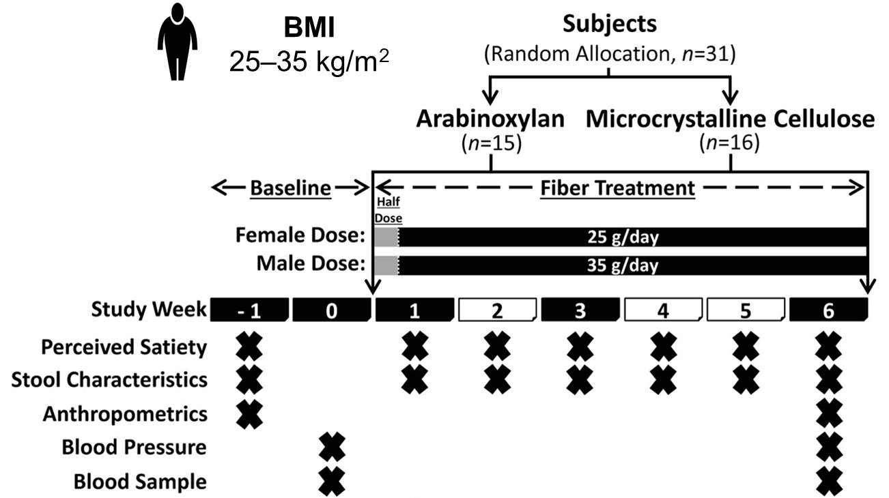
Fiber Structure
Determines Physiological Effects
Nguyen
Nguyen
Dr. Terry
Zhang
Dr. Jens
Walter
Corn Bran Arabinoxylan
(AgriFiber SFC)
Microcrystalline Cellulose (Microcel MC-12)
(Nguyen et al., Microbiome, 2020; Deehan et al., Microbiome, 2022)
Notes:
Microbiome composition by 16S RNA gene sequencing & fecal SCFA and BCFA concentrations by gas chromatography

Slide 28
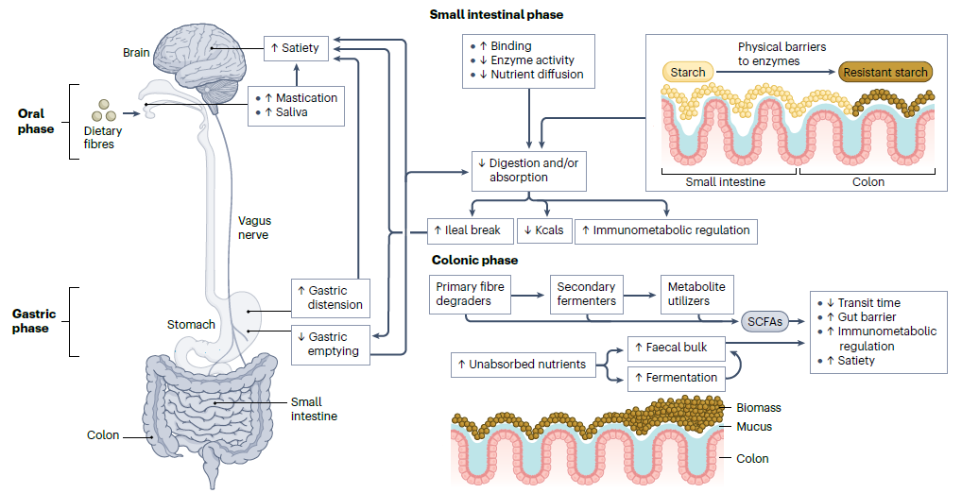
Fiber Structure Determines Physiological Effects
Long-Chain,
Moderately Viscous,
Fermentable
Corn Bran Arabinoxylan
Large Particle,
Non-Accessible Microcrystalline Cellulose
(Modified from Deehan et al., Nat Rev Gastroenterol Hepatol, 2024)
Notes:
Increasing evidence suggests that the gut microbiome plays an important role in health & disease.
Interactions between the microbial community and host health are driven by metabolites.
Production of these metabolites is directly dependent by substrate presence & community composition.
This is exciting as it means we can change health effects by selectively changing the substrates.

Slide 29
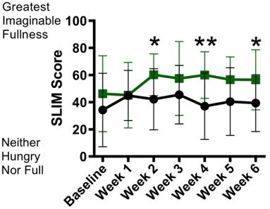
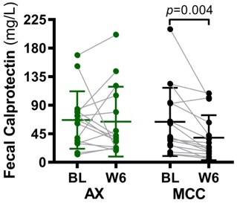
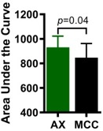
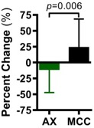
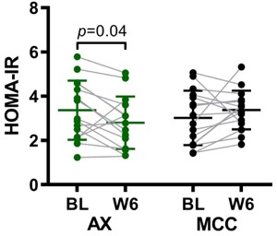
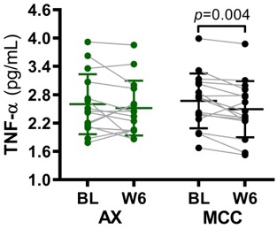
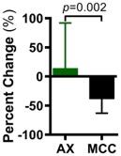
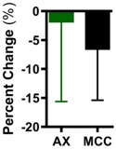
Health Effects of a Fermentable vs. Non-Accessible Fiber
Fermentable Arabinoxylan
Non-Accessible Cellulose
Perceived Satiety
(After a Meal)
Intestinal Inflammation
Insulin Resistance
Systemic Inflammation
*
**
Corn Bran Arabinoxylan (AgriFiber SFC)
Microcrystalline Cellulose (Microcel MC-12)
p<0.05 p<0.01

Slide 30
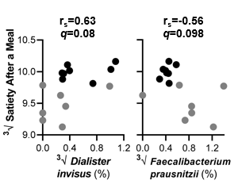
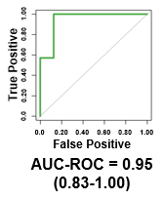
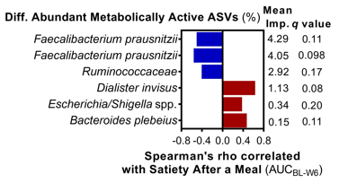
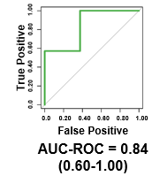
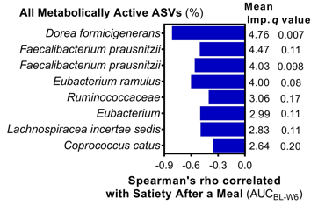
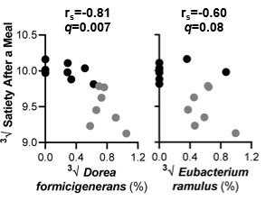
Satiety Effects are Predictable by
the Exact Taxa that Fermented Arabinoxylan
Perceived Satiety
BONCAT Detected
Bacterial ASVs
Arabinoxylan
(Deehan et al., Microbiome, 2022)

Slide 31
Prebiotic Effect of Dietary Fibers
Prebiotic: Substrate that is selectively utilized by host microorganisms conferring a health benefit.
(Gibson et al., Nat Rev Gastroenterol Hepatol, 2017; Swanson et al., Nat Rev Gastroenterol Hepatol, 2020)

Slide 32
Questions to Discuss
What are dietary fibers?
Why should dietary fibers be included in MNT for obesity and related cardiometabolic diseases?
What dietary fibers should be consumed and where to find them?

Slide 33
Eat More Whole Plant Foods and a Variety
Whole
Plant Foods
Plant Storage Vacuole
Plant
Cell Wall
(Gill et al, Nat Rev Gastroenterol Hepatol, 2020; Armet et al, Cell Host Microbe, 2022)

Slide 34
Eat More Whole Plant Foods and a Variety
(Modified from Deehan et al., Nat Rev Gastroenterol Hepatol, 2024)

Slide 35
↑ Plant Food Variety = ↑ Microbiota Diversity
Microbiota Diversity
n = 219
(McDonald et al., mSystems, 2018)

Slide 36
Whole Grains:
Oats & Barley = β-Glucan
Fermentability
Viscosity
Binding
FDA-Approved Health Claims
+3 g/day of β-glucan soluble fiber
FDA-Approved Qualified Health Claims
(Lim et al, Jpn J Food Eng, 2010; www.fda.gov/food/food-labeling-nutrition)
Notes:
β-Glucan, arabinoxylan, resistant starch, inulin.
~1 cup of oats/day.

Slide 37
Specific Fibers: Psyllium
Husk from Plantago ovata, rich is arabinoxylan
Viscosity
Binding
Water Holding
FDA-Approved Health Claims
+7 g/day of Psyllium soluble fiber
FDA-Approved Qualified Health Claims
(www.fda.gov/food/food-labeling-nutrition)
Notes:
~10 grams of psyllium husk

Slide 38
(Gholami and Paknahad, J Funct. Foods, 2023)

Slide 39
Specific Fibers: Resistant Starch Type II
Fermentability
Binding
Energy Density
FDA-Approved Qualified Health Claims
Resistant Starch labeling:
High-Amylose Corn Starch
Resistant Corn Starch
Resistant Potato Starch
Green Banana Flour
(Shen et al, Plant Communications, 2022; www.fda.gov/food/food-labeling-nutrition)

Slide 40
Specific Fibers:
Resistant Starch Type III
(Yadav et al., Int J Food Sci Nutr, 2009; Ghassemi et al, Chem Rev, 2022)

Slide 41
Pulses: Beans, Peas, & Lentils = Resistant Starch & Oligosaccharides
Fermentability
Binding
(Modified from 2022; Basuray et al, Eur J Clin Nutr, 2024)

Slide 42
Prebiotic Dietary Fibers
Fermentability
Energy Density
(https://prebioticassociation.org/prebiotic-types/)

Slide 43
Global Prebiotic Association
GPA Mission:
“Increase public awareness about the production, quality and science of prebiotic products, expand manufacturer understanding of the solid science supporting both well-known and newfound benefits, and create needed transparency about product quality.”
(https://prebioticassociation.org/about/association/)

Slide 44
Take Home Messages
Dietary fibers are a very heterogenous group of nutrients with diverse health benefits.
Whole grains, legumes, vegetables, fruits, nuts, and seeds each provide a different source of beneficial fibers.
A prudent diet rich in a variety of whole plant foods would support a ‘healthier’ gut microbiome, maintain gut barrier function, and improve health.
Structure determines a fiber’s behavior along the gastrointestinal tract, thus, determining its effects on health (or lack of effect).
Caution should be taken with purified sources of fiber.
There is convincing evidence for vicious β-glucans (oat, barley) and psyllium, and resistant starches (replacing flour).
Prebiotics offer promise for the treatment of obesity by targeting the gut microbiome to promote health, but further research is needed.
Gut Microbiome

Slide 45
Acknowledgements
Karen Madsen
Valentin Mocanu
Jens Walter
Zhengxiao (Terry) Zhang
Nguyen Nguyen
Maria Elisa Perez-Muñoz
Janis Cole
Catherine Field
Carla Prado
Benjamin Seethaler
Stephan Bischoff
Alessandra Riva
David Berry
Award #: P20 GM104320

Slide 46
Thank You! Questions? Email: edeehan2@unl.edu

Slide 47
Approaches to Improve GI tolerance of High-Fiber Intake
Fibers intrinsic & intact within the food matrix
Slow rate of microbial fermentation &
hydrogen production
Maintain
euhydration
 Flatulence
Improved Gastrointestinal Tolerance
 Borborygmi
 Abdominal Pain
Lower doses of
fast-fermenting fibers
 Bloating
Adaptation of gut microbiome to
increased fiber fermentation
Gradually increasing amounts of fiber over time
Higher doses of slow-fermenting fibers
(Modified from Basuray et al, Eur J Clin Nutr, 2024)

