Slide 1
What’s Going on With Food Allergies?
An update on advancements in recent years
Lisa Woodruff, RDN, LMNT
April 2023
Notes:
Thank you for the introduction.
Alright, let’s talk food allergies!

Slide 2
Disclosures
Owner of Lisa Woodruff Nutrition
Author of the children’s book Be A Food Allergy Helper!
Host of the podcast Let’s Talk Food Allergies
Child Health Specialty Clinic Dietitian, University of Iowa Hospitals & Clinics
No conflict of interests
No association with any brands or food companies of any kind
Notes:
As of just this month I am a child health specialty clinic dietitian with The University of Iowa Hospitals & Clinics, working with food allergy kids using early intervention services.
I also have a private practice, published a children’s book and host a podcast; my podcast does not use any sponsors or advertising.
So I have no conflicts of interests or associations to disclose. I don’t sell or promote any products; if I do mention anything specific it will just be personal preference or random suggestion

Slide 3
Learning Objectives
Define food allergy and prevalence in both children and adults.
Identify common misconceptions in food allergy management and treatment.
Review clinical and legislative advancements in food allergy nutrition.
List strategies for food allergy prevention, specifically peanut allergy.
Discuss a case study for practice application of food allergy MNT
Notes:
Here are the objectives; we’ve got a lot to cover in the next hour!

Slide 4
Food Allergy Prevalence
32 million Americans have food allergies
Approx. 26 million adults (1 in 10)
5.6 million children in the United States (7.6% or 1 in 13)
40% allergic to more than one food
42% history of at least one severe food allergy reaction
200,000 people require emergency medical care for food allergy reactions in the United States each year
Gupta, Warren, Smith, et al. 2018; Clark, Espinola, Rudders, et al. 2010
Notes:
So let’s look at the prevalence. 1 in 10 American adults have a food allergy – and just under half report adult-onset food allergy! We’ll get to that in a bit.
With kids in the US, about 1 in 13 have food allergy, which is about 1-2 in every classroom!
And of those children with food allergies, 40% have more than one allergy
And just under half have had at least one severe food allergy reaction!
There may be some discrepancy in the exact prevalence; some studies report the physician-confirmed pediatric food allergy may be closer to 5%, whereas another survey found 11% of parents report their child has a food allergy.
But regardless of the actual numbers, the prevalence of food allergy is growing AND food allergy reactions are serious and can be life-threatening.
Every year in the US, 200,000 people require emergency medical care for food allergy reactions
Additionally, every 3 minutes, a food allergy reaction sends someone to the ER
*****
Many studies have confirmed increased prevalence over the past 2 decades
For example, the prevalence of peanut allergy tripled from 1997 to 2008.

Slide 5
Disparities in Food Allergy
Higher prevalence in Black Americans than White Americans
White Americans have a lower prevalence than Hispanic- and Asian-Americans
Increase in self-reported food allergy per decade:
Non-Hispanic blacks: 2.1%
Hispanics: 1.2%
Non-Hispanic whites: 1.0%
Warren et al., 2021; Keet et al., 2014
Notes:
So there are some disparities in food allergy prevalence;
we know food allergy is greater in blacks than whites.
Additionally, white Americans have a lower prevalence than Hispanic- and Asian-Americans
And you can see differences in self-reported food allergy per decade.
And most recently, findings from FORWARD, a multi-site cohort study, suggests that shellfish and fin fish allergy are more common in African American children than White children
*****
Language used is based on language used in each study

Slide 6
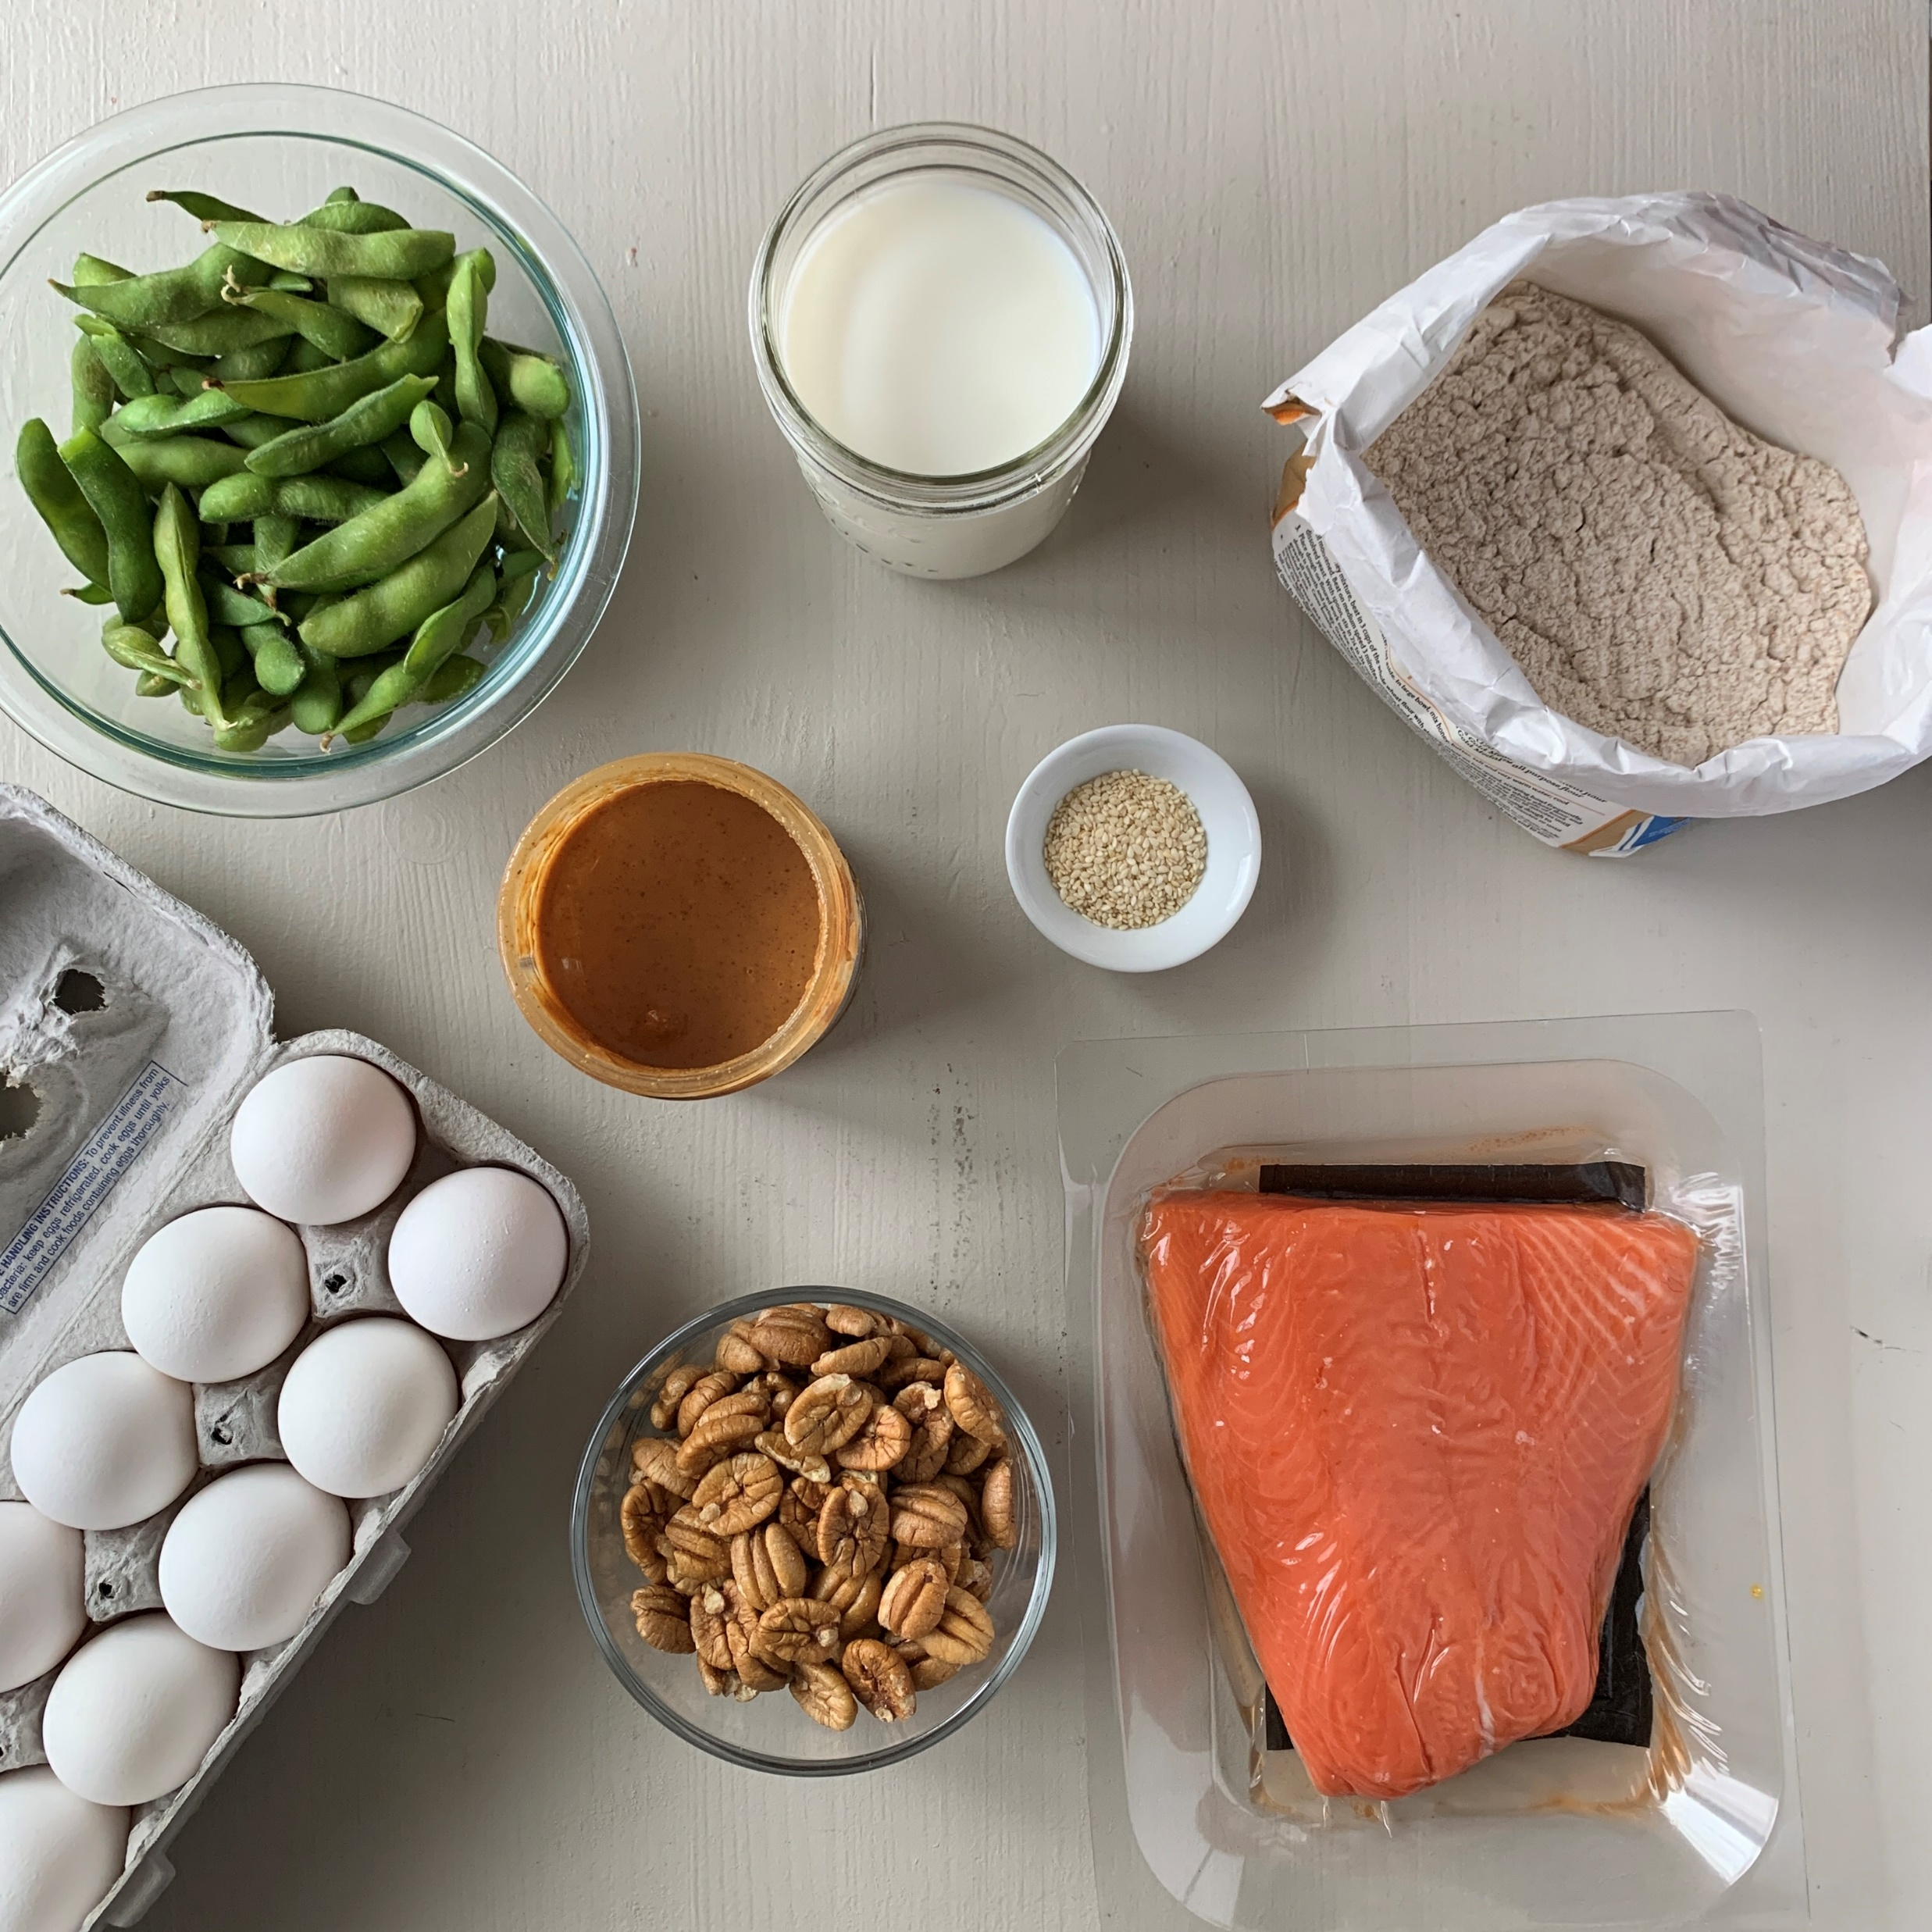
But what exactly is food allergy…
When the body’s immune system sees a certain food as harmful and reacts by causing symptoms with every exposure.
Photo by Lisa Woodruff
Notes:
So we’re all on the same page; let’s define food allergies.
At its core, a food allergy is when the body’s immune system sees a certain food as harmful and reacts by causing symptoms with every exposure.

Slide 7
…and what are adverse food reactions?
Adverse Food Reactions
Immune-Mediated
(Food Allergy & Celiac disease)
Non-Immune Mediated
(Intolerances)
Microbial
Non-IgE-mediated
(Allergic Proctocolitis, FPIES, Food protein-induced proctocolitis)
IgE-mediated
(Acute urticaria, Anaphylaxis, Pollen Food Allergy Syndrome)
Pharmacologic
(Caffeine, Alcohol)
Metabolic
(Lactose intolerance)
Infections
(Bacterial food positioning)
Toxic
(Scombroid fish poisoning)
Mixed IgE & Non-IgE
(Atopic dermatitis, EoE, Eosinophilic gastroenteritis)
Cell Mediated
(Celiac disease)
Finding a Path to Safety in Food Allergy, 2016
Notes:
When trying to understand what “food allergy” is, I think it’s helpful to look at where it fits within the larger picture of Adverse Food Reactions.
As you can see on the left side of the screen, Immune-Mediated food reactions include food allergy as well as Celiac disease
On the ride side of the screen, you see non-immune mediated reactions as well as microbial → these conditions are NOT food allergy.
*****
AD = form of eczema
Subset that has food allergy contributing to their disease

Slide 8
Food Allergy Diagnosis
Notes:
Let’s get into food allergy diagnosis, and we’ll talk about how a detailed history is really the “best test” for food allergy.

Slide 9
IgE-mediated Food Allergy
Food protein
“Hypersensitivity” or “Classic” food allergy
Immune system makes IgE antibodies after eating a food
IgE antibody = small antenna on mast cells & basophils used to detect specific food proteins
When antibody connects with food protein, signal sent back to cell
Results in release of histamine & other chemicals
”Allergy Cell”
IgE “Antenna”
Histamine
Notes:
So just a quick refresher; IgE-mediated Food Allergy is the “Hypersensitivity” or Classic Food Allergy.
At a basic level, an allergic reaction happens when the immune system makes IgE antibodies (or proteins) after eating a food.
If you are a visual person, think of an IgE antibody like a small antenna that sits on top of an allergy cell.
The IgE antibody is used to detect specific food proteins
When it connects with the food protein, a signal is sent back down to the allergy cell
This causes the cell to release histamine and other chemicals, which cause the symptoms of an allergic reaction

Slide 10
IgE-mediated Food Allergy Symptoms
Mouth/Nose
Swelling, itching, nasal congestion, runny nose, sneezing
Skin
Redness, itching, hives, measle-like bumps, swelling
Gut
Nausea, abdominal pain, reflux, vomiting, diarrhea
Throat
Swelling of voice box, hoarseness, dry cough
Lung
Chest tightness, shortness of breath, wheezing
Heart
Rapid heartbeat*, low blood pressure, dizziness, fainting
Brain
Sense of “impending doom”
Other
Uterine contractions; Itching, tearing, or swelling around eyes
Anaphylaxis: severe allergic reaction affecting multiple body systems (skin, gut, lungs, cardiovascular, *including slow heartbeat) that can occur quickly and worsen rapidly
NIAID Guidelines, 2011
Notes:
And what are the symptoms of an IgE-mediated Food Allergy? Good question!
You can see the different symptoms broken down by body system on the slide.
And symptoms really do affect the entire body – it’s not just hives or trouble breathing!
With IgE food allergy, symptoms will occur within 2 hours of eating an allergen – but usually reactions are evident within minutes.
Again, individuals with a food allergy should have some type of symptom every time they eat that food. It may be different symptoms, but there should be some type of reaction every time the allergen is ingested.
<<Animation>> Of course, the biggest concern is always risk of anaphylaxis, which is a severe allergic reaction that affects multiple body systems.
And just a quick note, that past reactions do not guarantee future reactions.
That is because food allergies are unpredictable.
Anaphylactic symptoms can occur quickly – like within minutes – and worsen rapidly. It can be fatal without an epinephrine injection.

Slide 11
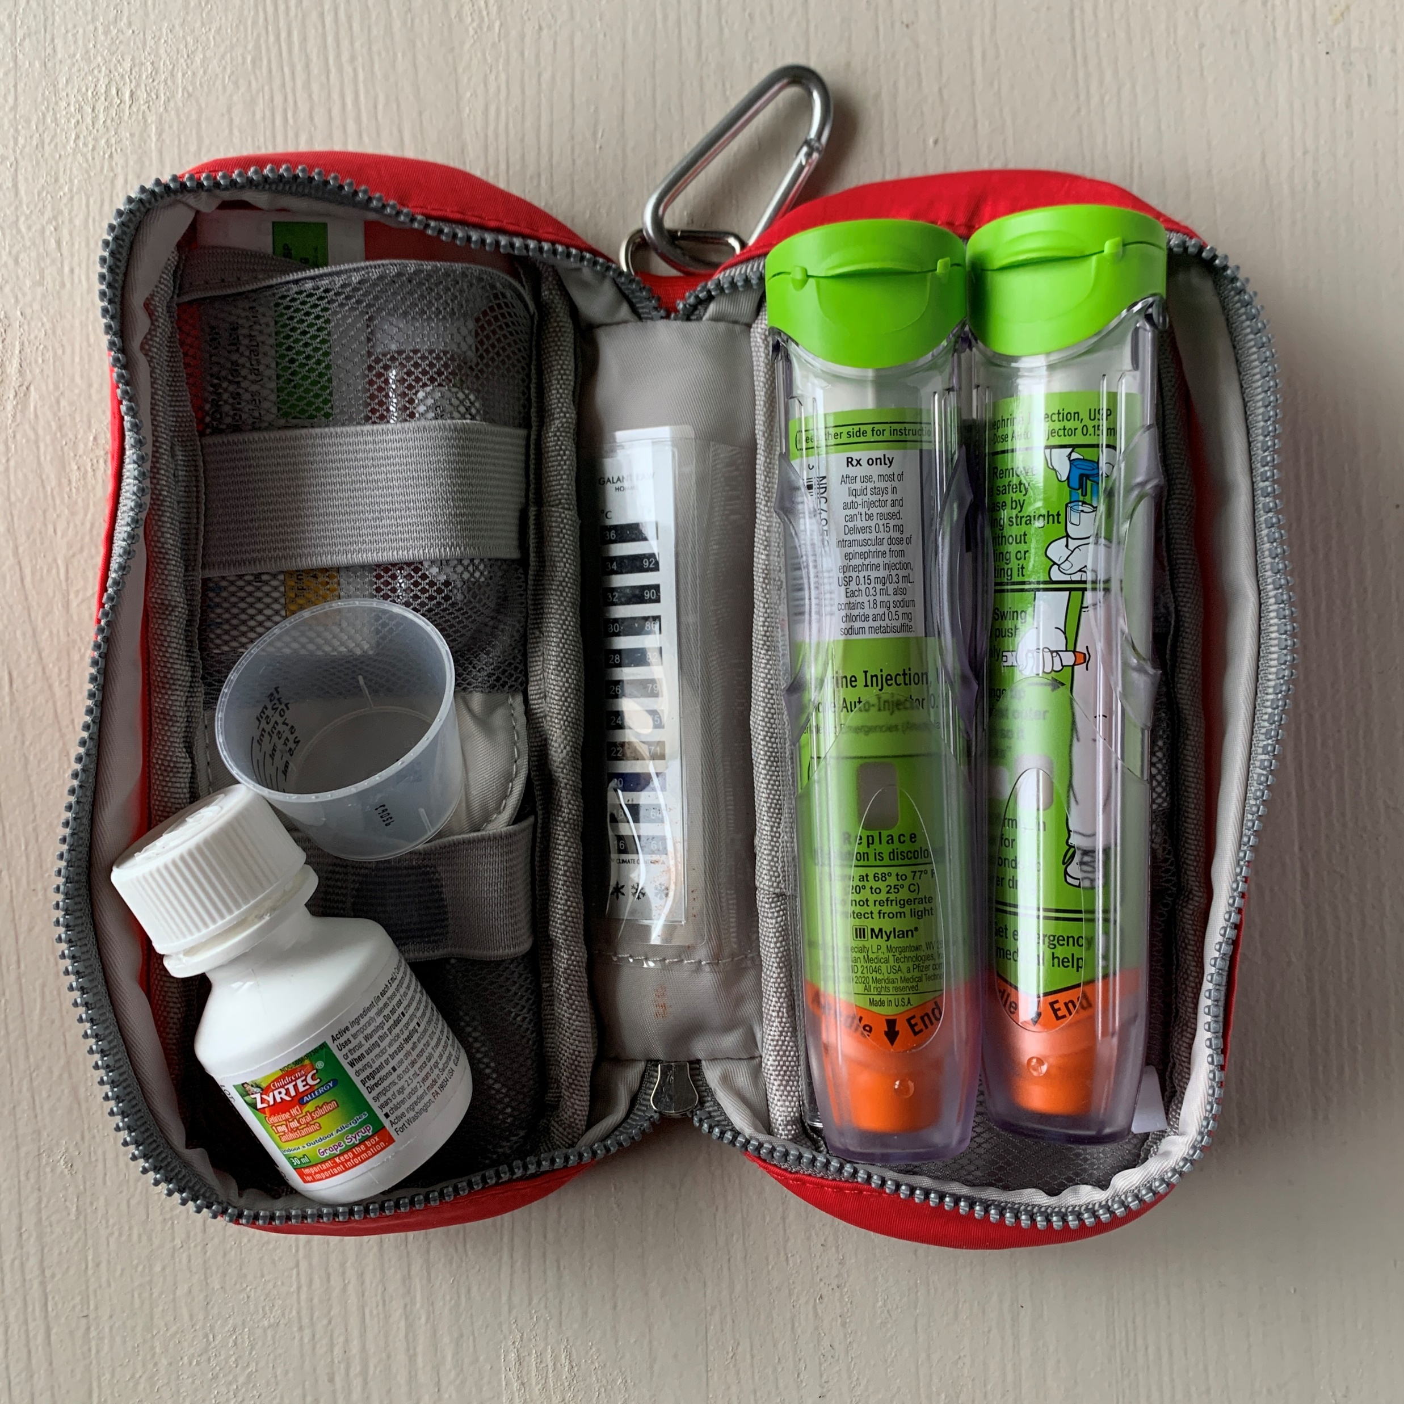
IgE food allergies are unpredictable
“Even the smallest amount of a food allergen can cause a serious reaction.”
Your Guide to Food Allergy video
Food Allergy Research and Education
www.foodallergy.org
Photo by Lisa Woodruff
Notes:
I want to emphasize that there are no mild food allergies – a reaction can be mild or severe, but any food allergy has the potential to have a severe reaction. And even the smallest amount of a food allergen has the potential to cause a serious reaction.
Yes – there are some allergens that statistically have lower rates of anaphylaxis. But the key takeaway here is that food allergy reactions are unpredictable – past reactions do not guarantee future reactions.
Very quickly, I’m going to take off my dietitian hat and I promise this is the only time I’ll be talking to you as a food allergy mom/advocate.
This picture is my son’s Epi bag. It goes everywhere he does.
In it, there is emergency contact information as well as a travel sized Zyrtec and 2 Epi Pens.
He has an individualized Food Allergy & Anaphylaxis Emergency Care Plan with instructions on when to use an oral anti-histamine versus Epinephrine.
You can see a travel bottle of Zyrtec in this picture – I should add that Benedryl is no longer recommended as a first choice for allergy medication
If my son is having severe symptoms or multiple parts of the body are affected, we Epi first and Epi fast. This is pretty standard for an Emergency Care Plan, but may vary depending on Allergist and individual.
Speaking of epinephrine auto injectors, there are several types. These are trainers – but here what a generic Epi Pen looks like as well as an Auvi-Q.<<show the epinephrine trainers>> Standard practice is to always carry TWO
There is a rare chance that one of the injectors could malfunctions. There is also the risk for user error with a caregiver accidently injecting themselves.
But the primarily reason why you should always carry two is the risk of a biphasic reaction. This is a second, more severe reaction that can occur after 4-8 hours. Actually up to 20% of those having an allergic emergency will need that second dose.
So both auto-injectors should ALWAYS be kept together, and easily accessible for the person they are prescribed to.
Because food allergies are unpredictable.

Slide 12
True or False: Only IgE-mediated food allergies are “real”
Notes:
Okay, show of hands: Raise your hand if you think only IgE-mediated food allergies are “real”? And how about if you think that is false?

Slide 13
Non-IgE-mediated allergies are REAL
IgE-mediated
Immediate Reaction: <2 hours
Small volume for reaction
Hives, swelling, vomiting, diarrhea, oral itching, anaphylaxis
Non-IgE-mediated or Mixed
Delayed Reaction: 1-6 hours
Sometimes larger volumes
Diarrhea, food refusal, FTT, gastroesophageal reflux, irritability/ abdominal distension, eczema
To Learn More: FREE CEU webinar from FARE (foodallergy.org/our-initiatives)
Non-IgE-Mediated Food Allergies Are Real and VERY Misunderstood
Finding a Path to Safety in Food Allergy; 2016
Notes:
This answer is false – so, Non-IgE-mediated allergies are very REAL and also very misunderstood.
Examples of Non-IgE food allergy includes Allergic Proctocolitis or FPIES.
And in addition to Non-IgE allergies, there is also a 3rd category of mixed IgE/non-IgE-mediated food allergy, such as EoE.
You can reference back to slide 8 for examples of each type of allergy.
So remember, any type of food allery involves an interaction between the allergen and the immune system. A non-IgE food allergy does not involve an IgE antibody.
Their reactions are typically delayed, often 4-6 hours after ingestion
Sometimes a larger volume of food is required to trigger a reaction
And while there is some overlap in symptoms, like diarrhea, we typically don’t see hives, swelling, or anaphylaxis.
*****
FYI: Allergic proctocolitis = gross blood in stool with or without other symptoms, in an otherwise healthy infant (most often related to milk allergy but also soy through breast milk or infant formula)

Slide 14
What about food sensitivity or intolerance?
Food intolerance: adverse health effects caused by food that do not involve the immune system
Example: lactose intolerance
Food Sensitivity: no consensus definition/no ICD-10 code
NOT the same as Non-IgE-mediated food allergy
Many tests heavily marketed that claim to diagnose food sensitivity… Important question to ask: is this test validated?
Conditions not proven to be related to food allergy: Migraines, Arthritis, Behavioral/developmental disorders, Seizures, IBD
NIAID Guidelines, 2011; Finding a Path to Safety in Food Allergy; 2016
Notes:
So, just to reiterate, non-IgE-mediated allergies are real food allergies, and not to be confused with food intolerance or sensitivities.
Food intolerances can be a “large basket” term to describe reactions to food that do not involve the immune system.
As we all known, a common example is lactose intolerance (someone that is lactose intolerance lacks the enzyme that breaks down lactose)
On the other hand, there is no consensus definition from the allergy community for food sensitivity.
There is no ICD-10 code.
We know it does not involve an immune response
And there are many tests marketed to claim to diagnose food sensitivity. As dietitians it is important to question if these tests are validated? Because most are not.
And I should add, just because these are not food allergies does not take away from the validity of someone’s symptoms. We just have to be careful that we’re not referring to them as food allergy.
****
So, conditions that have not been proven to be related to food allergy include things like migraines, arthritis, behavioral/developmental disorders like ADHD, seizures, IBD…. The emphasis here is they are not related to food allergy. For example, there may be trigger foods with IBD, but this would not be a food allergy, would be more of an intolerance as its not an adverse food reaction involving the immune system.
FYI: Dr. Stukos’ Food Sensitivity “Alternative Testing” includes: Specific IgG Antibodies, Mediatory Release Test (MRT), LEAP, Cytotoxic Testing, Applied Kinesiology, Nambudripad’s Allergy Elimination Technique (NAET), Provocation-neutralization, Electrodermal Analysis, Chemical Use of Hair and Urine

Slide 15
Diagnosing Food Allergy
Are signs & symptoms consisted with food allergy?
Timing of ingestion to symptoms?
Has food been eaten previously or subsequently?
Has the reaction been reproduced?
How much was eaten?
How was the suspected food prepared? (raw vs. baked vs. cooked)
How was reaction treated (Epi??) and outcome?
Were there other co-factors?
What are the differential diagnoses?
Physical exam
The most important “test” is a thorough clinical history.
Notes:
With food allergy, I think one of the biggest misconceptions in the general public is how they are diagnosed.
It would be wonderful if there was a simple, reliable test to accurately confirm a food allergy diagnosis.
But unfortunately, there is not.
Which is one of many reasons why we need Allergists & Immunologists.
The first step – and most important – is a thorough clinical history. This is just a sample of possible questions used in a new allergy work-up.
Because in general, any food allergy testing should focus on suspected trigger foods; panel testing without a clinical history is not recommended.

Slide 16
IgE Food Allergy Diagnostic Tests
Validated Diagnostic Tests
Skin Prick Test (SPT) Serum IgE blood test (sIgE) Component Diagnostic Testing
Not Recommended
Intradermal skin testing Atopy patch testing Food-specific IgA, IgG, or IgG4 testing Sublingual or intradermal provocation Lymphocyte activation Cytotoxic Testing Applied kinesiology Electrodermal testing Mediator Release Testing
Possibly in the Future
Basophil Activation Test (BAT) Epitope Pattern Analysis
To Learn More: FREE CEU webinar from FARE (foodallergy.org)
Food Allergy in 5 Lessons: Diagnostics, Lesson 2
(Finding a Path to Safety in Food Allergy, 2016; Kelso, 2018)
Notes:
This slide is specific to IgE food allergy testing. The green box includes validated diagnostic tests. Skin prick and serum IgE or blood tests are used most often. I’ll compare these two on the next slide.
Component Diagnostic Testing is able to determine which part of the allergen is actually binding to the IgE; this is only available with peanuts or tree nuts in the US and has geographic variability.
We are seeing this used more in clinical practice across the US
It may be useful in determining if someone has a clinical allergy if they’ve never had a reaction to that food before. Because if someone has had an allergic reaction after an exposure, knowing the type of protein is irrelevant; they have an allergy.
The yellow box includes tests that may have clinical use in the future.
Basophil Activation Tests are mainly used in research and are much more expensive. (BAT= blood draw looks at the activation of basophils; cells upregulate and can be measured in the lab to determine if there is a reaction.)
The Epitope Pattern Analysis is under investigation and may have clinical use in the future. (Epitope = the specific target that an individual antibody binds to; goal is to distinguish which epitope are less likely, moderate risk, or highly likely to cause a reaction.)
And finally, in the red column you can see a list of tests that are not recommended because of the lack of evidence demonstrating their value in IgE food allergy diagnosis. Bottom line: these test are not validated for food allergy diagnosis with good controlled studies!
Current international guidelines “do not recommend patch testing as a routine test for non-IgE-mediated allergies.”
Food-specific IgG testing is being done; however the issue is IgG is NOT an abnormal response to food; it can be made as a normal response of food
IgG is a memory antibody; it is naturally formed when exposed to things and is actually used by allergists as a marker of tolerance during immunotherapy treatment.
Problem: a lot of positive results and foods start to be eliminated from the diet without confirming that it is a true food allergy. This can be a huge problem especially with super young infants and children; they need diet variety!
From Dr. Stukos: MRT uses sample of blood & reports to measure release of various markers of inflammation when exposed to various foods & checmial
Identifies foods causing the least amount of problems; this is not validated
LEAP (Lifestyle Eating & Performance): uses MRT combined with clinical history to develop individualized dietary avoidance plans
Often results in avoiding dozens of foods, including derivaties and “hidden” sources
No evidence to support this approach
*****
What is the harm?
Cost – tests not covered by insurance
Unnecessary dietary avoidance
Delay in diagnosis for underlying condition
Also must ask: are we creating an unhealthy obsession with food in this person or family?
Note: if non-immune reactions are suspected, most allergists will refer on to GI.

Slide 17
Sensitization ≠ Allergy
30-40% are sensitized
5-8% have clinical allergy
Notes:
Before we go on, I want to emphasize that sensitization is not the same as food allergy.
Sensitization is the presence of IgE antibodies. On its own, a positive test does not confirm an allergy.
30-40% of people are sensitized to food allergens
5-8% of people are actually allergic (see prevalence data)

Slide 18
IgE Food Allergy Diagnostic Tests
Skin Prick Testing | Blood Testing (sIgE)
High sensitivity | High sensitivity
Low specificity (positive predictive value) | Low specificity (positive predictive value)
Does not determine severity of reaction | Does not determine severity of reaction (assigned classes have no meaning)
Minimal patient discomfort; can be difficult to keep young child from itching | Minimal patient discomfort; does require blood draw
Performed in allergy clinic | Typically done in standard lab
Antihistamines can impact results | Antihistamines do not impact results
(Finding a Path to Safety in Food Allergy, 2016)
Notes:
Skin prick testing is often done on the forearm of the back; allergen tests are compared with two controls: negative saline and positive histamine. This is usually done in an allergic clinic, as very rarely reactions can occur. Results are read after 15-20 minutes.
Serum IgE blood tests are typically done in an outpatient lab.
There is a high correlation between these two results, especially when tests are negative, as there are low rates of false negatives.
On the other hand, both have about 50% false positive rates.
Neither test determines the severity of a reaction – they just give insight into the likelihood of a reaction occurring
This is especially important to know for blood testing, as labs will often assign arbitrary class numbers – severity has nothing to do with class designation
Remember - all IgE-mediated food allergies should be considered serious as future reactions cannot be guaranteed.
Using these categories to guide nutrition recommendations can cause unnecessary confusion, anxiety or psychosocial distress
Skin prick testing does seem to be preferred with young children and babies, but blood testing is a better choice in patients with severe eczema or who are unable to go off their antihistamines prior to skin prick testing. And some Allergists prefer to do both tests, as we’ll get into on the next slide.

Slide 19
Predictive Value of Food-specific IgE Testing
What is the likelihood of a reaction if ingested?
Peanut: >95% Positive
sIgE | SPT
≥14 kIU/L | ≥8 mm wheel
Peanut
Milk
Egg
Fish (sIgE only)
Milk & Egg (under 2 years)
What is the chance of no reaction if ingested?
Peanut: ~50% Negative
sIgE | SPT
≤2 kIU/L& prior reaction | ≤3 mm wheel
≤5 kIU/L & no prior reaction
Sampson et al., 2014
Notes:
So this is where I think food allergy diagnostics starts to get really interesting.
There are actually food-specific predictive values for blood and skin prick testing for peanut, milk, egg, and fish.
Milk and egg have separate values for those under two.
Again, I’m not an Allergist so this is just a brief overview to help understand that predictive values do exist for some of our top food allergens. If you are interested in the full table, the reference is on the slide. Hopefully additional foods will be added in the future, but the data is not reliable at this point.
I’m using peanut as an example, but want to stress that predictive values are different for each food. So, this is why these tests can be useful even if they cannot give a yes or no answer to food allergy on their own:
If the blood test is greater or equal than 14 or skin prick wheel is greater or equal than 8, there is a 95% chance that a reaction will occur if peanut is ingested.
On the flip side, there is about 50% chance of no reaction if the skin prick wheel is less than or equal to 3
If blood test is less than or equal to 2 WITH a history of prior reaction OR
If blood test is less than or equal to 5 WITHOUT any prior reactions to that food.
These values can then help an Allergist’s decision making process when it comes to oral food challenges. If test results are in this lower box, or have been trending down, that may be an indication a patient could be a candidate for a challenge.
This data is one reason why skin and blood testing might both be ordered, even if the clinical history is compelling enough on its own.

Slide 20
Common Misconceptions about IgE Testing
There is a comprehensive test to find all trigger foods
No comprehensive test exists. Diagnosis requires a careful medical history + thoughtful selection of tests.
A positive SPT or blood test identifies an allergy
On average, both SPT and blood tests have about 50% false positive rates.
A negative SPT or blood tests means a food is safe
This is often true, but it is possible to have a false negative (i.e. true allergy).
SPT wheel size or blood test level indicates the severity of a reaction
Severity of reaction is not well reflected by tests. But the stronger a positive test, the more likely its a true allergy.
Finding a Path to Safety in Food Allergy; 2016
Notes:
So, let’s do a quick review about these common misconceptions with IgE Testing:
(don’t read red boxes to save time!)
No comprehensive test exists; diagnosis requires a careful medical history and thoughtful selection of tests. Panel testing can be misleading.
On average, both skin prick and serum IgE blood tests give false positive results about half the time.
3) A negative allergy tests USUALLY means a food is safe to eat, however there can be false negatives about 5% of the time.
A supervised food challenge is really the gold standard for confirming a diagnosis or tolerance.
4) Reaction severity is not well reflected by either test. But the higher the level or larger the wheel, the more likely a true allergy does exist.
Remember, the “levels” associated with blood tests from a lab are completely arbitrary. Someone either has a food allergy or they don’t.
And there are so many factors that can affect the severity of a reaction to food that can’t be captured in a test

Slide 21
Factors that can lower IgE-mediated allergic threshold
Underlying comorbid conditions (asthma)
Current health status (concurrent upper respiratory tract infection or uncontrolled atopic dermatitis)
Exercise after ingestion of allergen
Alcohol after ingestion of allergen
Amount of allergen ingested
Use of medications (beta blockers, NSAIDs)
Sampson et al., 2014
Notes:
And here are several reasons why determining severity is so difficult with a single test: all these factors that can lower an allergic threshold, which could make a reaction more severe on a particular day:
Underlying asthma
Viral illness or uncontrolled eczema
Exercise
Alcohol
Amount consumed
And use of certain medications like beta blockers or NSAIDs
*****
From source (Sampson et al. 2014):
Fatal and near-fatal reactions have been reported to be caused by food allergy, and these reactions have been related to a number of factors, including adolescent age, underlying respiratory disease (eg, asthma), concomitant use of b-blocker medications, reactions that do not involve the skin, and delayed treatment or failure to treat with epinephrine.
NSAIDs may function as haptens capable of inducing allergic sensitization
Haptens = small molecule which, when combined with a larger carrier such as a protein, can elicit the production of antibodies that bind specifically to it

Slide 22
Food Allergy Panel Testing
Retrospective review of IgE tests ordered at Nationwide Children’s Hospital in 2013
10,794 single-food IgE tests
3,065 allergen panels
“PCPs order significantly more food allergen panels, tests for uncommon causes of food allergy, and generate higher cost per patient compared with allergists.”
Stukus et al. 2016
Notes:
So this is an interesting review of IgE food tests ordered at Nationwide Children’s Hospital in Columbus, Ohio in 2013.
Over 10,000 single-food tests and 3,000 food panels were ordered by providers from 16 different specialties.
So looking just at Allergists and PCPs (which included pediatricians, family practice, or internal medicine providers) you can see the difference in ordering practices.
Almost all of the tests ordered by Allergists were single food IgE
Whereas the PCPs had a more even split between single food and panel testing.
Additionally, PCPS ordered significantly more tests for foods associated with low prevalence of IgE-mediated food allergy, such as strawberry, beef, corn, and tomato
Why is this data important?
1) it costs more money to do unnecessary tests and panels
2) can lead to unnecessary food avoidances
3) If someone is sensitized to a food that they eat regularly, and is told to remove it, they are now at risk for developing an IgE-mediated food allergy. This doesn’t happen to everyone, but there are cases of it happening. Especially with milk and egg, there have been cases of allergic reaction after removing them for just a few months – even having anaphylaxis with first reintroduction.
*****
Additional study info:
The most ordered food panel included 11 foods: clam, cod, corn, egg, milk, peanut, scallop, shrimp, soy, walnut, and wheat
Within the PCP group, Pediatricians ordered the most single food IgE tests (97.9%)
Allergists ordered significantly more total IgE tests per physician compared with PCP

Slide 23
Oral Food Challenges (OFC)
Example: Six Dose Protocol for OFC
Used to evaluate the presence or absence of allergic reactivity to foods:
Aid in allergy diagnostics
Determine natural tolerance**
Different protocols depending on allergy (IgE vs. FPIES vs. Atypical)
4 hour fast (2 hours for young kids)
Increasing amounts of allergen given every 15-30 minutes
Medical supervision required
AAAAI Work Group Report, 2020
Notes:
The final diagnostic tool I want to go over today is the Oral Food Challenge.
This is a procedure that involves consuming a known or suspected allergen in a controlled setting to essentially see if someone will have a reaction or not.
It is also used to assess for natural tolerance, which honestly this is the more common use in clinical practice.
There are many different protocols out there; on the screen is an example of a 6-Dose Protocol for someone with an IgE food allergy from the quadA-I Work group Report. Regardless of protocol, food challenges are long and stressful events for a patient and their families.
It requires a 2-4 hour fast, depending on age
Increasing amounts of the allergen are given every 15-30 minutes. Sometimes these percentages are adjusted – like with a baked egg muffin challenge – to make it easier to divide the actual food; other challenges use protein powders in a vehicle like applesauce.
The entire challenge will take several hours in the clinic, while the patient is being monitored for signs of an allergic response.
Have you ever spent 3 hours in a tiny room with a toddler? You can imagine how stressful this experience can be for parents. Plus the added anxiety of a potential reaction.
Which is why most food challenges are either done in the clinic or hospital - medical supervision is absolutely required.
Reactions can and do occur. The clinic and staff need to be prepared to treat a potentially threatening reaction.

Slide 24
Role of Registered Dietitians in OFCs
Develop OFC dosing protocols
Determine age-appropriate servings, textures, and/or protein content of foods
Determine appropriate challenge vehicles
Manage volume of OFC
Provide post-challenge avoidance or introduction education
Help trouble-shoot when patient doesn’t want to eat the food
Notes:
So, while dietitians are not administering or supervising an oral food challenge, food allergy dietitians can still play a huge role in preparation and post-challenge education.

Slide 25
Nutrition Care for Food Allergy
Notes:
So this is a good transition into Nutrition Care & Considerations for food allergies

Slide 26
Most Common Food Allergens in all Children (United States)
Food Allergy | Percentage Impacted
Peanut | 2.2%
Cow’s milk* | 1.9%
Shellfish | 1.3%
Tree nuts | 1.2%
Egg* | 0.9%
Fin fish | 0.6%
Wheat* | 0.5%
Soy | 0.5%
Sesame | 0.2%
*higher prevalence in children <2 years
Gupta et al., 2018
Notes:
Here is a breakdown of the most common food allergens for children in the United States, using data from a 2018 study by Gupta et al.
Of note, egg, milk, and wheat have much higher prevalence in children 1-2 years of age.
Understanding prevalence is important in diagnostic workup – what is the pretest probability or likelihood that a diagnosis will be present in a particular patient?

Slide 27
Adult-onset IgE-mediated Food Allergy
Little published – more research needed!
2015 study identified 171 cases
Age of onset peaked in early 30s
49% reported anaphylaxis
Most common new allergies:
Shellfish
Tree nut
Fish
Soy
Peanut
Sicherer & Sampson, 2018
Notes:
When it comes to adult-onset food allergy, we need more research for better understanding.
A 2015 study identified 171 cases of adult-onset food allergy from a data warehouse using a diagnostic codes search and chart review
54% cases shellfish - This tracks, with observations from allergists on the east coast, who report patients in 30s and 40s developing shellfish allergy \
43% cases tree nut
15% cases fish
13% cases soy
9% cases peanuts
Tree nuts, fish, soy, and peanuts rounded out the top five adult-onset allergies. Of note, there were over 30 food allergens identified, including foods from all the different food groups (meat and poultry, grains, fruits, vegetables, seeds, herbs, and spices).
*****
It was interesting that about 16% of those patients were allergic to more than one food.

Slide 28
True or False: Only high protein foods can cause serious allergic reactions

Slide 29
Over 170 foods reported to cause allergic reactions!
Illustrations by Olive Phan
© 2022 Lisa Woodruff Nutrition
Notes:
So I’ve encountered this misconception a lot with health care providers, including dietitians and nurses. There are actually over 170 different foods have been reported to cause an allergic reaction in the United States.
So while just nine foods are responsible for the most of IgE allergy cases,
Individuals can have serious allergic reactions to foods from all the different food groups – not just “high protein foods”
And even tiny, tiny amounts of protein in a food can cause a reaction.

Slide 30
How to avoid IgE food allergy reactions?
Identify non-food sources of allergens
Understand cross-contact risk
Find suitable alternatives
Support optimal growth & oral motor skill development
Learn how to safely eat outside the home
Eliminate allergens (label reading)
FALCPA
Precautionary Allergen Labels
FASTER Act
Learn to recognize symptoms & treat reactions
Notes:
The nutrition management of food allergy really depends on a clear clinical diagnosis, as we reviewed earlier.
Elimination diets remain the cornerstone for food allergy nutrition management.
Despite the progress of immunotherapies, there is no “cure” for food allergies right now.
It is just as important that patients learn how to recognize and treat their symptoms – which sometimes can fall through the cracks during healthcare appointments.
But I want to stress that label reading alone is not enough for nutrition education. <<cue animation>> It’s just the starting point.

Slide 31
Food Allergen Labeling and Consumer Protection Act (FALCPA)
FALCPA-regulated allergens can be identified in one of these ways:
In the ingredient list, using the allergen’s common name → wheat
Parenthetically in the ingredient list, if the ingredient is not the common name → farina (wheat)
In a Contains statement (if used, all allergens must be included) → Contains wheat, milk, almond
Notes:
The Food Allergen Labeling and Consumer Protection Act of 2004, or FALCPA provides guidance for food labels that contain any of the top 8 allergens, which are cow’s milk, egg, wheat, soy, peanuts, tree nuts, fish, and shellfish.
There are only 3 ways that these allergens can be identified on a label:
Within the ingredient list, using the allergen’s common name
Parenthetically within the ingredient list, if the ingredient is not the common name
An example would be farina, must have wheat in parathesis immediately afterwards
Under the ingredient list in a Contains statement
If this method is used, all the common allergens must be included.

Slide 32
True or False: “Dairy-free” or “non-dairy” foods are safe for milk allergy

Slide 33
Cannot rely on front of package claims!
Front of package labeling not useful
“Dairy-free” is not defined
“Non-dairy” allows milk protein by definition
MUST read the ingredient list and check for Contains statement!
Check every ingredient, every time!
Notes:
Just a reminder that you cannot rely on what the front of a package claims or labels.
For example:
Dairy free is not defined
Non-dairy is defined but allows milk protein
Individuals with food allergies MUST read the ingredient list and Contains statement. The saying goes, check every ingredient, every time.

Slide 34
More FALCPA: What is a “tree nut?”
FALCPA (United States) | Canada | European Union
Almond, Brazil nut, Cashew, Hazelnut, Macadamia nut, Pecan, Pistachio, Walnut | Almond, Brazil nut, Cashew, Hazelnut, Macadamia nut, Pecan, Pistachio, Walnut | Almond, Brazil nut, Cashew, Hazelnut, Macadamia nut, Pecan, Pistachio, Walnut
Pine nut | Pine nut
Beech nut, Butternut, Chestnut, Chinquapin, Coconut, Ginkgo nut, Hickory nut, Lychee, Pili nut, Shea nut
FALCPA Section 201 (qq)
Notes:
I wanted to touch briefly on tree nuts, which can be a little tricky because it is such a broad category.
It gets a little more confusing when you compare intentional standards, as you can see the list is much shorter in the EU and Canada than the FALCPA definition here in the US.
We do not know that much about the risk of allergenicity with the bottom row of tree nuts.
For example, Coconut, is rarely allergenic in those that have other tree nut allergies. And shea nut is used primarily in personal care products as opposed to our food supply.

Slide 35
Exemptions to FALCPA
Note: FALCPA does NOT apply to:
Alcoholic beverages or any other product regulated by the Alcohol, Tobacco, Tax, and Trade Bureau (ATTB)
Any food product regulated by the USDA, including fresh meat, poultry, certain egg products
Kosher labeling not related to FALCPA
Personal care items (cosmetics, shampoo, mouthwash, toothpaste, shaving cream)
Pet foods, supplements, supplies, treats
Prescription or over-the-counter drugs
Restaurant food, street venders, festival foods, fast food restaurants
Highly refined oils
Ice structuring proteins
Soy lecithin – if used as a release or processing agent
Notes:
So there are three exemptions to FALCPA:
Highly refined oils
Ice structuring proteins
Soy lecithin – if used as a release or processing agent; it must be labeled if it is an intentional ingredient
Additionally, FALCPA does not apply to a long list of foods or items that contain food.
This includes alcoholic beverages and any foods regulated by the USDA.
Personal care items and craft supplies can be a hidden source of food allergens.
For example – someone with a milk allergy shouldn’t use hand soap that contains milk.
And a toddler that puts things in their mouth probably shouldn’t play with Play-doh.
Pet foods, treats, and supplements also need to be checked for allergens.
Take dogs for example. If an allergen is in their food and they lick your hands or mouth, there is a chance to ingest enough of the allergen to cause a reaction.
Or those chew toys that you can put peanut butter or other treats inside – if a baby or toddler tries to chew on that, can cause an allergic reaction. And trust me – I have dogs and 3 little kids – if a dog toy is on the floor, they WILL try to put in their mouths.
Side note, human supplements must comply with FALCPA
Any type of drugs, need to read the list of inactive ingredients for possible food allergens
And of course, any foods that are placed in a wrapper or container in response to a person’s order – like at a restaurant – are not regulated under FALCPA.
*****
Ice structuring proteins are basically the anti-freezes of the food supply (proteins that may have been derived from major allergens but have been altered to the point that studies do not indicate that they maintain any allergenicity)

Slide 36
True or False: “May contain” statements for major allergens are required by law

Slide 37
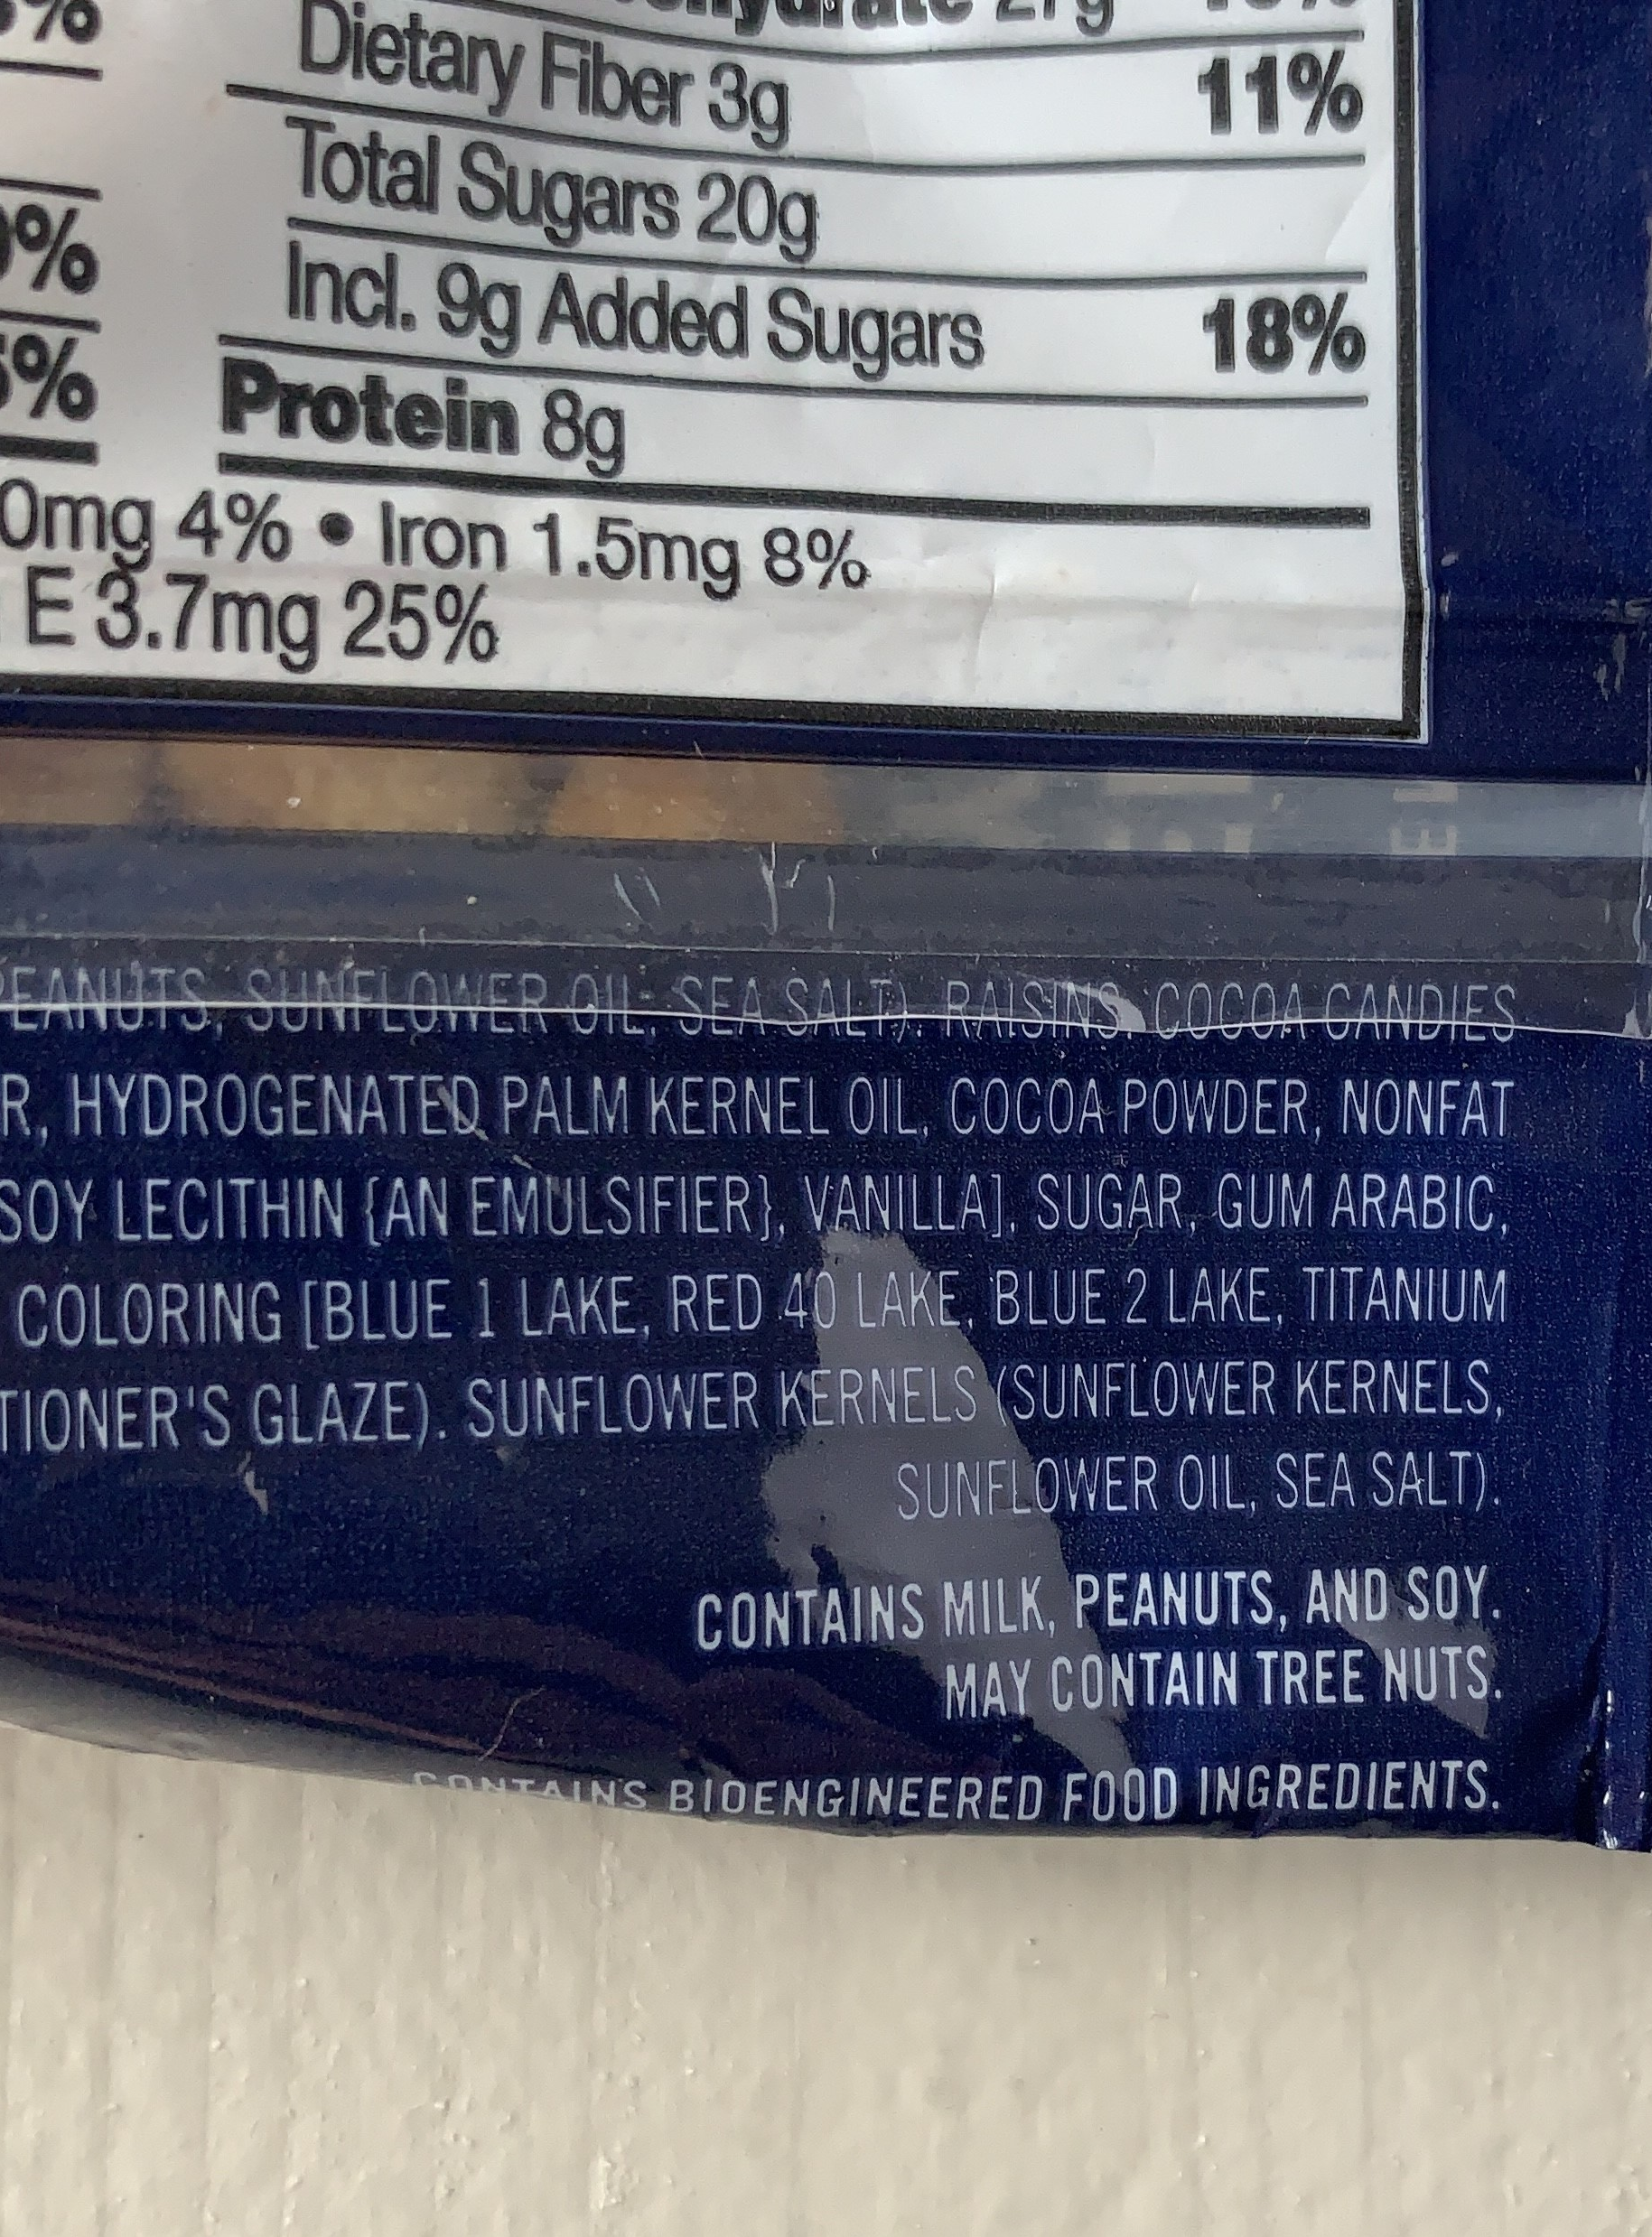
FALSE: Precautionary Allergen Labeling (PAL) is Voluntary
May contain…
Manufactured in a facility…
Manufactured on shared equipment…
Labels are NOT based on potential amount of allergen
Photo by Lisa Woodruff
Notes:
This is FALSE! A “may contains” statement is considered Precautionary Allergen Labeling or PAL
Other examples include “manufactured in a facility”… or “manufactured on shared equipment” or “shared lines”
These are all voluntary and NOT required!
Also – they all mean the same thing; one statement does not carry more or less risk than another.
Pretty much a company will choose one of these labels and use it across the board. So again, these are voluntary. If you don’t see a PAL on a product, that does not necessarily mean the product is safe. You really need to know that company’s PAL policy in order to understand what is –or what’s not - on that label.
FALCPA does give some guidance in that companies need to be truthful and can’t arbitrarily add a PAL statement.
And you can see from this picture, unlike Contains statements, PALs can simply list tree nut without identifying which tree nut it may contain.

Slide 38
Should PALs be avoided?
Egg: 0.084-0.26 mg/serving
Milk: 0.13-7.3 mg/serving
80% of milk-free dark chocolates with PALs had detectible milk
Peanut: 0.17-5.8 mg/serving
Some individuals have reacted to 1 mg peanut protein
egg
milk
peanut
Ford et al., 2010
Notes:
So the more important question is should precautionary labels be avoided if someone has a food allergy?
If there is any allergen present, the risk is low, for the most part. But we can’t discern from a label how much of that ingredient might actually be in that product.
This 2010 study looked at 400 foods with and without precautionary labels for egg, milk, and peanut.
When serving size was considered, the amount of egg in the various products was pretty low.
With milk contamination, the risk was be pretty significant. In fact, the product with the greatest risk for cross contact was milk-free dark chocolates - 80% with PALs had detectible amounts of milk.
Peanut contamination was also pretty significant; some individuals have reacted to as little as 1 mg of peanut protein.
Detectable residues were found in products both with and without PALs.
So to answer our question, should PALs be avoided, its really going to come down to the individual and what type of allergy they have.
As a dietitian, it is hard for us to define an individuals’ threshold for reaction.
So unless that threshold has been established through a food challenge or previous reaction, we should generally recommend IgE allergy patients avoid PALs, unless their allergist advises otherwise.
FPIES patients probably don’t need to avoid. And EoE patients, it will depend on their doctor and maybe if they are in diagnostic stage or maintenance.
And I want to emphasize the importance of knowing a company’s PAL policy. My son got hives after eating a few sprinkles that were manufactured on shared lines with peanuts. There was no precautionary label on that bottle of sprinkles, but when I looked further I discovered that manufacturer does not always label for shared lines.
Another thing to consider with precautionary labels: Younger children may be able to tolerate, but older children are more likely to have anaphylaxis to smaller doses. And we all know that younger children grow up to become older children. So this is another issue to navigate when it comes to shared decision making with a food allergy family.
Anyone in school foodservice? In general, foods with precautionary labels should be on the “do not serve” list for kids with food allergies, unless specific instructions from family to do otherwise – 1) safety and 2) legal standpoint
*****
FPIES → not typically
EoE → probably should avoid during initial diagnostic phase, probably safe during maintenance
Baked milk or eggs → depends on product
High threshold for reaction → not easy to define
If the patient has a significant reaction to trace amounts in the past, then they really need to be careful with PALs

Slide 39
FASTER Act
Food Allergy Safety, Treatment, Education and Research (FASTER) Act
February 2019: introduced in Congress
April 23, 2021: enacted by Congress
January 1, 2023: sesame must be identified as an allergen on packaged foods
1.6 million Americans allergic to sesame
Sesame now considered a Top 9 Allergen
Warren et al., 2019
Notes:
Let’s switch over to the FASTER Act, which is the first time that a new allergen has been added to labeling laws since FALCPA
As you can see, this timeline moved fairly quickly for federal legislation, and as of January 1, 2023 any food introduced into interstate commerce MUST identify sesame on the label.
Sesame cannot be “hidden” on the label as a generic “seasoning” or “spices” or “natural flavoring”
The FASTER Act does additional things for food allergies in the US, one of which is tasking the FDA to establish a framework for adding future allergens, which is important because we know many countries, like the EU, include more than our Top 9 in their labeling laws.
Yes – sesame allergy, it is very real. 1.6 million Americans have a sesame allergy, which makes it the ninth most prevalent allergen in the United States.
*****
The FASTER Act does more than just require sesame labeling.
Sesame becomes the 9th food allergen that the FDA requires plain-language labeling. It must be identified as sesame on the label.
The Secretary of Health & Human services will issue a report on scientific opportunities in food allergy research, including prevention, treatment, and new cures
And will establish a risk-based scientific process and framework for how to establish additional food allergens in the US.
FDA has released a draft of these guidelines for adding future allergens, which currently include a path for FDA to add allergens as well as citizen petition.

Slide 40
FASTER Act, continued
The elephant in the room…
Major food brands are intentionally adding sesame flour OR labeling “contains sesame” when products do not
Perceived safe foods → now appear unsafe
Who is affected? Food allergy individuals/families, restaurants, school foodservice, hospitals and other institutions…
Bottom line: What’s left in the bakery that will be safe for those with sesame allergy?
To Learn More: FARE webpage: www.foodallergy.org/resources
FARE Webinar: www.foodallergyacademy.org
Notes:
But the elephant in the room is that major food brands are intentionally adding sesame flour OR labeling “contains sesame” when products do not.
Food allergy families are finding that once perceived safe foods now appear unsafe.
This is affecting everyone – from food allergy individuals and families to restaurants, school food service, hospitals, and other institutions.
Ultimately, we need an answer for what’s left in the bakery that will be safe for those with sesame allergy?
I have more resources on the screen; in addition to their official statement, FARE’s webpage provides:
Link of companies that do not add sesame flour to baked products
FAQs
Key news stories
How to become a FARE advocate

Slide 41
True or False: Sesame oil is safe for those with sesame allergy.
Notes:
So, speaking of sesame, raise your hand if you think sesame oil is safe for those with sesame allergy. And raise your hand if you think this is false.

Slide 42
False: Sesame oil is not a refined oil
 | Typically safe | Ask the Allergist | Typically NOT safe
Sesame allergy |  |  | Sesame oil
Cow’s milk allergy |  | Baked milk | Goat or sheep milk Ghee or milk fat
Hen’s egg allergy |  | Baked egg | Separated yolk or egg whites
Soy allergy | Soy oil Soy lecithin
Fish |  | Canned tuna | Fish oil
Peanuts, tree nuts, & seeds |  | Refined peanut oil | Unrefined peanut oil
Corn allergy | Corn oil Corn syrup
Durban et al., 2021
Notes:
This is False. If you remember from earlier, highly refined oils are except from FALCPA labeling. BUT sesame oil is not a refined oil and can actually be more allergenic than sesame seeds.
This chart highlights some of the more confusing foods with food allergy safety.
Note that soy or corn oil are considered typically safe, because they are usually highly refined in the US so they would not contain soy or corn protein.
Soy lecithin is also typically safe; the amount used when it is used as an intentional ingredient is so small that it is considered safe for most of those with a soy allergy.
Same with corn syrup, corn protein is usually not detected.
Peanut oil is a little more tricky; unrefined may contain protein even though refined peanut oil should be safe. The problem is with how oils are labeled makes it difficult to tell what is refined or unrefined. Just to be safe, I usually recommend avoiding unless your allergist says otherwise.
And finally, I always defer to the Allergist when it comes to baked milk or egg. Even though a high percentage can tolerated baked products, because of the risk of anaphylaxis I always tell patients to talk to their Allergist about a food challenge; this is typically not something tried at home.

Slide 43
Baked milk & Baked egg
~70% of kids can tolerate baked milk or egg
Standardized recipes include flour matrix and baking for at least 30 minutes at 350°F
Benefits:
increased diet diversity
reduced avoidance burdens
more inclusion in social activities
COMING SOON!
The Baked Egg & Baked Milk Cookbook: Recipes for those with milk or egg allergy
By Allison Schaible, Wendy Elverson, Marion Groetch and Carina Venter
To Learn More: Dietary Management of Food Allergy by Durban et al. (2021) – Box 1: Baked milk and baked egg recipes
Durban et al., 2021
Notes:
Up to 70% of children with cow’s milk or egg allergy can tolerate baked milk or egg.
This is because heating disrupts the structure of specific proteins, making them less allergic
Standardized recipes are important so you know how much protein is in each serving size. Some requirements of “baked” include:
Flour matrix
Baking for at least 30 minutes at 350°F
All products must be baked through so that the center is not wet or soggy.
Typically baked milk or egg is introduced as part of an oral food challenge, because of the risk for severe allergic reactions. Unfortunately those that can’t tolerate tend to have more severe reactions. But there are benefits to assuming this risk, including:
Increased diet diversity/more food choices
Reduced avoidance burdens
More inclusion in social activities
There is also the possibility that intake of foods with baked milk and egg content may accelerate the development of tolerance to uncooked milk and egg!
And coming soon; a baked egg and baked milk cookbook by a group of food allergy dietitians to offer muffins, whole wheat breads, savory crackers, and other foods to increase variety of baked milk and baked egg options.
*****
The use of a wheat matrix in baked goods is believed to actually decrease IgE antibody binding to milk proteins (Bavaro SL, De Angelis E, Barni S, et al. Modulation of milk allergenicity by baking milk in foods: a proteomic investigation. Nutrients 2019;11(7):1536

Slide 44
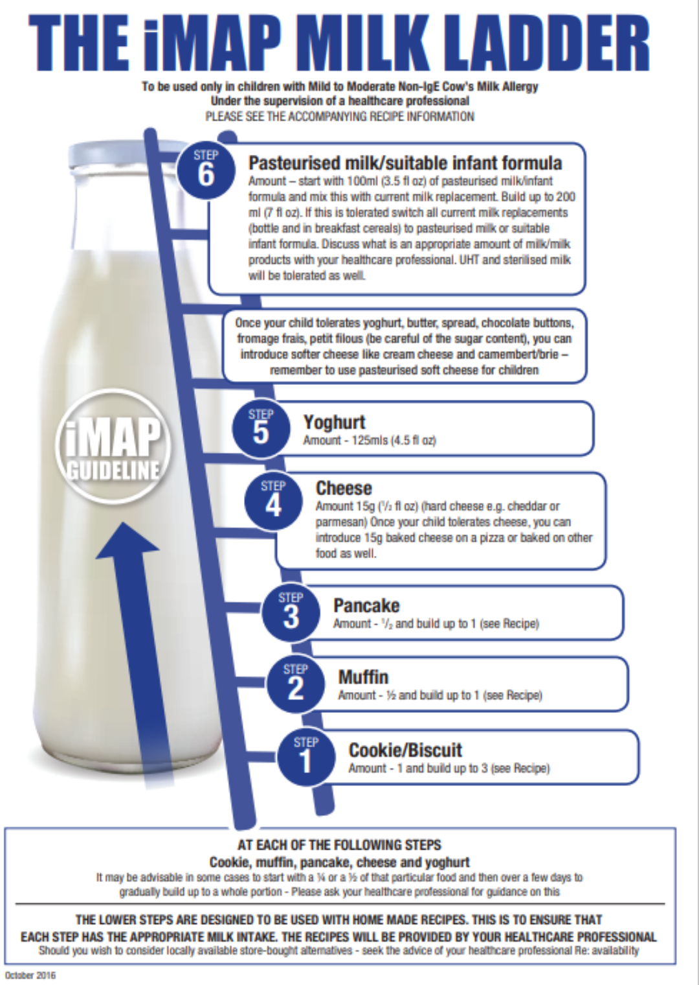
Food Allergen Ladders
A process of gradually reintroducing food allergens (milk, egg) into an individual’s diet
Clinical uses:
Mild-moderate Non-IgE-mediated food allergy (not FPIES)
? IgE-mediated with prior mild, non-anaphylactic reactions
Non-asthmatic preferable
Willing & prepared patients & families with ready access to emergency services
To Learn More: Mediterranean Milk Ladder: Integrating a Healthy Eating Plan While Reintroducing Cow’s Milk by Vassilopoulou et al. (2023)
Better recognition, diagnosis and management of non-IgE-mediated cow’s milk allergy in infancy: iMAP – an international interpretation of the MAP (Milk Allergy in Primary Care) guideline by Venter et al. (2017)- Additional File 4: iMAP Milk Ladder Recipes
Venter et. al, 2017; Vassilopoulou et al., 2023)
Notes:
Food Allergen Ladders, like the iMAP milk ladder pictured here, can be used to help establish tolerance to baked milk, cheese, yogurt, and other forms of processed milk.
This was originally intended for home-introduction with children with mild to moderate non-IgE-mediated food allergy (which by definition, excludes FPIES).
Remember, it is difficult to define IgE-mediated food allergy as mild or severe, because so many external factors can influence a reaction threshold.
However, we are starting to see some clinical use of this ladder with IgE-mediated cow’s milk allergy (encouraged perhaps by published guidelines suggesting its use from the British Society for Allergy and Clinical Immunology)
In addition to the original UK milk ladder, there is this a six-step international Milk Ladder and just earlier this year a Mediterranean milk ladder was published, which achieves corresponding protein content as each step the iMAP ladder, but uses foods based on principles of the Mediterranean eating pattern.
There are currently ladders available for milk and egg, with more data needed for soy and wheat ladders.
******
Benefits: increased food variety or diversity, quality of life
Additional benefits of using a food allergen ladder: the convenience of introducing food at home (food challenges take HOURS and cost MONEY in the clinics or hospitals) so less financial strain and less time buying specialty foods.
Reduced risk of reaction from accidental ingestion/cross contact as tolerance to trace amounts and more have been established
Some study findings have suggested these ladder approaches may function as a form of OIT in some patients (oral immunotherapy)
Risks: potential for allergic reaction with limited ability to predict who will present with severe symptoms
Some factors that have been associated with more severe symptoms include:
High allergen-specific IgE levels and certain IgE epitope binding patters
skin prick test size
dose that triggered the initial reaction
History of past severe reactions
Age (younger children less likely to present with anaphylaxis – but it has been reported in the past*)
Other co-existing allergic diseases – asthma
Factors that can lower an individuals’ threshold of reaction: fatigue, viral infections, exercise, exacerbation of other allergic diseases such as asthma
Additionally, if the intake is interrupted the threshold could decrease, with a risk of allergic reaction when the intake is resumed
FYI - Allergenicity of food proteins can be changed by different types of processing
Cooking, boiling, other forms of heating
Fermentation
Chemical & enzymatic degradation
Wheat matrix (baked goods)

Slide 45
True or False: All individuals with peanut allergy must avoid tree nuts

Slide 46
False: Low risk of cross reactivity
Peanut | Cross Reactive Food | Risk (varies with region)
 | Tree Nuts (co-allergy) | ~33%
 | Lupine | ~20%
 | Sesame (co-allergy) | 10-15%
 | Green bean, pea, soy | 5-20%
Tree Nuts | Cross Reactive Food | Risk (varies with region)
 | Other Tree Nuts | 15-33%
 | Sesame (co-allergy) | 10-15%
 | If walnut allergy→ Pecan If pecan allergy → Walnut | ~66-75% >95%
 | If cashew allergy → Pistachio If pistachio allergy → Cashew | ~66-83% >95%
 | If Peanut + Tree nut → Sesame | 50%
Cox et al., 2021
Notes:
Cross reactivity resource: Cox et al. 2021
So this advice is outdated – peanut and tree nuts have low, if any cross reactivity.
Just to clarify - a highly allergic individual that is more likely to have multiple food allergies can have both tree nut and peanut allergies, but that doesn’t mean they are cross-reactive.
We have to take an individual approach
BUT – in individuals with a peanut allergy, there is only a 33% risk for a tree nut co-allergy.
This is just a snippet of the full table from Cox and collogues in 2021
I would say to be careful sharing this information with patients; some might find it reassuring to know the lower risk of cross-reactivity, others might become more anxious about trying new foods due to presence of any risk of cross reactivity.
So when is a good time to introduce tree nuts for those with a peanut allergy? This is a good question for the allergist.
Now, if a patient has testing done that is negative to tree nuts, that is always a good time to introduce.
Because that same patient can come back a year later for follow-up testing and now test positive to tree nuts.
There are ways to safely introduce tree nuts to very young children, even infants.

Slide 47
Growth Concerns and Food Allergies
Inappropriate or excessive dietary elimination
Delay in introduction of nutrient-dense solids
Increased risk of nutrient deficiencies
Delay in oral-motor development and texture/taste acceptance
Feeding difficulties
Ongoing pain & discomfort
Ongoing gut inflammation
Stunting more prevalent than low weight
9% stunting vs. 6% underweight
Children at risk of poor growth:
Cow’s milk allergy
3+ food allergens
Non-IgE-mediated food allergy
including FPIES
Mixed IgE- and non-IgE-mediated
Meyer et al. 2019
Notes:
A 2019 international study looked at prospective growth data from 430 patients from 12 different allergy centers around the world.
Stunting was more common in children with food allergies than low weight.
5% were considered undernourished
Key takeaway is the importance of an individual assessment – not every child with a food allergy will be malnourished or have growth problems!
This study also identified children to be particularly at risk of poor growth, including those with:
Non-IgE mediated food allergy, including FPIES
Avoiding 3 or more food allergens
Mixed IgE and non-IgE
Cow’s milk allergy
Just a side note – in developing countries, the prevalence of stunting can increase to almost 25% → study by Vieira et al. BMC Pediatr 2010
<<cue animation>> As you can see, there are many interconnected, potential contributing factors to growth faltering in food allergy.

Slide 48
Infants & Cow’s Milk Protein Allergy (CMPA)
Hypoallergenic formula = tolerated by 90% of children with CMPA with a 95% Confidence Interval
Extensively hydrolyzed formula (EHF)
Amino Acid formula (AAF)
For most children, EHF sufficient for symptom resolution
On average, 10% of IgE-mediated CMPA will react with EHF
AAF considered first-line approach in EoE, may be warranted if growth faltering (including height), anaphylaxis, or failure on EHFstory and com
To Learn More: When Should Infants with Cow’s Milk Protein Allergy Use an Amino Acid Formula? A Practice Guide by Meyer et al. (2018)
Meyer et al., 2018.
Notes:
Most children with CMPA present before age 1, during which breastmilk or formula is the primary source of nutrition.
I’ll talk more about nutrition for breastfeeding mothers later on, but what to emphasize that if breastfeeding should be supported when possible for infants with CMPA. The use of AAF in children who are breastfed remains highly controversial.
In the interests of time, I want to emphasize that MOST infants on formula with cow milk allergy will see symptom resolution with an Extensively Hydrolyzed Formula.
There is a subset that will need Amino Acid formula, but this switch is only recommended after at least a 2 week trial for IgE allergy and 4-6 weeks or more trial for non-IgE allergy
The exception would be using Amino Acid formula as a first-line approach with EoE and possibly those with growth faltering or maybe history of anaphylaxis.
*****
So the definition of a hypoallergenic formula is that studies must demonstrate that it is tolerated by 90% of children with cow’s milk protein allergy with a 95% confidence interval. There are different types:
EFH: short peptides
AAF: provides protein as amino acids
A blanket approach for using AAF is not advised, as the hypoallergenic formula choice may lie in each individual’s history and combination of symptoms.
Using AAF is highly debated, but I want to emphasize that MOST children with CMPA will see symptom resolution with an EHF.
Important because of increase cost of AAF as well as other factors
Note: infants with non-IgE-mediated food allergy tend to have a higher failure rate with EHF than IgE-mediated
However, on average 10% of IgE-mediated CMPA will react while on EHF → AAF recommended after 2+ week trial for IgE CMPA and 4+ weeks for non-IgE
Additionally, AAF is considered a first-line approach in infants with EoE
AAF may also be indicated when growth faltering is seen, as well as children who have experienced anaphylaxis
Source: When Should Infants with Cow’s Milk Protein Allergy Use an Amino Acid Formula? A practical Guide. Meyer R., Groetch, M, and Venter, C. 2017 J Allergy Clin Immunol Pract 2018;6:383-99

Slide 49
Cow’s Milk Substitutes (CMPA)
Infant formula or breast milk should be sole source of “milk” until at least 1 year.
(240 ml) | Cow’s milk | Almond | Cashew | Coconut | Flax-seed | Hemp | Oat | Pea | Rice | Soy
Calories Pro (g) Fat (g) CHO (g) Sugar (g) Ca (mg) Vit D (IU) | 150 8 8 13 12 300 120 | 30-100 1-5 3 9-22 7-20 300 110 | 25-80 0-1 2-3.5 1-20 0-18 100-450 125 | 45-90 0-1 5 8-13 0-9 100-450 125 | 55 0 2.5 9 9 300 100 | 70-170 2-4 5-6 1-35 0-23 400 150 | 130 4 2.5 24 19 350 120 | 115 8 5 11 10 450 150 | 110 1 2.5 20 13 300 120 | 90 6 3.5 15 9 400 120
To Learn More: North American Society for Pediatric Gastroenterology, Hepatology, and Nutrition Position Paper: Plant-based Milks by Merritt et al. (2020)
Merritt et al., 2020
Notes:
I won’t spend much time on this slide either, I just want to highlight that cow’s milk substitutes vary significantly in regards to nutrition profile.
Which is one reason why kids with cow’s milk allergy are at higher risk for growth concerns
The key takeaway here is that while every patient has individualized needs, in general, Soy milk or Pea protein milk would be the most nutritionally comparable alternative to cow’s milk
And of course, infant formula or breastmilk should be the sole source of “milk” until at least 1 year of age.
*****
Note: there are variations in some nutrients because of different products available; averages or ranges are reported
“Despite lay concerns regarding adverse health impacts of cow’s milk, epidemiologic research has found that dairy product intake appears to:
Reduce the risk for common chronic diseases in the population
Increase population height
Supply key nutrients for growth and development “
Nutrients of concern when milk is removed from diet: protein, fat, Calcium, & Vitamin D (and added sugar in some plant-based “milks”)

Slide 50
True or False: Only IgE-mediated food allergy reactions can be medical emergencies

Slide 51
Food Protein Induced Enterocolitis Syndrome (FPIES)
Chronic
Acute
Onset 1-4 weeks after milk or soy formula introduction in infants
Progressive illness:
Watery diarrhea
Mucous & blood in stools
Intermittent & progressive emesis
Low albumin & total protein
Elevated WBC, neutrophils
“Failure to Thrive”
Occurs after accidental ingestion or exposure to new food
Repetitive, profuse vomiting 1-4 hours after ingestion
Systemic reaction may include lethargy, pallor, limpness, shock
May have diarrhea 5-10 hours later (may contain blood)
Nowak-Wegrzyn, Chehade, Groetch et al. 2017
Notes:
And finally, I want to touch on FPIES, as this is one non-IgE-mediated allergy with emerging research and resources in recent years.
FPIES, or Food Protein Induced Enterocolitis Syndrome is characterized by delayed, often dramatic GI symptoms
It is a systemic reaction different from anaphylaxis.
It is much more common in infants than in adults, but there are cases that persist into adulthood and even adult-onset FPIES.
There are two phenotypes: chronic and acute
As well as Atypical FPIES, which is when allergic sensitization develops to an FPIES trigger food, and is often associated with a prolonged disease course (commonly cow’s milk or egg).
Chronic FPIES occurs most often in young infants that are fed continuously with milk or soy formula.
Symptoms start 1-4 weeks after formula introduction and get progressively worse.
Often starts with watery diarrhea, mucous or blood in stools, and vomiting that gets progressively worse
Often see a “failure to thrive” diagnosis as part of workup
Symptoms will resolve once trigger food has been removed from diet for several weeks
Acute FPIES occurs after an accidental ingestion to a known trigger or after exposure to new food
Repetitive, profuse vomiting is typically seen up to 4 hours after ingestion (remember, this is delayed compared to IgE-mediated reactions)
FPIES does have the risk to become a medical emergency – fluids or IV fluids can be necessary for treatment to an acute systemic reaction.

Slide 52
FPIES and Complementary Feeding
 | Lower Risk | Moderate Risk | Higher Risk
Vegetables | Squash, carrot, white potato, green bean | Squash, carrot, white potato, green bean | Sweet potato, green pea
Fruit | Blueberries, strawberries, peach, plum, watermelon | Apple, pear, orange | Banana, avocado
High Iron Foods | Lamb, fortified quinoa cereal, millet | Beef, fortified grits and corn cereal, wheat, fortified barley cereal | Fortified infant rice and oat cereals
Other | Tree nut and seed butters | Peanut, beans, chickpeas, lentils | Milk, soy, poultry, egg, fish
Nowak-Wegrzyn, Chehade, Groetch et al. 2017
Notes:
With FPIES, it is important to start introducing solid foods by 6 months of age, if not earlier when developmentally appropriate. In the past, some doctors wanted to delay starting solids in FPIES babies but that is not what we want to do now.
Common FPIES triggers are found in the Higher Risk Column here, which include Milk, egg, soy, oat, and rice
But also sweet potato, peas, avocado, banana + wheat and corn (moderate risk column)
The higher risk food column has some similarities but is definitely different that the most common IgE-mediated allergens.
Also – just a side note that fish FPIES is one that tends to stick around into adulthood.
And I think I mentioned this earlier, but most infants with FPIES have a higher threshold for reaction than IgE food allergies. Its very rare for reactions to trace/invisible amounts, so usually this group doesn’t have to avoid precautionary labels.
*****
Remember, with FPIES we see a delayed reaction up to 4 hours after eating. Also, the vast majority of infants with FPIES will have a higher threshold for reaching (think like an infant mouthful) and its very rare for reactions to trace/invisible amounts.

Slide 53
FPIES and Psychosocial Impact
FPIES parents report more difficulty managing the food allergy
Burden on caregiver significantly higher
Self-efficacy significantly lower
To Learn More: The Practical Dietary Management of Food Protein-induced Enterocolitis Syndrome by Groetch et al. (2021)
International Consensus Guidelines for the Diagnosis and Management of Food Protein-induced Enterocolitis Syndrome: Executive summary – Workgroup of the Adverse Reactions to Foods Committee, AAAAI (2017)
Maciag et al. 2020
Notes:
That said, FPIES parents do report more difficulty managing food allergy than parents of IgE allergies.
This can have trickle-down affects on feeding behaviors and poor growth, so infants with FPIES may require a more detailed weaning plan to avoid future nutritional problems.
There is a lot more we could talk about with FPIES, but in the interest of time we need to move on. <<cue animation>> That said, here are two papers if you want to learn more or need more detailed information.
*****
Of note, the International Consensus Guidelines were published in 2017, right before the early introduction guidelines were released in the United States and more FPIES research has come out since it was published, so anticipate some of these guidelines may change in the future. One example – avocado was originally published as a low risk food but has changed to high risk due to case series published after 2017.

Slide 54
Nutrition for Food Allergy Families
Notes:
Really quickly, I want to highlight a couple scenarios when food allergy nutrition interventions can directly impact other family members.

Slide 55
Breastfeeding Mothers
Are there food antigens in breast milk?
2001 study: Participants avoided peanuts/legumes for 24 hours, then consumed 50 grams dry roasted peanuts
Peanut protein detected in breast milk of 11/23 (48%)
Peanut protein appeared after 1 hour in 8/11
Peak peanut protein concentration: <1 mg peanut protein per 8-oz breast milk
Vadas et al. 2001
Notes:
So, the big question with breastfeeding mothers is going to be if food antigens pass into breast milk.
This study by Vadas and colleagues is from 2001, but still a good one to look at.
In this study, 23 participants avoided peanuts & all legumes for 24 hours
Then consumed 50 grams of dry roasted peanuts, which is equivalent to 4 Tablespoons of peanut butter. So more peanut protein that what is typically consumed in 1 sitting.
Samples of breast milk were collected fasting, and then at intervals beginning at 1 hour after ingestion.
So what did they find?
Over half of the moms did not have peanut protein in their breastmilk, even after eating such a high dose.
In those that DID have peanut protein in breast milk, in 8 of the 11 it appeared after just 1 hour.
And the peak protein concentration was very small; median amount was 200 nanograms!
If you look at this in the context of a 8-oz serving of breastmilk, that is still less than 1 milligram of peanut protein total.
Caveats: this is peanut protein; other studies looking at beta-lactoglobulin from cow’s milk have reported a longer clearance time of several hours to a few days from breast milk.

Slide 56
Breastfeeding Mothers
**Exception** First step is maternal milk elimination diet OR hypoallergenic formula for Allergic Proctocolitis (AP or FPIAP)
Should breastfeeding mothers also do elimination diets?
Food antigens have been seen in breast milk BUT amounts are very small
Many mothers don’t have any proteins in their breast milk
Bottom line: Breastfeeding mothers should not eliminate allergens themselves unless a reaction is suspected from breastfeeding
The probability of an IgE-mediated allergic reaction in a food-allergic infant breast fed by a women consuming the allergen(s) is estimated at <1:1,000.
Gamirova et al. 2022
Notes:
So the next question – should breastfeeding mothers ALSO do elimination diets?
Yes , food antigens have been found in breast milk. But we know from the last slide that these amounts are very small.
And it’s going to vary between different foods, different mothers, and even within 1 mother from time to time.
Ultimately, mothers will NOT have any proteins in their breast milk. Across the studies, this ranges from 30-50%.
So the bottom line? We should not be advising breastfeeding mothers to also avoid suspected or confirmed allergens unless a reaction is suspected from breastfeeding.
Let me qualify this by saying I wouldn’t encourage a mother to go crazy and eat 5 peanut butter sandwiches or drink a pint of milk 1-2 hours before nursing.
Let’s be sensible – normal consumption should be safe unless a past incident suggests otherwise.
<<cue animation>> The probability of an IgE-mediated allergic reaction via breastmilk in a mom that consumes the allergen is estimated at less than one in 1,000.
Same recommendations apply to FPIES
<<cue animation>> Not the case for all non-IgE food allergies; for example Allergic Proctocolitis the first step is maternal milk elimination diet or hypoallergenic formula.
******
Statistic from: Gamirova A, Berbenyuk A, Levina D, et al. Food Proteins in Human Breast Milk and Probability of IgE-Mediated Allergic Reaction in Children During Breastfeeding: A Systematic Review. J Allergy Clin Immunol Pract. 2022;10(5):1312-1324.e8.

Slide 57
Breastfeeding Mothers
How long do food antigens stay in breast milk?
2010 NAIAD Food Allergy Guidelines
Once suspected trigger foods are eliminated, immunologically active protein may persist for a few days.
Most often, allergens are not detectable in breastmilk after a few hours.
Bottom line: For those with a suspected reaction after breastfeeding, 2-4 weeks of “pump and dump” is unnecessary.
Notes:
Okay, so next big question: for the subset of mothers that DO have food antigens cross over into breast milk, how long are they present? Or more specifically – how long should a mom “pump and dump?”
The 2010 NAIAD Food Allergy Guidelines tell us that
Immunologically active protein can persist for several days.
But most women, food antigens are not detectable after just a few hours
<<cue animation>> Bottom line here: for infants with a suspected reaction after breastfeeding, 2-4 weeks of “pump and dump” is really unnecessary – mom should only be doing this for just a few days.
*****
IF there is a reason why food proteins are present in some mother’s milk but not others, we don’t know the answer to that. We just don’t have a lot of answers right now.

Slide 58
Breastfeeding Mothers
How long should a trial maternal elimination diet last?
2010 NAIAD Food Allergy Guidelines
If reaction suspected after breastfeeding, may pursue trial maternal elimination:
IgE-mediated: typically 2 weeks
Non IgE-mediated: longer duration, possibly up to 4-6 weeks
Bottom line: Educate breastfeeding moms that it could take several weeks for symptoms to resolve after starting elimination diet
Notes:
So, final question – how long should a trial elimination diet last in breastfeeding mothers?
Again, IF a reaction is suspected after breastfeeding, the 2010 NAIAD Guidelines suggest a trial maternal elimination diet. We need more research into the optimal duration of a diagnostic elimination diet.
Typically its 2 weeks for IgE-mediated food allergy
And a longer duration for non IgE-mediated food allergy; depending on the type of food allergic disorder or symptoms, some studies suggest 4-6 weeks may be necessary.
The bottom line with this, is that we don’t want breastfeeding mothers to think symptoms will completely resolve in a few days after starting an elimination diet. This can lead to them searching for more foods to eliminate and then in a short time they’re on a very restrictive diet, which is something we really want to avoid.

Slide 59
Young Siblings without Food Allergies
Risk vs. benefit of allergen-free home
Consider Early Intervention guidelines
Notes:
Another thing to consider is when there are young siblings at home with a food allergy child.
Each family must weigh the risk vs. benefit of an allergen-free home.
This should be factored into shared decision making with allergist and dietitian.
We’ll talk about early intervention guidelines in a little bit, but it’s important to consider how these guidelines affect any siblings, especially ones under 3 that have similar risk factors as child with food allergies.

Slide 60
Food Allergy Management
Notes:
So next – Food Allergy management

Slide 61
True or False: There is no “cure” for food allergies
Notes:
Raise your hand if you think there is no “cure” for food allergies. Raise your hand if you think this is fale.

Slide 62
There is no “cure” for food allergy
“For those who have not acquired tolerance naturally, a cure for food allergy does not exist yet.”
Finding a Path to Safety in Food Allergy
(Chapter 2), 2016
Photo by Lisa Woodruff
Notes:
This is true – For those that do not “grow out” of their allergy or acquire natural tolerance, a cure for food allergy does not exist yet. Yet.
What do we have for food allergy management strategies?
Avoidance of allergens
Immediate treatment of symptoms when a reaction occurs
But there are also a growing body of evidence for specific therapeutic interventions for inducing tolerance.

Slide 63
Food Allergy Tolerance & Desensitization
Tolerance = immune system no longer responds to a former allergen
65-80% for cow’s milk, wheat, soy, or egg
10-20% for peanut or tree nuts
Desensitization = state of clinical & immunological non-responsiveness to an allergen
Achieved by careful, physician-guided administration of gradually increasing amounts of the allergen over a relatively short period of time
Maintenance typically requires continued regular exposure
Desensitization does not guarantee true tolerance
Finding a Path to Safety in Food Allergy, 2016
Notes:
Before we get into immunotherapies, I want to review a few definitions.
Natural tolerance is when the immune system no longer responds to foods that once induced an allergic, immune response
This can develop over time, and can vary based on food, age, and geography.
This is also known as “growing out” of a food allergy, and prevalence can vary:
Not everyone will develop natural tolerance or “grow out” of food allergy
It’s its more likely for those cow’s milk, wheat, soy, or egg allergies.
It’s less likely for peanut and tree nut
And rare for fish and shellfish allergies
Two key takeaways here:
Not everyone with milk, wheat, soy, or egg allergy will develop natural tolerance.
It is feasible that someone could develop tolerance for some but not all their food allergies.
Desensitization is a state of clinical and immunological non-responsiveness to an allergen that is
Induced by careful, physician-guided administration
Of gradually increasing amounts of the offending allergen
Over a relatively short period of time, such as hours to days.
Continued, regular exposure to that food is required to maintain desensitization. With out that exposure, sustained unresponsiveness could last weeks to months, or even less.
*****
Another way to think of desensitization is that an individual will tolerate more of the food on a food challenge, even in some cases to the point of not reacting to the “serving sized” amounts of the food.
But this does not guarantee “true tolerance“
Which essentially is the long-term loss of clinical reactivity to the allergen when an individual is no longer exposed to that allergen on a regular basis
In some individuals, sustained unresponsiveness can last weeks to months, while in others, desensitization is lost more quickly when treatment for food allergy is stopped.

Slide 64
Food Immunotherapy
FDA-approved OIT:
Palforzia (peanut) for 4–17-year-olds
Therapies currently in clinical trials:
OIT
Milk, egg, multiple food combinations
Baked milk, baked egg
OIT in combination with anti-IgE medication
SLIT
EPIT (milk, peanut)
Oral (OIT): allergen swallowed directly, often in powder mixed with another food
Sublingual (SLIT): drops of liquid with allergen placed under tongue & held for 1-2 minutes
Epicutaneous (EPIT): allergen embedded in a small patch that is placed on the skin for 24 hours
To Learn More: FREE CEU webinar from FARE (foodallergy.org/our-initiatives)
Food Allergy in 5 Lessons: Treatment, Lesson 4
Sampson et al., 2014
Notes:
In the interest of time, I’m just giving a very brief overview of food allergy immunotherapy.
There is Oral Immunotherapy or OIT, which is when an allergy is swallowed directly
Often as a powder mixed with another food
But can also be a food form
The goal is to desensitize patients to a particular food by giving small, daily doses and gradually building their body’s resistance to that allergen; this is achieved by increasing the dose about every 2 weeks
Sublingual Immunotherapy or SLIT is like to OIT, except drops of liquids containing the allergen are placed under the tongue and held for 1-2 minutes.
And then either spit out or swallowed
This is also a daily therapy with a progression protocol.
Epicutaneous Immunotherapy or EPIT uses a small patch directly on the skin of the back or upper arm
The allergen is embedded in the patch
Which is changed every 24 hours
This approach may take years of therapy, much longer than OIT or SLIT
Both OIT and SLIT have been used by some Allergists in this country for over two decades, but currently the only FDA-approved immunotherapy is Palforzia for peanut allergy OIT.
The good news is that food allergy patients may have multiple treatment options available in the near future, as you can see by the list of therapies currently in clinical trials. However, not all patients are a good candidate for immunotherapy and there are several risks, including allergic reactions, anaphylaxis, and new onset EoE.
Again, shared decision making is important, especially since these therapies require daily maintenance doses for the foreseeable future. If you have questions or want to learn more, FARE has a great webinar that does an overview of Treatments.
*****
Anti-IgE medications: target the IgE antibody used in conjunction with OIT which seems to shorten the length of time required to reach each maintenance dose.

Slide 65
Reasons for Allergist Referral
Evaluation of suspected food allergy
Confirmation of food allergy diagnosis
Education on signs & symptoms of allergic reaction and anaphylaxis
Recommendation of appropriate food elimination/avoidance diet
Update prescriptions and Emergency Care Plans
Establish appropriate food allergy management plan, including follow-up testing, oral food challenges, and potential immunotherapies
Illustrations by Olive Phan
© 2022 Lisa Woodruff Nutrition
Notes:
So if it’s not obvious by now, there are many reasons why food allergy patients should establish care with an Allergist/Immunologist.
But I want to highlight that not all allergists specialize in food allergy, and not all clinics offer oral food challenges or immunotherapy.

Slide 66
Food Allergy Prevention
Notes:
There’s been a lot of buzz about Early Intervention and food allergy prevention in recent years…

Slide 67
Early Intervention
Who is at greatest risk for developing a food allergy?
Infants with severe eczema
Potentially ↑ risk in infants with:
History of mild-moderate eczema
Family history of atopic disease
Prior or existing food allergy
To Learn More: FREE CEU webinar from FARE (foodallergy.org/our-initiatives)
Food Allergy in 5 Lessons: Prevention, Lesson 5
Du Toit et al., 2016
Notes:
Before I get into the LEAP Trial we need to establish who is at greatest risk for developing a food allergy:
Infants with severe eczema
As well as potentially increased risk in infants with:
A history of mild to moderate eczema
A family history of atopic disease in at least one parent
And those with a known food allergy diagnosis
So, the LEAP trial included over 600 infants determined to be at risk for peanut allergy
They were divided into a consumption group (which is essentially an early introduction group) and an avoidance group.
As you can see, overall only 3.2% of the Early Introduction group developed peanut allergy, compared to 17.2% in the avoidance group.
Huge takeaway from this trial: early exposure to peanut (like through a breakdown in the skin barrier in those with eczema) may lead to sensitization while early dietary exposure may lead to tolerance.
*****
it’s not just the LEAP Trial, there is a significant and growing body of research supporting Early Introduction:
Learning Early About Peanut Allergy (LEAP) Trial
Enquiring About Tolerance (EAT) Study
Preventing Atopic Dermatitis and Allergies in Children (PreventADALL)
Prevention of Egg Allergy with Tiny Amount Intake (PETIT) Study
Strategy for Prevention of Cow Milk Allergy by Daily Ingestion of Infant Formula in Early Infancy (SPADE)
HealthNuts Study

Slide 68
Early Intervention Guidelines
2016 Addendum Guidelines for the Prevention of Peanut Allergy in the United States: Report of the NIAID-Sponsored Expert Panel
Guideline | Infant criteria | Recommendations | Earliest age of peanut introduction
#1 | Severe eczema, egg allergy, or both | Strongly consider sIgE and/or SPT (and OFC if necessary). Based on test results, introduce peanut-containing foods. | 4-6 months
#2 | Mild to moderate eczema | Introduce peanut-containing foods | ~6 months
#3 | No eczema or any food allergy | Introduce peanut-containing foods | Age appropriate and in according with family preferences and cultural practices
NIAID Addendum Guidelines, 2017
Notes:
This is a breakdown of three of the 2016 Addendum Guidelines for the prevention of peanut allergy in the united states.
Guideline #1: Infants with severe eczema, egg allergy, or both should have introduction of age-appropriate peanut-containing foods as early as 4-6 months of age to reduce risk of peanut allergy.
There is additional information on the use of blood test, and/or skin prick tests and even oral food challenges PRIOR to early introduction to help determine how peanut-containing foods should be introduced (at home or after Allergist referral)
Note: to minimize a delay in peanut introduction for children who may test negative, blood testing is the preferred initial approach in certain healthcare settings. Panel testing is not recommended due to poor positive predictive value.
Guideline #2: Infants with mild to moderate eczema should have introduction of age-appropriate peanut-containing food around 6 months of age to reduce risk of peanut allergy
Peanut should not be THE first food, but one of the first. This is to demonstrate that infants are developmentally ready for solids.
This can be done in-home, but some caregivers or healthcare providers may prefer an in-office supervised feeding.
Guideline #3 is for infants without eczema or any other food allergy, but still supports and encourages early introduction, perhaps with a little less urgency that those at mild to moderate or severe risk.
Again – early introduction is generally considered safe and no evidence exists for restricting common food allergens in infants without known or suspected food allergy
Early introduction is believed to contribute modestly to an overall reduction in prevalence of peanut allergy.
With this group of infants, its not quite as urgent to get peanuts introduced right around 6 months, but I would still highly recommend by 7 or 8 months.
So these guidelines are specific to peanuts, and to some extent egg, but I would encourage early intervention of most of the common allergens, and would anticipate updated guidelines at some point in the future.

Slide 69
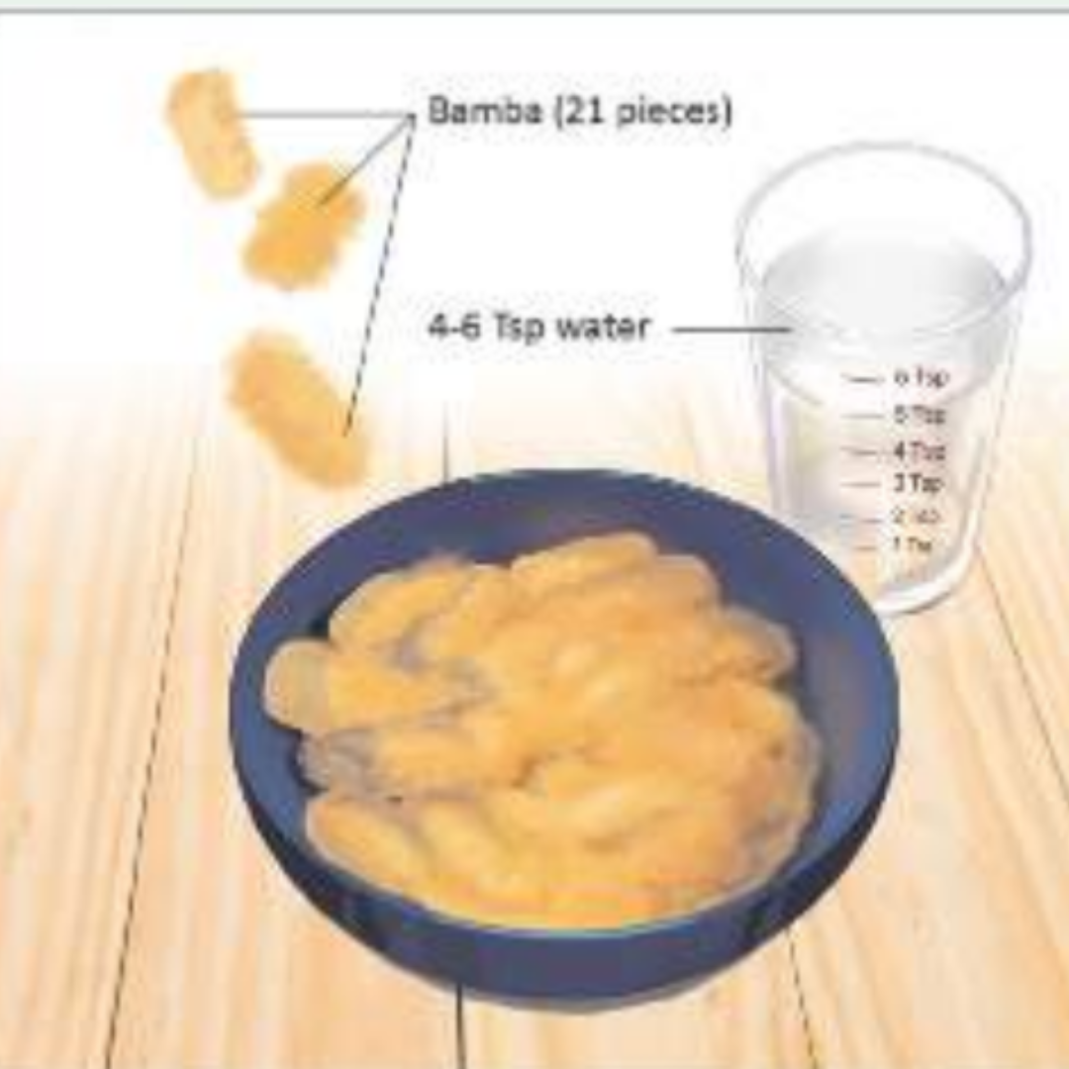
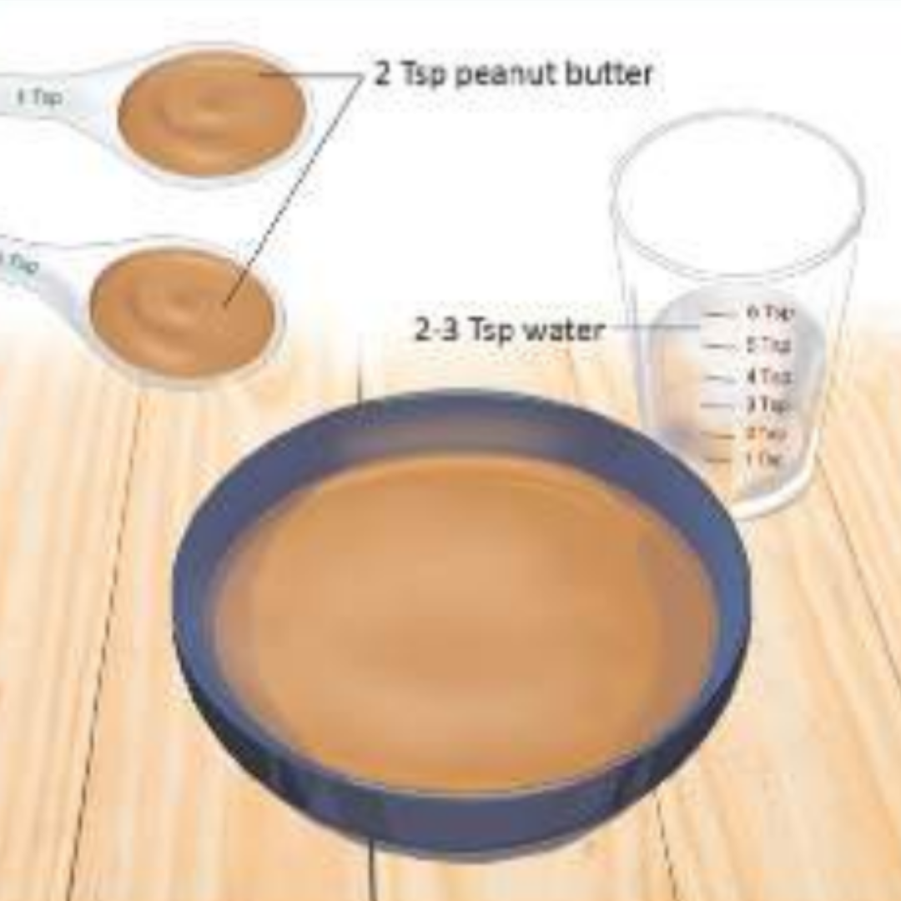
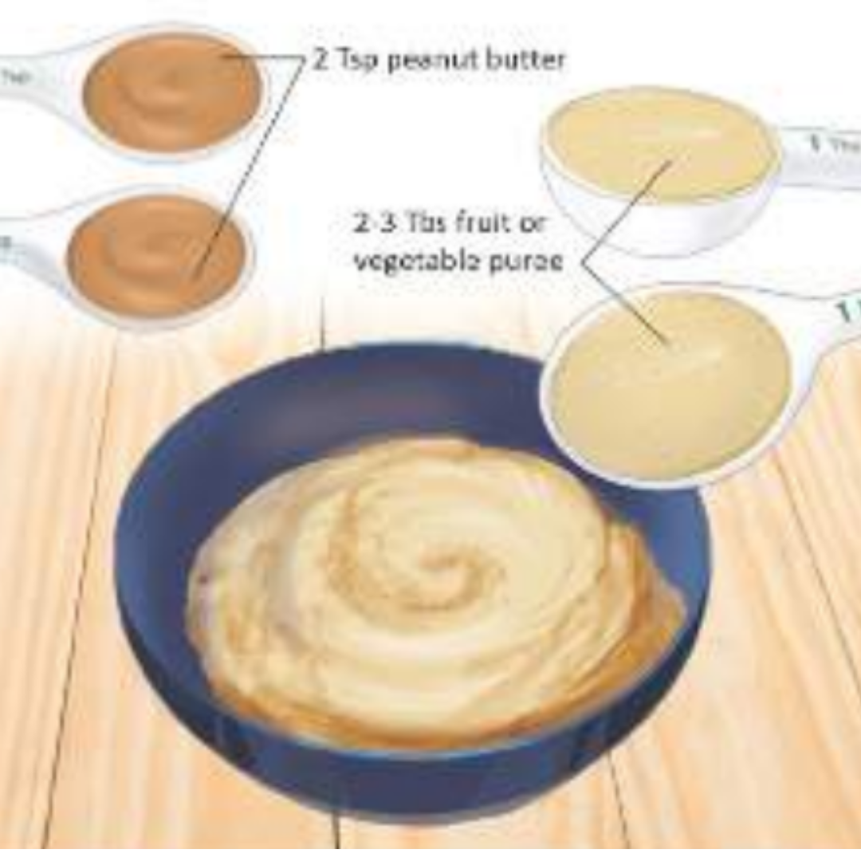
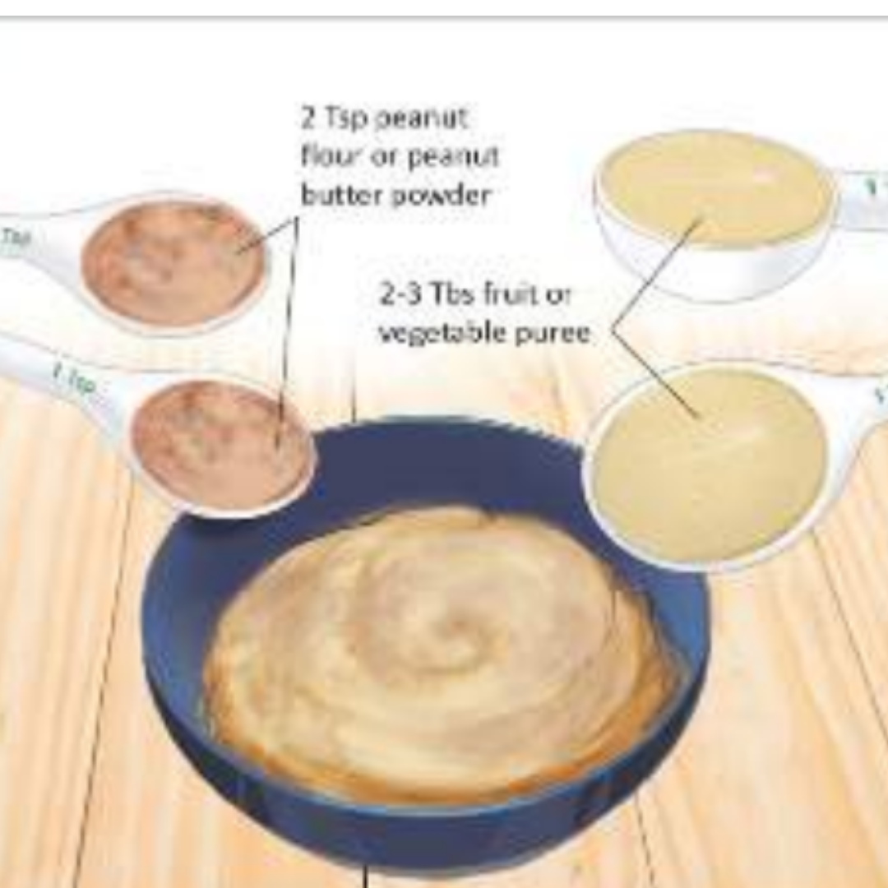
Instructions for Home Feeding of Peanut Protein for Infants at Low Risk of Reaction
Feed a new food only if infant healthy
Give the first peanut feeding at home – not daycare or restaurant
At least 1 adult needs to be able to give 100% attention to infant
Watch for signs of reaction for at least 2 hours after feeding
Prepare full portion, but only serve 1 small bite
Wait 10 minutes
If no initial reaction, slowly give remainder of portion at infant’s usual eating speed
NIAID Addendum Guidelines, 2017
Notes:
The addendum guidelines do provide general instructions for how to introduce peanut at home:
Obviously don’t introduce a new food if baby has a cold, vomiting, diarrhea, or other illness.
First peanut exposure should be at home – not at daycare or a restaurant.
One adult needs to be able to give their full attention to infant – if there are other kids at home, then at different adult needs to be supervising them.
Finally, parents need to be able to watch for signs of a reaction for at least 2 hours after the peanut exposure.
The guidelines include 4 recipes for home peanut introduction, including:
Softened bamba
Diluted smooth peanut butter
Peanut butter with fruit or veggie puree
Peanut flour or peanut butter powder with fruit or veggie puree
*****
Signs of an allergic reaction in infants:
Mild: a new rash, a few hives around the mouth or face
More severe: lip swelling, vomiting, widespread hives over the body, face or tongue swelling, any difficulty breathing, wheezing, repetitive coughing, change in skin color, sudden tiredness/lethargy/seeming limp

Slide 70
Limit unnecessary diet restrictions
Child with eczema eating a food without problems
Child with eczema eating a food without problems
Elevated food specific IgE but continues eating the food
Elevated food specific IgE AND told to avoid that food
TOLERANCE
ALLERGY
Spergel et al., 2015; Eigenmann et al., 2020
Notes:
The final aspect of food allergy prevention really comes down to limiting unnecessary diet restrictions.
This is a good visual to understand the potential harm in trying a diet restriction “just to see” or eliminating a food strictly because of a test result.
Child #1 has eczema. We know that a lot of children with eczema have falsely elevated IgE levels to foods.
So Child #1 is eating a food without problem. For whatever reason, has a positive IgE blood test BUT continues to eat that food. This is TOLERANCE.
Child #2 also with eczema is eating a food without problems. Again, for whatever reason has a positive IgE blood test AND is told to avoid that food.
We KNOW that continued exposure to that food is important for maintaining tolerance.
If they take that food out of their diet, and then are exposed to it down the road, they can actually develop a clinical IgE food allergy and have a reaction. A reaction that would have been 100% avoidable if that food remained in their diet.
While this scenario is possible, it will not happen to everyone in this situation. But we can’t predict who will go on to develop allergy, so we need to be careful to avoid unnecessary diet restrictions, especially in children.
*****
This study concluded that serum IgE levels were not clinically useful for predicting food allergy development in infants with atopic dermatitis. And as a common rule with patients with atopic dermatitis, skin care should be addressed before any allergic workup.

Slide 71
Summary
Food allergy is an immune response to a certain food that causes symptoms with every exposure.
The most important “test” for food allergy diagnosis is clinical history.
Sesame is now a Top 9 Allergen in the United States.
Exciting advancements in recent years with food immunotherapy and Early Intervention Guidelines.
Label reading alone is not enough; food allergy dietitians can help with:
Establishing an individualized avoidance strategy
Finding suitable alternatives and eating outside the home
Supporting adequate nutrition for optimal growth and oral motor skill development.
Notes:
Before we get into a case study, I want to do a quick summary since we covered so much today.
Food allergy is an immune response that causes symptoms with every exposure. With IgE food allergy, past reactions do not guarantee future ones.
The most important “test” for a food allergy diagnosis is the clinical history. And its so important for an allergist to get involved, especially with multiple suspected food allergies.
Thanks to the FASTER Act, sesame is now considered one of the Top 9 Food Allergens in the US.
There have been several exciting advancements in recent years for both food immunotherapies and Early Intervention Guidelines and understanding.
Label reading alone is not enough for food allergy families; referral to an allergy specialist dietitian is key for families and individuals to confidently learn how to manage food allergies.

Slide 72
Resources
Notes:
I want to share a few quick resources first

Slide 73
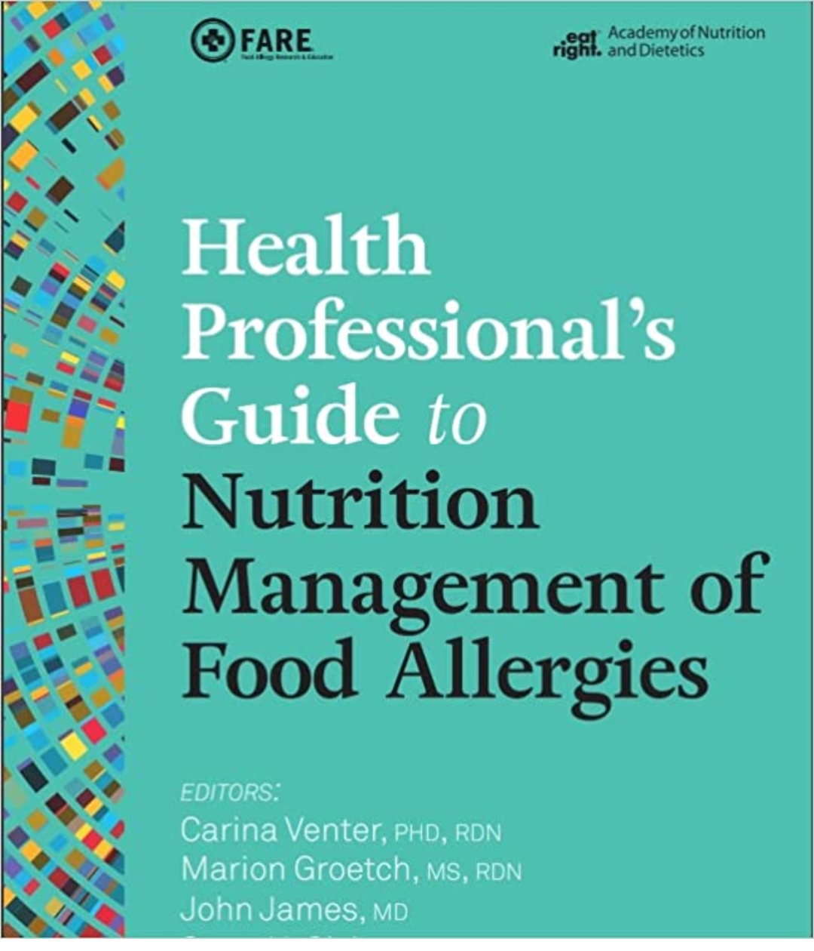
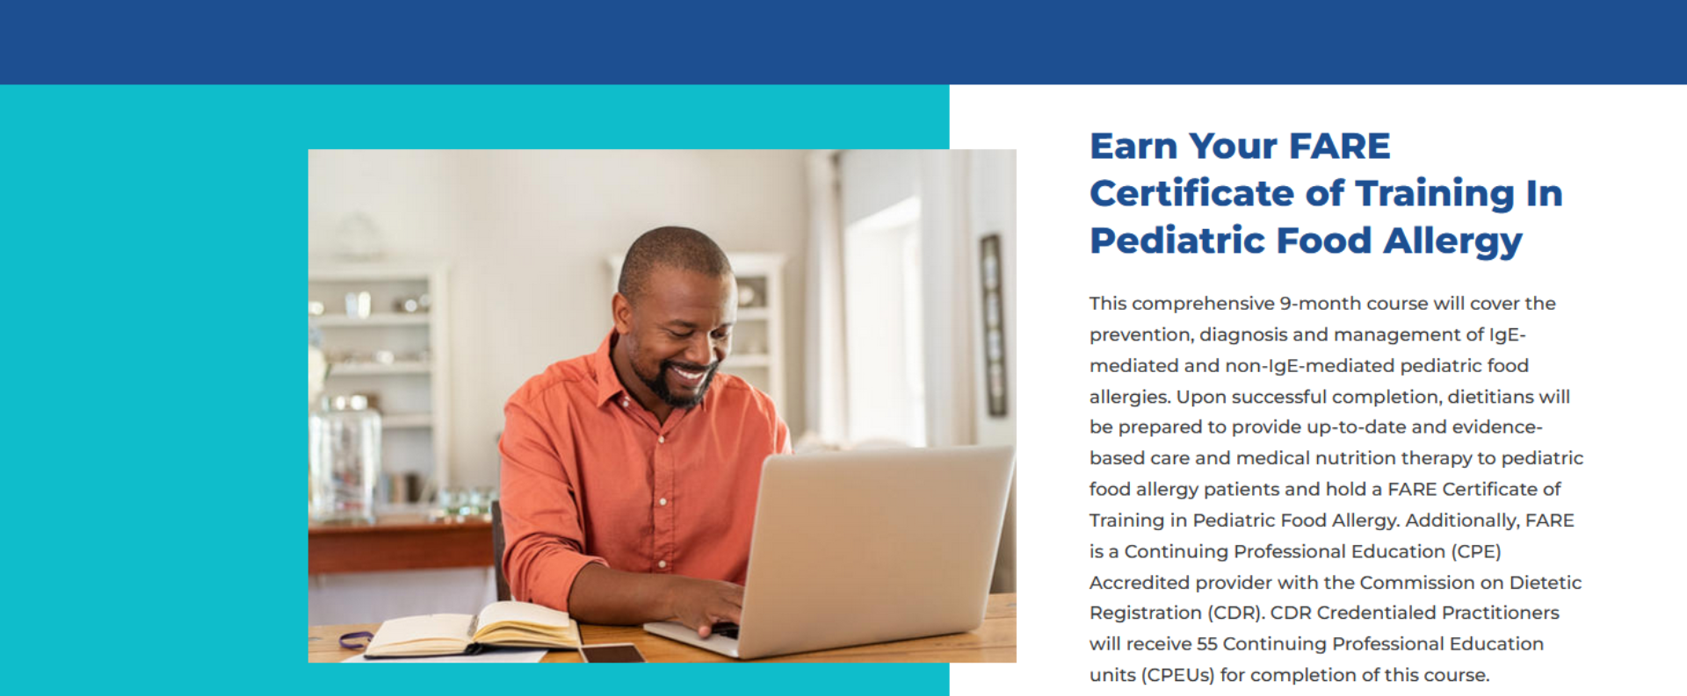
www.foodallergy.org
Coming June 2023
Find a FARE-trained dietitian:
foodallergy.org/resources/fare-trained-registered-dietitians
Notes:
I wanted to highlight a few specific resources here:
FARE has many wonderful FREE CEU opportunities for dietitians at foodallergy.org
Coming this summer, is the Health Professional’s Guide to Nutrition Management of Food Allergies.
And finally, we need more FARE-trained dietitians, especially here in the Midwest. I highly recommend this 9-month course and would be happy to answer any questions about my experience in the program.
Additionally, complex food allergy patients may need to be referred on to a FARE-trained dietitian; you can search for one on the website on the screen.

Slide 74
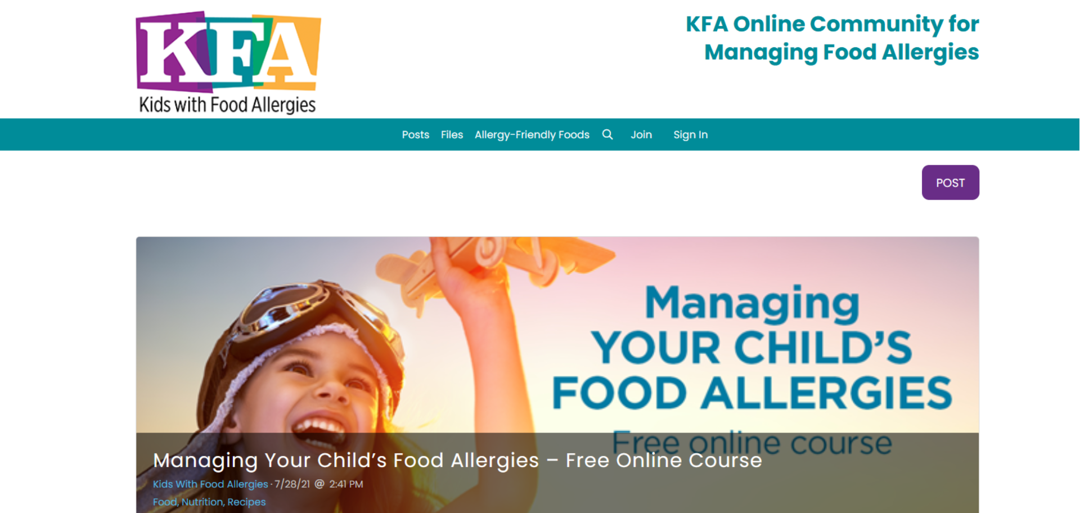
Notes:
Kids with Food Allergies is another great resource; they have a free online course that parents can take to learn more about managing their child’s food allergies.

Slide 75
Food Allergy Case Study

Slide 76
Case Study: 6-month Male
History: mild eczema; natural birth; Dad has eczema + seasonal/cat allergies
Diet: exclusively breastfed, no suspected allergies/ intolerances, just started CF foods (banana, carrot)
Family: lives with Mom, Dad, 2.5yo sister + 4yo brother, family eats peanut butter 1-2x per day
Guideline #2: Mild-moderate eczema introduce peanut-containing foods at ~6 months
When should peanut be introduced?
Illustrations by Olive Phan
© 2022 Lisa Woodruff Nutrition
Notes:
Let’s talk a look at this case study, which in full disclosure – is based on my food allergy child.
Our 6-month male has mild eczema, natural birth, and has a parent with eczema + ragweed and cat allergies
He is exclusively breastfed, no suspected allergies or intolerances, and just started complementary foods – banana and carrot
Lives with parents, older sister and brother. Of note, family eats peanut butter 1-2x per day
Q: Based on his risk/history, when should peanut be introduced?
A: Yes! Based on his mild eczema, he would fall into Guideline #2. Of note, even though it’s not specifically included in the guidelines, having a parent with atopic disease may increase risk for food allergy. And while not specific to peanut, there can be a genetic component to allergies in general

Slide 77
Case Study
Clinical: First exposure to diluted peanut butter; 2 hours since last feeding. No other solids. Develops widespread hives (chin, neck, chest, & back) within 10 minutes.
Pediatrician: prescribes epinephrine auto-injector and encourages Mom to eliminate peanuts while breastfeeding.
Family: eliminates peanuts, peanut butter, and peanut-containing foods from house.
Pets: family verifies dog food is peanut-free and gets rid of all dog treats that contain peanuts as well as dog toys that may have cross contact.
What could have been done differently?
No need for maternal elimination
Training or demo of auto injector
Reconsider peanut-free house (age of sibling ↑ their allergy risk)
Illustrations by Olive Phan
© 2022 Lisa Woodruff Nutrition
Notes:
After discussion with pediatrician, family plans to do at-home peanut introduction. What results is a textbook case of allergic reaction to diluted peanut butter.
Pediatrician prescribes an epi pen and after discussion with mom, encourages Mom to eliminate peanuts while breastfeeding. Frozen supply is deemed “unsafe”
Family eliminates all forms of peanut from the house.
Pet food is peanut-free and family gets rid of all dog toys that may have been in contact with peanut butter treats.
First – what went well?
epinephrine auto-injector
Dog food/treats/toys
What could have been done differently?
No need for maternal diet elimination – prior to oral ingestion, no suspected food allergy and mom was eating peanut butter daily. Which also means frozen supply could have been used.
No training or demonstration of auto injector from clinic or pharmacy
In regards to peanut-free house: since his sister is under 3 and also has eczema/same family history, removing peanuts from her diet could place her at risk for peanut allergy

Slide 78
Case Study: 3 months later
Family: experiments with peanut alternatives; adds peanut exposures x2/week for siblings.
Clinical: Infant has 2 more allergic reactions at 7 months (banana or avocado) & 8 months (scrambled eggs)
Mom request referral to Allergist
Diet: Mom continues breastfeeding; parents scared to introduce new foods. At 9 months eating fruits, vegetables, wheat, oats, & yogurt
Growth: Height-for-age 69th percentile (4m)→ 38th percentile (6m)→ 5th percentile (10m).
What about a referral to a food allergy dietitian?
Allergen labeling + cross contact
Lower risk foods for diet variety
Social support & resources: The Food Allergy Counselor Director
Illustrations by Olive Phan
© 2022 Lisa Woodruff Nutrition
Notes:
3 months later: family is experimenting with peanut butter alternatives in addition to twice weekly peanut exposure for siblings.
However, our patient has 2 more allergic reactions at home, one possibly to banana or avocado or cross contact and the other to scrambled eggs.
Mom is still breastfeeding but extremely anxious and scared to introduce new foods. At nine months, he is eating a handful of fruits and vegetables, in addition to wheat, oats, and occasional yogurt.
On the growth chart, height-for-age has taken a huge drop but weight is relatively the same.
Mom requests referral to see an Allergist
So – do we think a referral to a food allergy dietitian would have helped? YES
Of course allergen labeling and cross contact
Offered reassurance and helped with a plan for introducing lower risk foods and increasing diet variety
Introduced social support and resources, such as The Food Allergy Counselor Directory, which allows people to find food allergy-aware counselors near them
Make sure to add weight-for-age relatively unchanged 65th percentile → 51st percentile → 45th percentile

Slide 79
Case Study
Allergy Consult at 10.5months
Skin Prick Testing (SPT) done:
positive for egg white, egg yolk, peanut
negative for milk, soy, wheat, banana
Emergency Action Plan established for mild and severe reactions.
Instructions to introduce tree nuts at home
“How to read a label…” handout provided for milk-free, egg-free, soy-free, peanut-free, wheat-free, & tree nut-free diets
What about a referral to a food allergy dietitian?
Individualized avoidance strategy
PALs and contacting a company
Increase diet diversity
Additional resources: support groups, kids books or TV shows
Illustrations by Olive Phan
© 2022 Lisa Woodruff Nutrition
Notes:
Finally gets in to Allergist at 10.5 months; skin prick testing done:
Positive for egg white, yolk, and peanut
Negative for milk, soy, wheat, and banana
Emergency Action Plan established – four months after initial reaction
Family encouraged to introduce tree nuts at home
Education consists of a “how to read a label” handout for all the top allergens.
What about a referral to a food allergy dietitian? YES
Individualized avoidance strategy specific to peanut and egg
As well as precautionary labels and how to contact a company
Increasing diet diversity
And additional resources for navigating life with food allergies
*****
SPT: only tested for foods that infant was already exposed to (no blanket testing). Only exception was soy, as infant had never received formula but Allergist wanted to test in case infant needed to switch to formula at any point in the future. At this point in time, there was not a skin prick test readily available for avocado. If a family wanted to test for it, they would need to bring an avocado to next appointment so clinic could make a test solution.

Slide 80
Case Study: 6 months later
Diet: weaned at 16 months; drinking whole milk, increasing food variety
Growth: Height-for-age: 7th percentile (15m) → 15th percentile (18m)
Clinical: Allergic reaction to sprinkles (cross contact), none to accidental baked egg exposure
Oral Food Challenge (OFC) scheduled:
Completed each dose without reaction
Per Allergist, okay to eat baked egg
What about a referral to a food allergy dietitian?
Help prepare for OFC
Education on “baked eggs”
Age-appropriate strategies for safely introducing tree nuts, fish
More resources: Chef cards, navigating daycare or playdates
Illustrations by Olive Phan
© 2022 Lisa Woodruff Nutrition
Notes:
Six months later – patient is now 17 months and has a 6-month allergy follow-up.
Weaned by 16 months, drinking whole milk, and increasing food variety
Height has appeared to stabilize on the growth chart
In the past 6 months, he had an allergic reaction to cross contact from generic sprinkles, but no reaction to accidental ingestion of baked egg
So allergist recommends oral food challenge. Patient completes each dose without reaction, and is given the green light to eat baked egg at home
Things are going well, but how could a food allergy dietitian contributed?
Strategies to prepare a toddler for a food challenge
Post-challenge education on “baked eggs”
Age-appropriate strategies to safely introduce tree nuts and possibly fish
As child is growing, resources on dining out or navigating playdates or daycare with food allergies

Slide 81
Case Study: 6 months later
Diet: “normal” for age; eating pecans & almonds
Clinical: 3 possible allergic reactions to walnuts vs. peanut cross contact
Skin Prick Testing (SPT) done:
positive for peanut (12x18 → 4x4)
negative for egg, walnut, avocado
Oral Food Challenge (OFC) scheduled:
Refused to eat scrambled eggs; did swallow crumbs + ketchup during initial dose
Per Allergist, offer “crumbs” of egg at home
What about a referral to a food allergy dietitian?
Help prepare for OFC
Strategies to incorporate egg
Selective eating with food allergies
Additional resources as needed
Illustrations by Olive Phan
© 2022 Lisa Woodruff Nutrition
Notes:
Patient is now 2 years old and back at Allergist for annual follow-up testing
Diet is “normal” for age and now includes ground pecans and almonds
Concern for 3 possible reactions to Walnut – Allergist thinks this is unlikely as patient eating pecans regularly (you can refer back to cross reactivity chart)
Skin prick testing comes back negative for walnut, but also egg and avocado
Positive for peanut, but wheel has significantly decreased; if trend continues may be eligible for food challenge in 1-2 years
Allergist does want to challenge egg to confirm patient has developed natural tolerance
This challenge does not go as smoothly as the last one. Toddler refused to eat scrambled egg – who can blame him; first exposure to that consistency – BUT did swallow some crumbs smothered in ketchup during first dose.
Allergist says to continue “crumbs” of egg at home
And how could a food allergy dietitian helped?
Helped family prepare for OFC – maybe worked with Allergist to find different vehicle for challenge
Strategies to help family incorporate egg and navigate selective eating with food allergies
*****
SPT: emphasize there is no threshold for food allergy diagnosis from SPT or blood work. However, if test results are trending up or down may influence an Allergist’s decision to try an oral food challenge

Slide 82
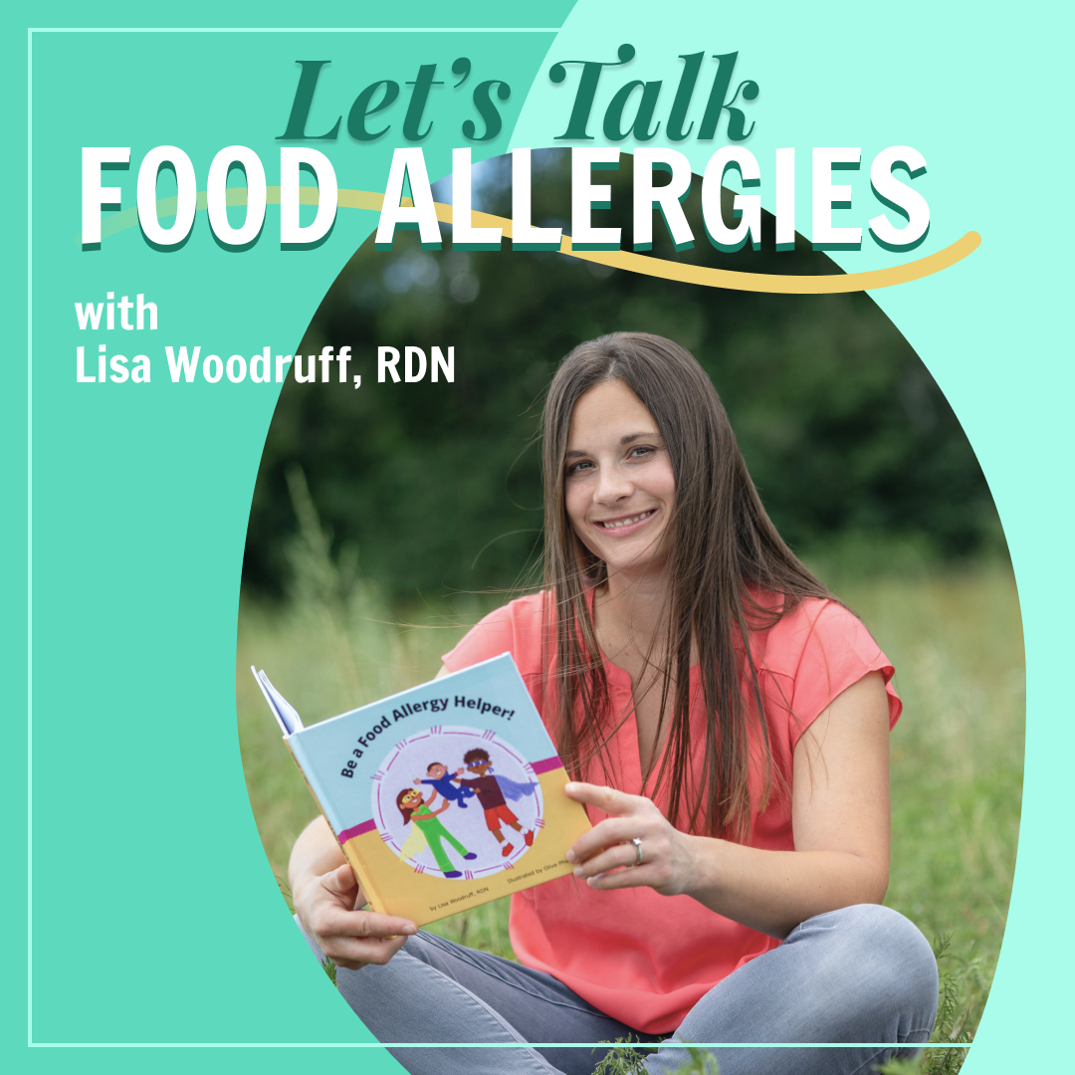
Questions?
hello@lisawoodruffnutrition.com
@allergy.friendly.nutrition
@beafoodallergyhelper

Slide 83
References
“AAAAI Work Group Report:” Bird JA, Leonard S, Groetch M, et al. Conducting an Oral Food Challenge: An Update to the 2009 Adverse Reactions to Foods Committee Work Group Report. J Allergy Clin Immunol Pract. 2020;8(1):75-90.e17. doi:10.1016/j.jaip.2019.09.029
Clark S, Espinola J, Rudders SA, Banerji A, Camargo CA Jr. Frequency of US emergency department visits for food-related acute allergic reactions. J Allergy Clin Immunol. 2011;127(3):682-683. doi:10.1016/j.jaci.2010.10.040
Cox AL, Eigenmann PA, Sicherer SH. Clinical Relevance of Cross-Reactivity in Food Allergy. J Allergy Clin Immunol Pract. 2021;9(1):82-99. doi:10.1016/j.jaip.2020.09.030
Du Toit G, Roberts G, Sayre PH, et al. Randomized trial of peanut consumption in infants at risk for peanut allergy [published correction appears in N Engl J Med. 2016 Jul 28;375(4):398]. N Engl J Med. 2015;372(9):803-813. doi:10.1056/NEJMoa1414850
Durban R, Groetch M, Meyer R, et al. Dietary Management of Food Allergy. Immunol Allergy Clin North Am. 2021;41(2):233-270. doi:10.1016/j.iac.2021.01.009
Eigenmann PA, Beyer K, Lack G, et al. Are avoidance diets still warranted in children with atopic dermatitis?. Pediatr Allergy Immunol. 2020;31(1):19-26. doi:10.1111/pai.13104
Ford LS, Taylor SL, Pacenza R, Niemann LM, Lambrecht DM, Sicherer SH. Food allergen advisory labeling and product contamination with egg, milk, and peanut. J Allergy Clin Immunol. 2010;126(2):384-385. doi:10.1016/j.jaci.2010.05.034
Gamirova A, Berbenyuk A, Levina D, et al. Food Proteins in Human Breast Milk and Probability of IgE-Mediated Allergic Reaction in Children During Breastfeeding: A Systematic Review. J Allergy Clin Immunol Pract. 2022;10(5):1312-1324.e8.

Slide 84
References
Groetch M, Baker MG, Durban R, Meyer R, Venter C, Muraro A. The practical dietary management of food protein-induced enterocolitis syndrome. Ann Allergy Asthma Immunol. 2021;127(1):28-35.
Gupta RS, Warren CM, Smith BM, Blumenstock JA, Jiang J, Davis MM, Nadeau KC. The Public Health Impact of Parent-Reported Childhood Food Allergies in the United States. Pediatrics. 2018 Dec;142(6):e20181235. doi: 10.1542/peds.2018-1235. Epub 2018 Nov 19. Erratum in: Pediatrics. 2019 Mar;143(3): PMID: 30455345; PMCID: PMC6317772.
Keet CA, Savage JH, Seopaul S, Peng RD, Wood RA, Matsui EC. Temporal trends and racial/ethnic disparity in self-reported pediatric food allergy in the United States. Ann Allergy Asthma Immunol. 2014;112(3):222-229.e3. doi:10.1016/j.anai.2013.12.007
Kelso JM. Unproven Diagnostic Tests for Adverse Reactions to Foods. J Allergy Clin Immunol Pract. 2018;6(2):362-365. doi:10.1016/j.jaip.2017.08.021
Maciag MC, Herbert LJ, Sicherer SH, et al. The Psychosocial Impact of Food Protein-Induced Enterocolitis Syndrome. J Allergy Clin Immunol Pract. 2020;8(10):3508-3514.e5. doi:10.1016/j.jaip.2020.06.011
Merritt RJ, Fleet SE, Fifi A, et al. North American Society for Pediatric Gastroenterology, Hepatology, and Nutrition Position Paper: Plant-based Milks. J Pediatr Gastroenterol Nutr. 2020;71(2):276-281. doi:10.1097/MPG.0000000000002799
Meyer R, Groetch M, Venter C. When Should Infants with Cow's Milk Protein Allergy Use an Amino Acid Formula? A Practical Guide. J Allergy Clin Immunol Pract. 2018;6(2):383-399.
Meyer R, Wright K, Vieira MC, et al. International survey on growth indices and impacting factors in children with food allergies. J Hum Nutr Diet. 2019;32(2):175-184.

Slide 85
References
National Academies of Sciences, Engineering, and Medicine; Health and Medicine Division; Food and Nutrition Board; Committee on Food Allergies: Global Burden, Causes, Treatment, Prevention, and Public Policy, Oria MP, Stallings VA, eds. Finding a Path to Safety in Food Allergy: Assessment of the Global Burden, Causes, Prevention, Management, and Public Policy. Washington (DC): National Academies Press (US); November 30, 2016.
“NIAID Guidelines:” Boyce JA, Assa'ad A, Burks AW, Jones SM, Sampson HA, Wood RA, Plaut M, Cooper SF, Fenton MJ, Arshad SH, Bahna SL, Beck LA, Byrd-Bredbenner C, Camargo CA Jr, Eichenfield L, Furuta GT, Hanifin JM, Jones C, Kraft M, Levy BD, Lieberman P, Luccioli S, McCall KM, Schneider LC, Simon RA, Simons FE, Teach SJ, Yawn BP, Schwaninger JM. Guidelines for the diagnosis and management of food allergy in the United States: summary of the NIAID-sponsored expert panel report. Nutr Res. 2011 Jan;31(1):61-75. doi: 10.1016/j.nutres.2011.01.001. PMID: 21310308; PMCID: PMC4249938.
“NIAID Addendum Guidelines:” Togias A, Cooper SF, Acebal ML, Assa’ad A, Baker JR Jr, Beck LA, Block J, Byrd-Bredbenner C, Chan ES, Eichenfield LF, Fleischer DM, Fuchs GJ III, Furuta GT, Greenhawt MJ, Gupta RS, Habich M, Jones SM, Keaton K, Muraro A, Plaut M, Rosenwasser LJ, Rotrosen D, Sampson HA, Schneider LC, Sicherer SH, Sidbury R, Spergel J, Stukus DR, Venter C, Boyce JA. Addendum guidelines for the prevention of peanut allergy in the United States: Report of the National Institute of Allergy and Infectious Diseases–sponsored expert panel. World Allergy Organ J. 2017 Jan 6;10(1):1. doi: 10.1186/s40413-016-0137-9. PMCID: PMC5217343.
Nowak-Węgrzyn A, Chehade M, Groetch ME, et al. International consensus guidelines for the diagnosis and management of food protein-induced enterocolitis syndrome: Executive summary-Workgroup Report of the Adverse Reactions to Foods Committee, American Academy of Allergy, Asthma & Immunology. J Allergy Clin Immunol. 2017;139(4):1111-1126.e4.

Slide 86
References
Sampson HA, Aceves S, Bock SA, et al. Food allergy: a practice parameter update-2014. J Allergy Clin Immunol. 2014;134(5):1016-25.e43. doi:10.1016/j.jaci.2014.05.013
Sicherer SH, Sampson HA. Food allergy: A review and update on epidemiology, pathogenesis, diagnosis, prevention, and management. J Allergy Clin Immunol. 2018;141(1):41-58. doi:10.1016/j.jaci.2017.11.003
Spergel JM, Boguniewicz M, Schneider L, Hanifin JM, Paller AS, Eichenfield LF. Food Allergy in Infants With Atopic Dermatitis: Limitations of Food-Specific IgE Measurements. Pediatrics. 2015;136(6):e1530-e1538. doi:10.1542/peds.2015-1444
Vadas P, Wai Y, Burks W, Perelman B. Detection of peanut allergens in breast milk of lactating women. JAMA. 2001;285(13):1746-1748.
Vassilopoulou E, McMilin C, Venter C. Mediterranean Milk Ladder: Integrating a Healthy Eating Plan While Reintroducing Cow's Milk. Children (Basel). 2023;10(2):234. Published 2023 Jan 28. doi:10.3390/children10020234
Venter C, Brown T, Meyer R, Walsh J, Shah N, Nowak-Węgrzyn A, Chen TX, Fleischer DM, Heine RG, Levin M, Vieira MC, Fox AT. Better recognition, diagnosis and management of non-IgE-mediated cow's milk allergy in infancy: iMAP-an international interpretation of the MAP (Milk Allergy in Primary Care) guideline. Clin Transl Allergy. 2017 Aug 23;7:26. doi: 10.1186/s13601-017-0162-y. Erratum in: Clin Transl Allergy. 2018 Jan 25;8:4. PMID: 28852472; PMCID: PMC5567723.
Warren CM, Chadha AS, Sicherer SH, Jiang J, Gupta RS. Prevalence and Severity of Sesame Allergy in the United States. JAMA Netw Open. 2019;2(8):e199144.
Warren CM, Turner PJ, Chinthrajah RS, Gupta RS. Advancing Food Allergy Through Epidemiology: Understanding and Addressing Disparities in Food Allergy Management and Outcomes. J Allergy Clin Immunol Pract. 2021;9(1):110-118. doi:10.1016/j.jaip.2020.09.064

