Slide 1

HEALING CHRONIC DIETING, EMOTIONAL EATING, AND BODY SHAME
WHAT EVERY DIETITIAN NEEDS TO KNOW
Judith MatZ, LCSW
www.judithmatz.com @judmatz

Slide 2
UNDERSTANDING THE
PROBLEM

Slide 3
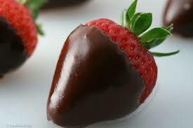
OUR CLIENTS
Binge Eating Disorder
Rebound Eating
Chronic Dieting
Emotional Eating
Diet Mindset
“I Want To Lose Weight”

Slide 4
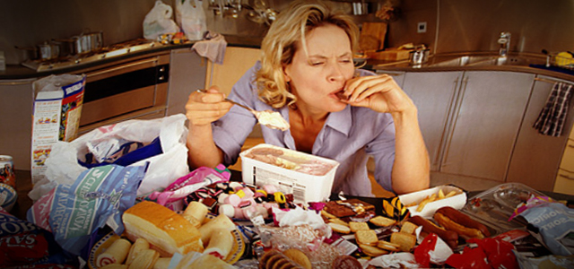
WHAT IS BED?
Recurrent episodes of binge eating; at least once/week for 3 months
Eating more than most people would in a discrete period of time
A sense of lack of control over the binge episode.
Three or more of the Following:
Eating rapidly
Eating large amounts of food when
not physically hungry
Eating until uncomfortably full
Eating alone because of embarrassment over quantity eaten
Feeling disgusted, depressed, or very guilty after eating

Slide 5
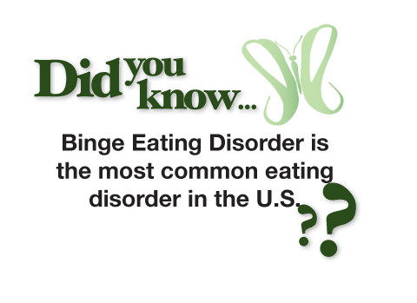
WHY THE DSM V MATTERS
Validates that BED is a “real thing.”
Insurance coverage for people seeking treatment
NOT THE SAME AS “OBESITY”

Slide 6
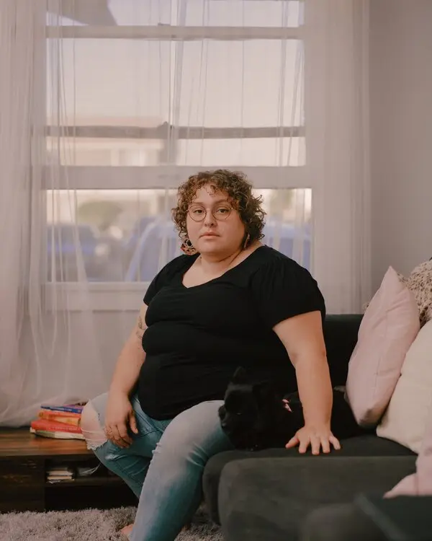

ATYPICAL ANOREXIA
‘YOU DON’T LOOK ANOREXIC’
New research shows our assumptions about eating disorders are wrong—and that many larger-bodied people are starving themselves. (NYTimes Magazine, 10/18/22)

Slide 7
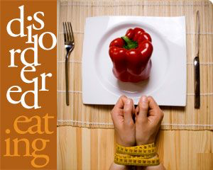
SUB-CLINICAL DISORDERED EATING PATTERNS
Skipping meals
Over-exercising
Fasting
Eliminating Food Groups (without a medical reason)
Disconnected From Hunger/Fullness
Eating to Discomfort
Rigidity (Orthorexia)
Dieting
Guilt

Slide 8
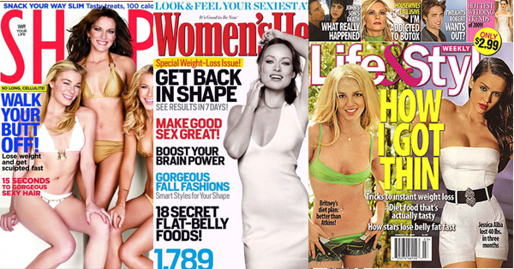
THE CULTURAL BACKDROP

Slide 9
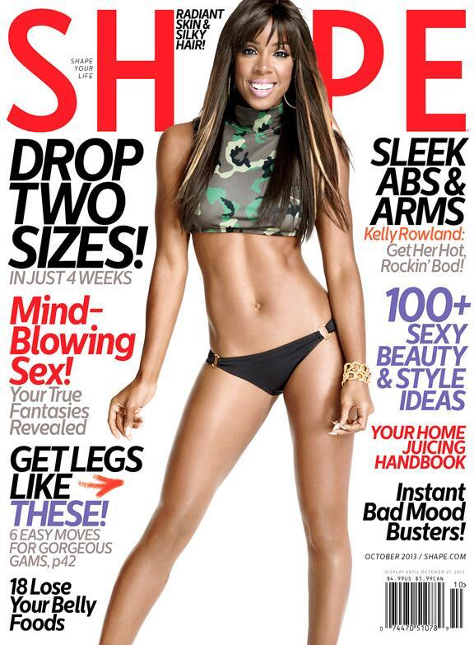
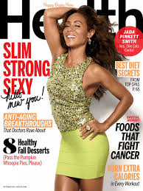
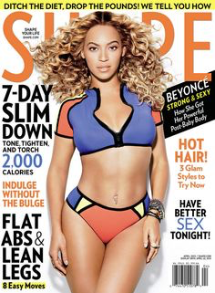
THE CULTURAL BACKDROP

Slide 10
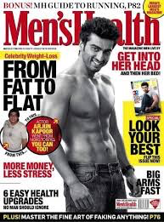
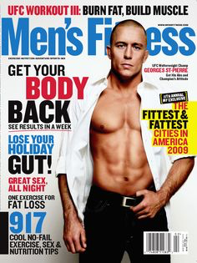
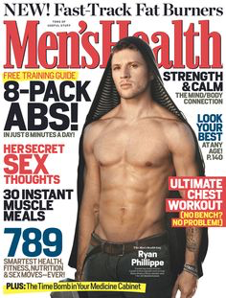
THE CULTURAL BACKDROP

Slide 11
WHAT’S NEW THIS YEAR?

Slide 12
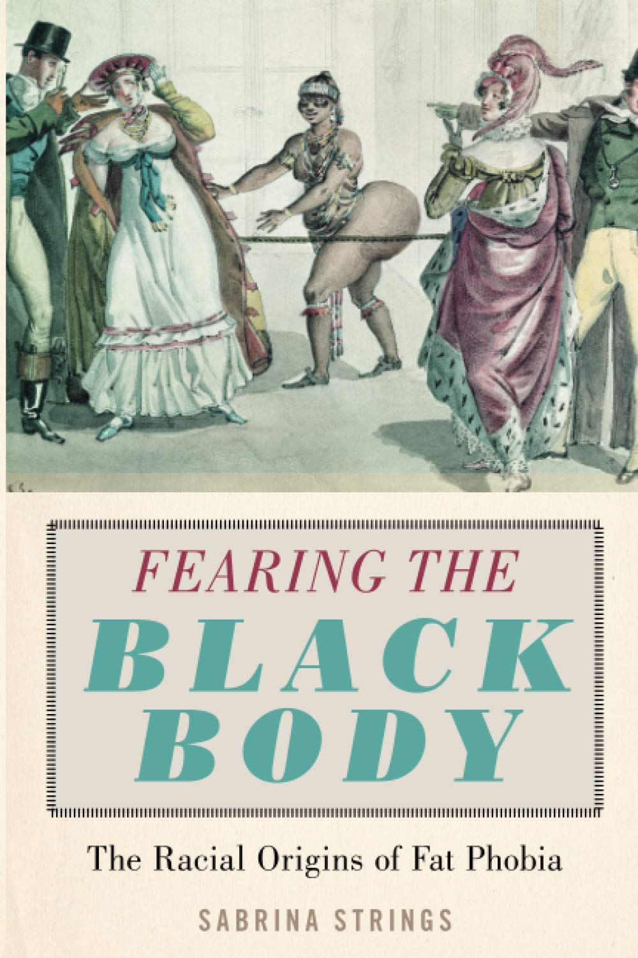
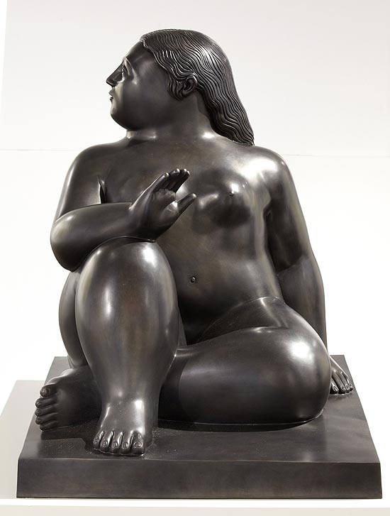
CULTURAL SUBJECTIVITY
Agricultural versus industrial economy
King Henry the Eighth and Oprah Winfrey effect
Cross-Cultural Perspective
Art museums
Racism: Fearing The Black Body by Sabrina Strings
“Ideals, by definition, are modeled on rare qualities…if and when, by artificial methods, the majority can squeeze into the ideal, the ideal changes. If it were attainable, what good would it be?” Charisse Goodman

Slide 13

VOGUE INTRODUCES TWIGGY
“Twiggy is called Twiggy because she looks as though a strong gale would snap her in two and dash her to the grounds.”

Slide 14
WHAT ARE THE MESSAGES?
“Become the woman every woman hates.”

Slide 15
WHAT ARE THE CONTRADICTIONS?

Slide 16
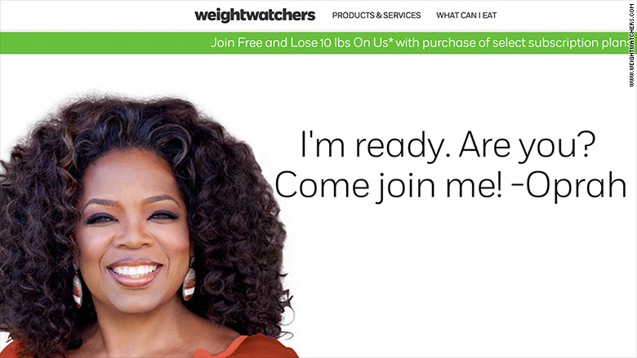
WHAT DOES EMPOWERMENT
LOOK LIKE?

Slide 17
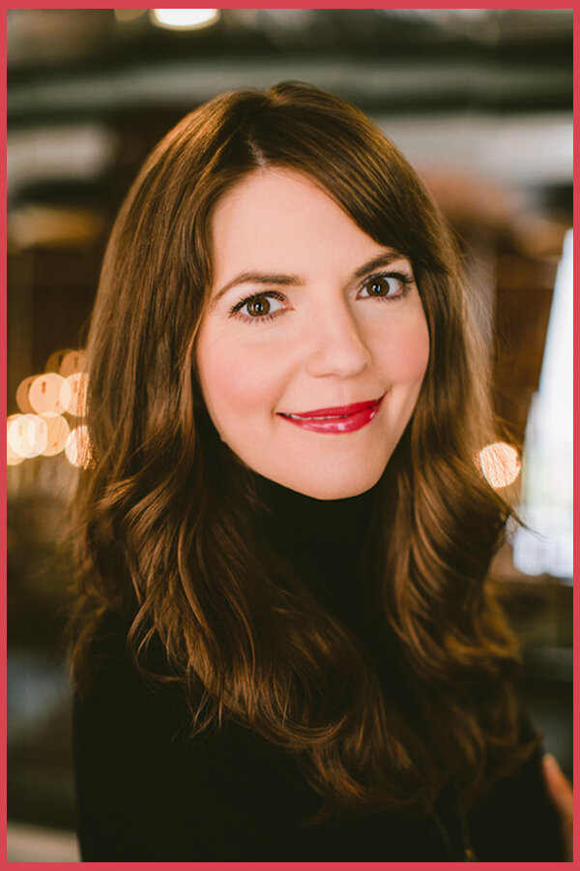
DIET CULTURE DEFINITION
Worships thinness and equates it to health and moral virtue, which means you can spend your whole life thinking you’re irreparably broken just because you don’t look like the impossibly thin ”ideal.”
Promotes weight loss as a means of attaining higher status, which means you feel compelled to spend a massive amount of time, energy, and money trying to shrink your body, even though the research is very clear that almost no one can sustain intentional weight loss for more than a few years.
Demonizes certain ways of eating while elevating others, which means you’re forced to be hyper-vigilant about your eating, ashamed of making certain food choices, and distracted from your pleasure, your purpose, your power.
Oppresses people who don’t match up with its supposed picture of “health,” which disproportionately harms women, femmes, trans folks, people in larger bodies, people of color, and people with disabilities, damaging both their mental and physical health.
My Definition of Diet Culture, Christy Harrision, www.christyharrison.com

Slide 18

DIET CULTURE AND
THE WELLNESS INDUSTRY
“The diet industry is a virus, and viruses are smart. It has survived all these decades by adapting, but it’s as dangerous as ever. In 2019, dieting presents itself as wellness and clean eating, duping modern feminists to participate under the guise of health. Wellness influencers attract sponsorships and hundreds of thousands of followers on Instagram by tying before and after selfies to inspiring narratives. Go from sluggish to vibrant, insecure to confident, foggy-brained to cleareyed. But when you have to deprive, punish and isolate yourself to look ‘good’ it is impossible to feel good. I was my sickest and loneliest when I appeared my healthiest.” -----Smash the Wellness Industry, Jessica Knoll, NYTimes, June 2019

Slide 19
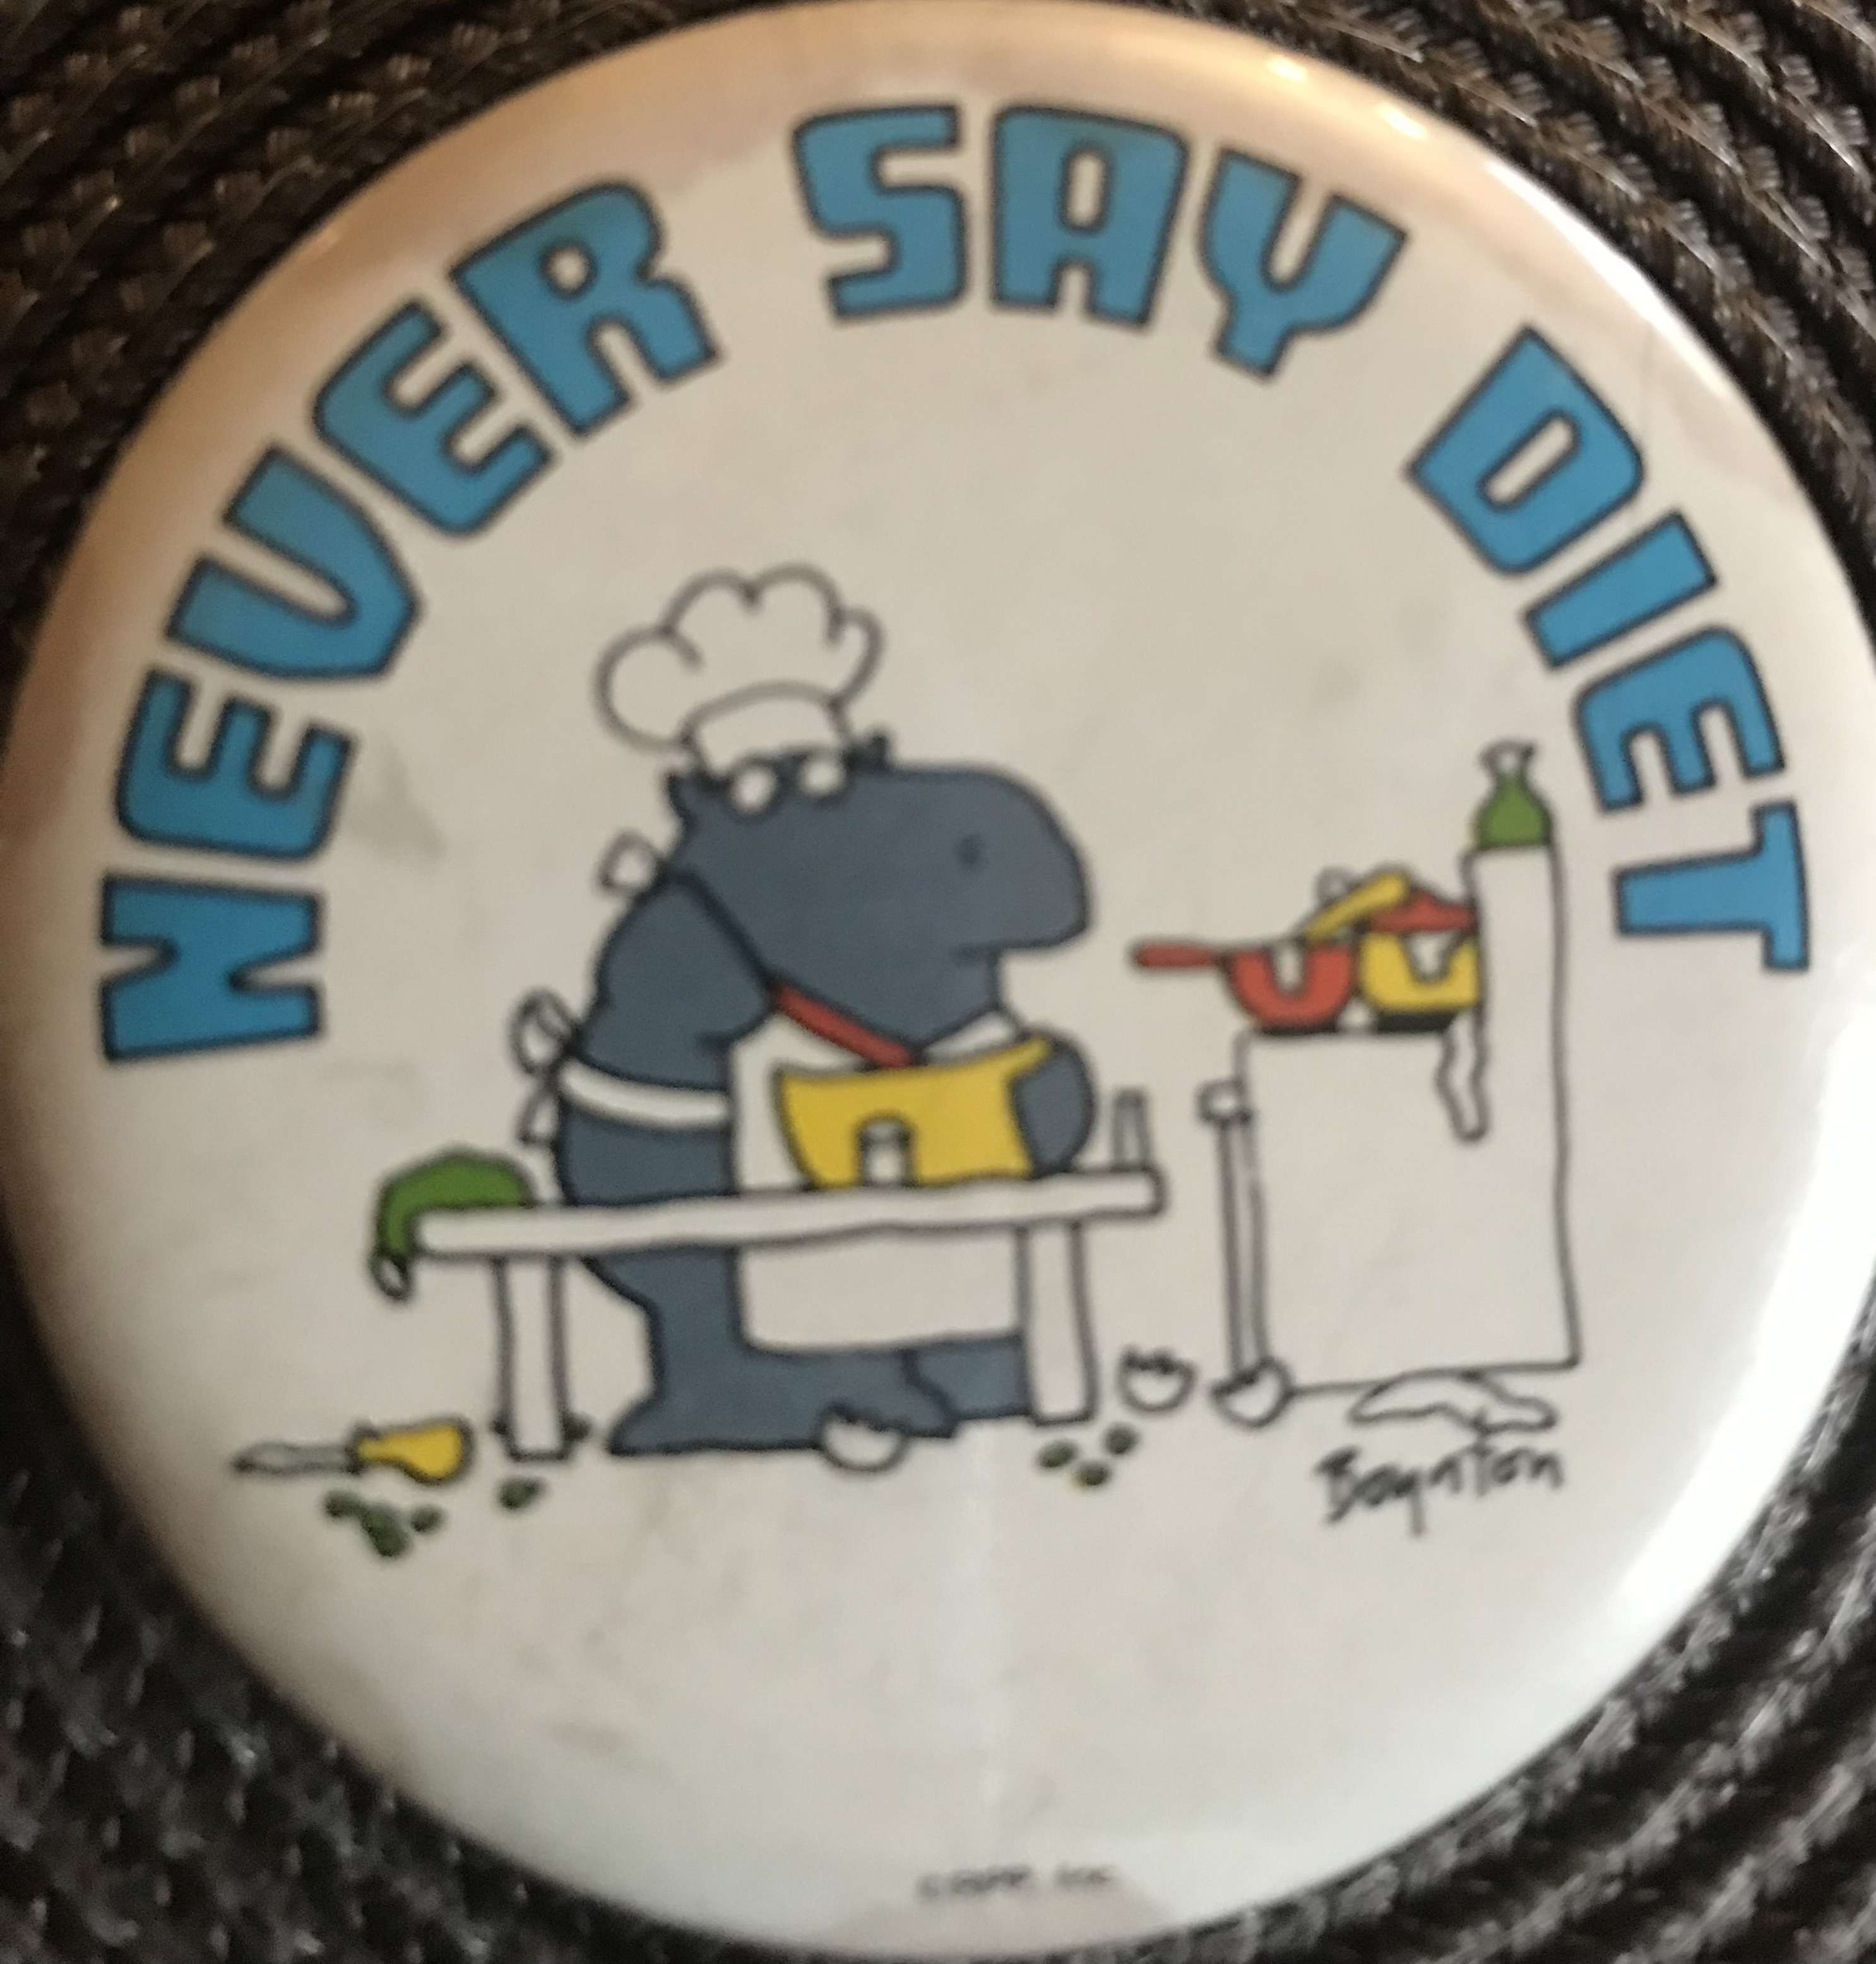
WHAT IS A DIET?
Any time a person manipulates food for the purpose of weight loss, they are on a diet.

Slide 20
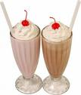
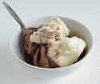
DEPRIVATION
The Milk Shake Study
Restrained vs. non-restrained eaters
“I’ve blown it anyway so I might as well keep eating before I go back on my diet.”

Slide 21

UNDERSTANDING DIET FAILURE
WHAT WE’VE KNOWN FOR DECADES
Minnesota Starvation Study
Albert Stunkard (1958) “Most obese persons will not stay
in the treatment of obesity. Of those who stay in treatment
most will not lose the weight and of those who do lose
the weight, most will regain it.
1992 NIH Panel Review

Slide 22
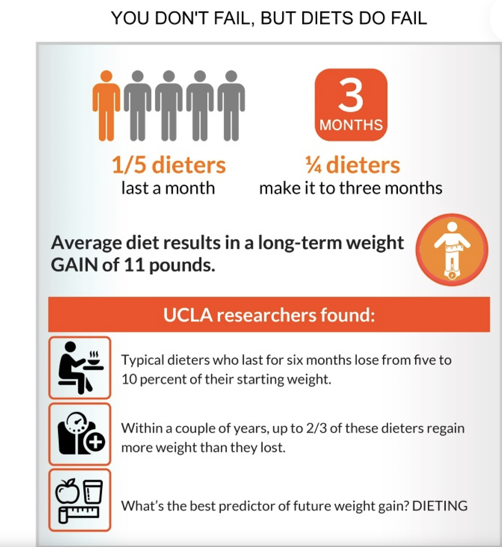
UNDERSTANDING DIET FAILURE
WHAT WE’VE LEARNED MORE RECENTLY
Tracy Mann (2007) Meta-analysis of weight loss studies: weight reaches lowest point
around 6 months, then starts increasing at about one year, after which weight
regain speeds up over time; 1/3 – 2/3’s of dieters end up higher than pre-diet weight.
Alison Fildes (2015): A study of 278,000 people found that, within 5 years, the
probability of regaining all of their lost weight is between 95 – 98 percent.
“A small percentage of dieters – something like 5 percent – can do it. And they do do it.
But they do it by devoting every minute of their life to staying at that weight. Basicallly,
they spend their entire life living like a starving person, fighting biology, and evolution.
And to me, that seems wrong.” (T. Mann, Secrets from the Eating Lab)

Slide 23
The Pink Elephant

Slide 24
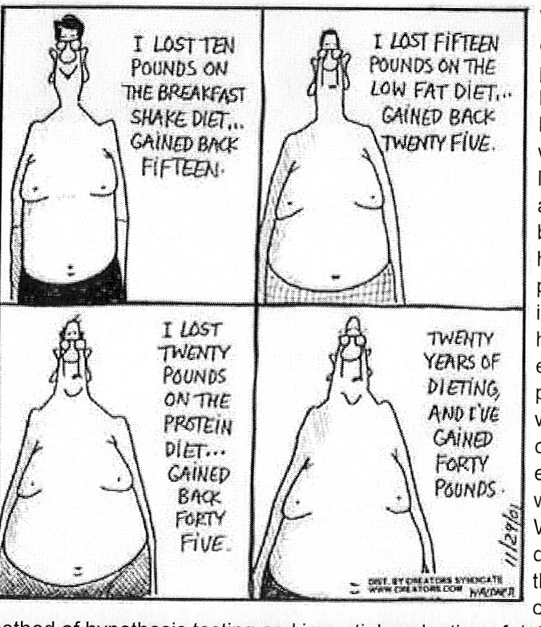
WHY DIETS FAIL
Genetics
Evolution
Adaptation
“A number of studies have shown the inescapable consequences of repetitious cycles of weight loss and gain appears to be even greater accumulations of fat.”
Glenn Gaesser, author of Big Fat Lies
Notes:
Genetics – twin study
Evolution = feast or famine – who survived
Adaptation – set point – read Linda’s quote

Slide 25
THE DIET CYCLE
Negative Thoughts
Diet
(Restrictions)
Deprivation
Rebound/Binge Eating
Shame
Notes:
Kendra: I’ve done every program and approach out there, too many to even list. I feel like I have some kind of mental block – I know exactly what to do to lose weight, I just feel so overwhelmed and discouraged to be at this current weight that I cannot even bring myself to do anything, except for eating all the wrong things, which makes me feel worse, which makes me eat more, and so on. I feel like I am dying on the inside and the outside and that I will never be successful at this. My weight haunts me every minute of every day. It makes me sick to even type these words because I feel like a broken record. I have tried everything except for therapy and I really hope that you can help.

Slide 26
IMPLEMENTING TREATMENT

Slide 27
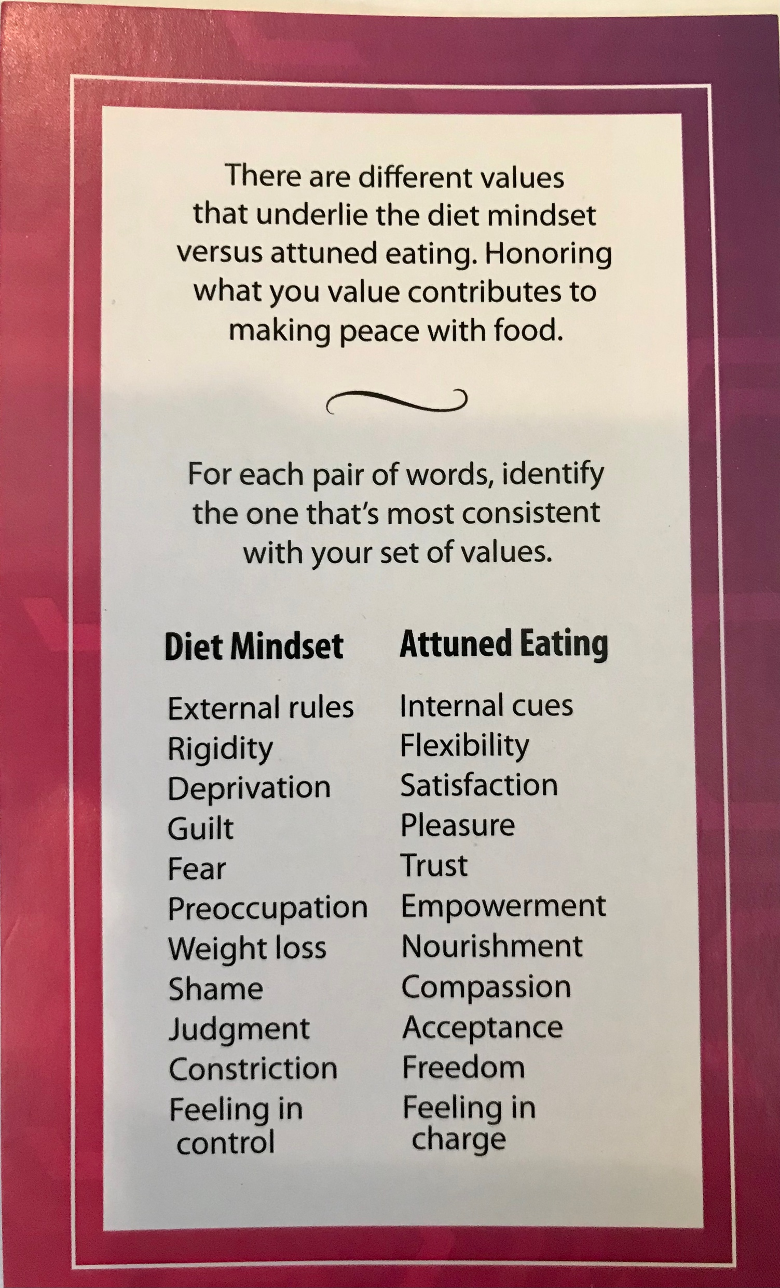
THE DIET MINDSET VS.
ATTUNED EATING
When hungry eat your rice, when
tired close your eyes. Fools may laugh
at me but wise men will know what I mean.”
--Lin-Chi

Slide 28
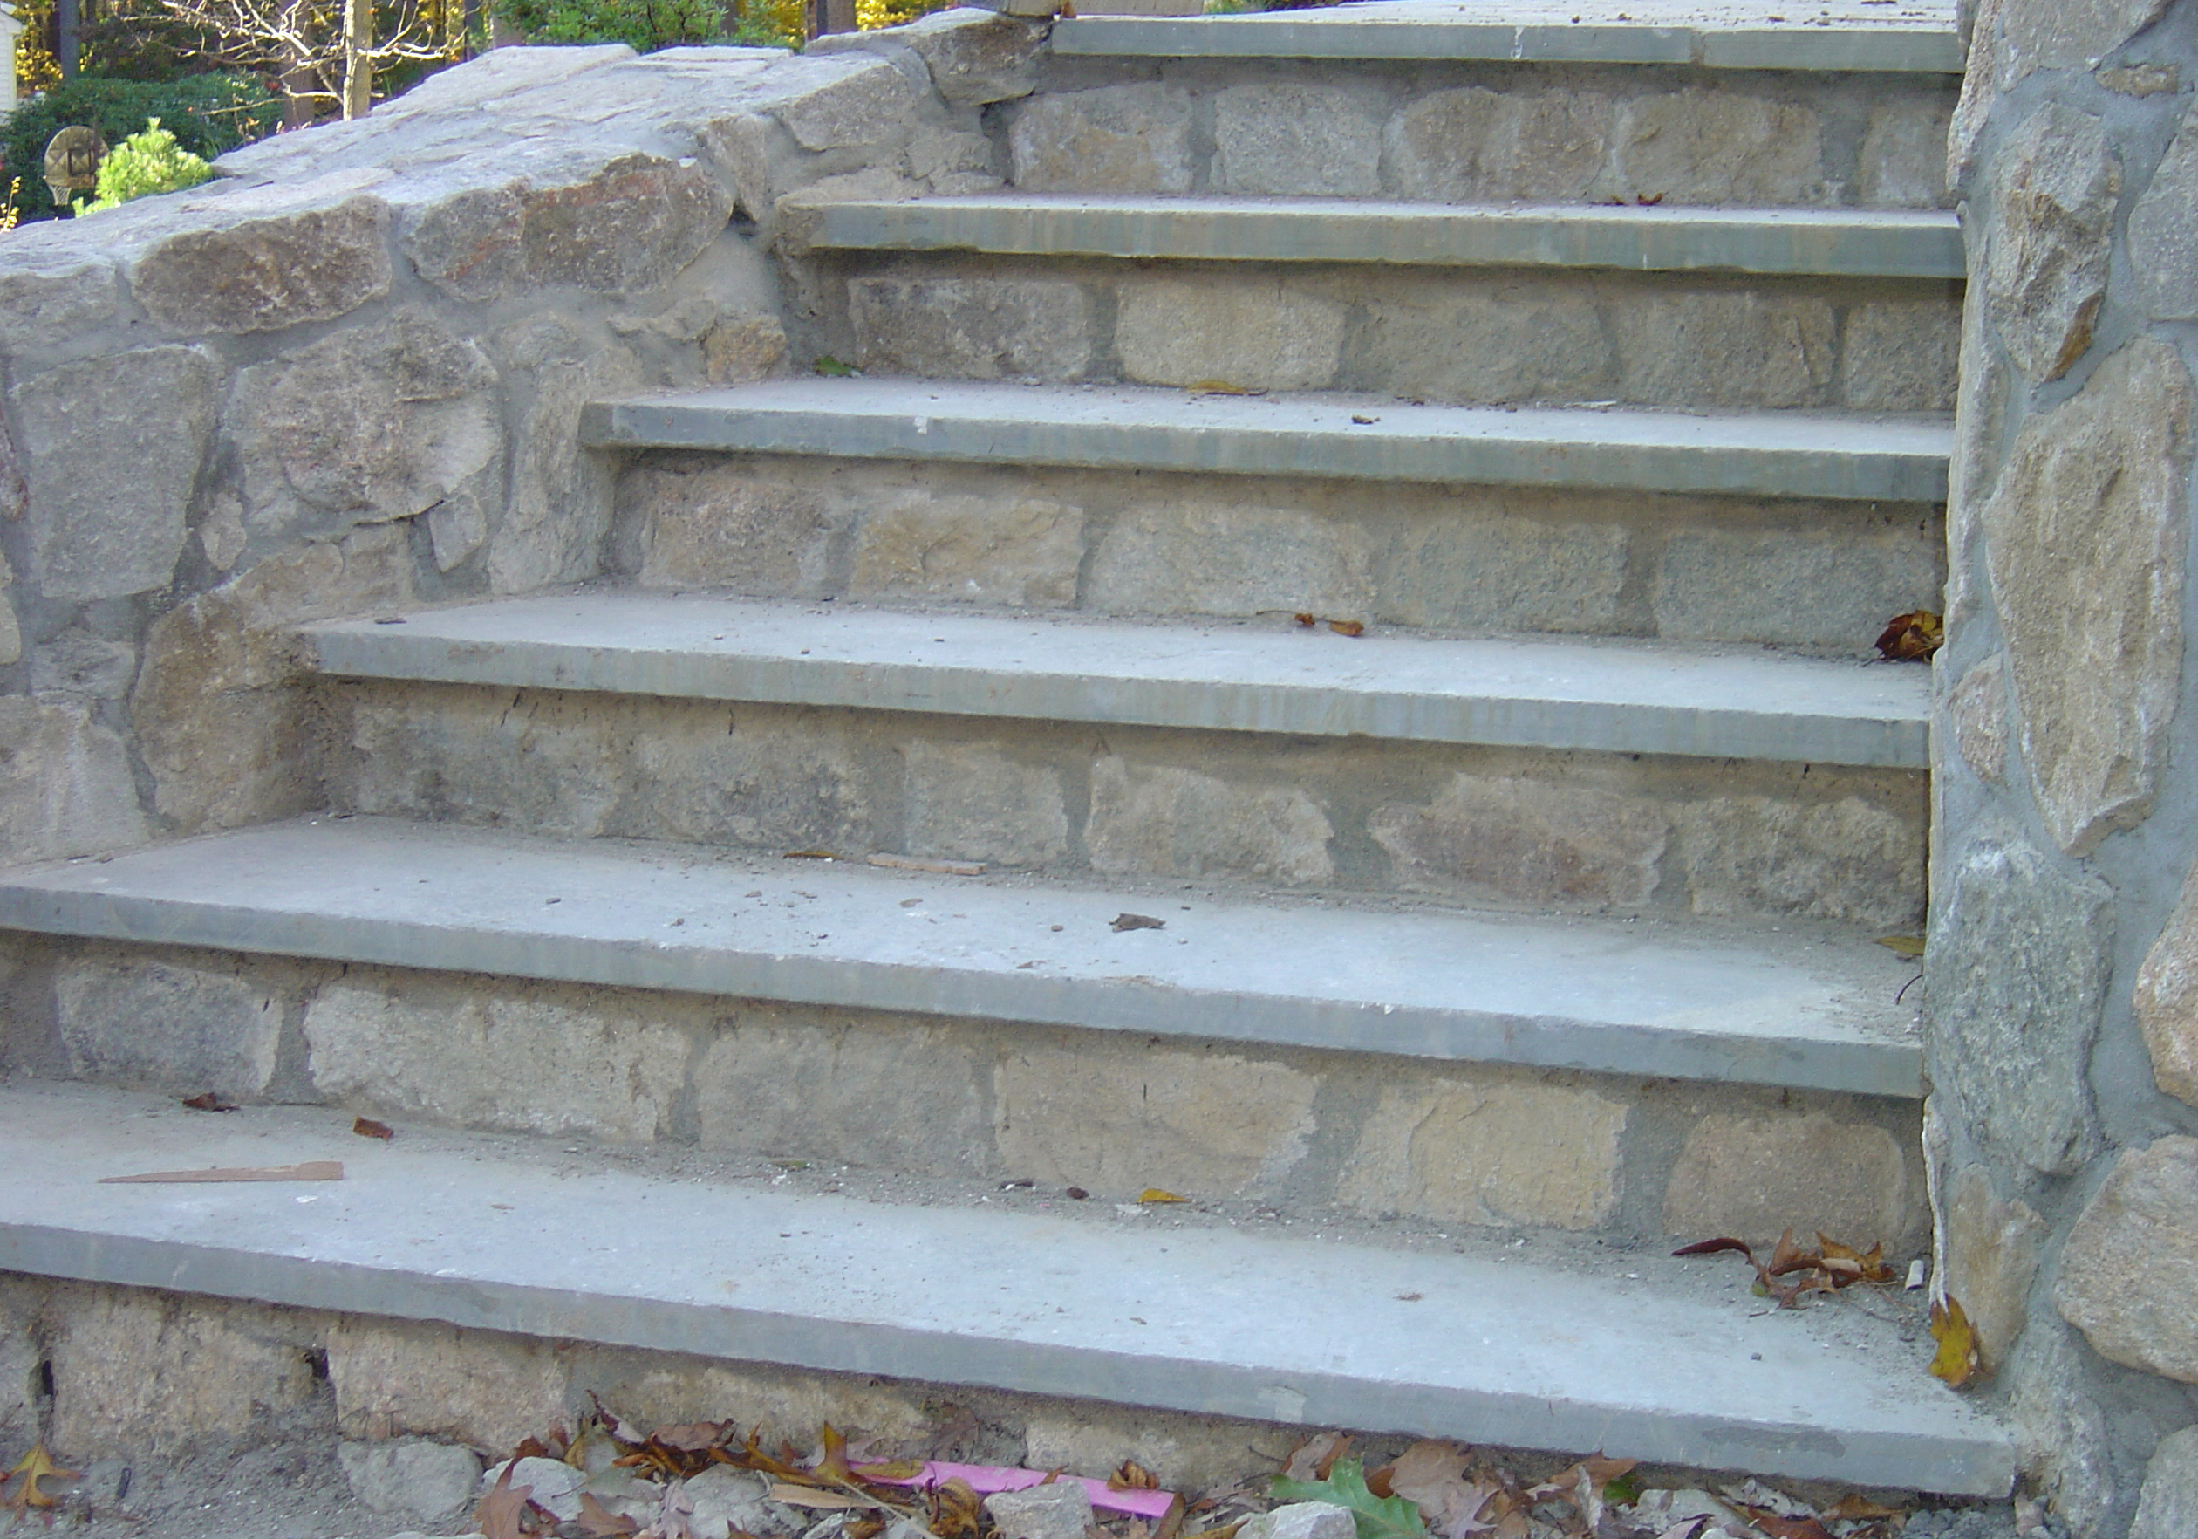
LEARN THE STEPS OF ATTUNED EATING
Do you know when you’re hungry?
Do you eat what you’re hungry for, choosing from a wide variety of foods?
Do you stop eating when
you’re full/satisfied?

Slide 29
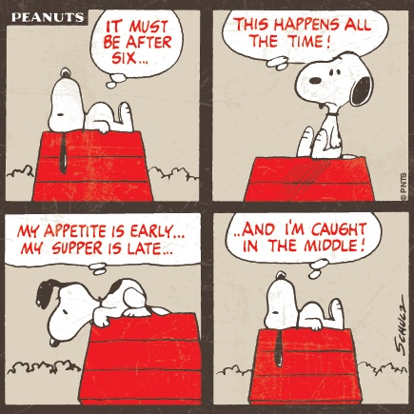
WHEN
1) Ravenous
2) Very Hungry
3) Hungry
4) Somewhat Hungry
5) Not Hungry/Not Full
6) Somewhat Full
7) Full
8) Very Full
9) Stuffed
(From Beyond a Shadow of a Diet, 2nd edition p. 82)

Slide 30
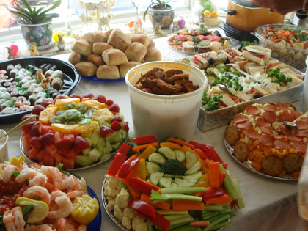
WHAT
Hot
Cold
Crunchy
Mushy
Smooth
Salty
Spicy
Sweet
Bland
Protein
Carbohydrate
Fat
(from Beyond a Shadow of a Diet, 2nd edition, p. 90)

Slide 31
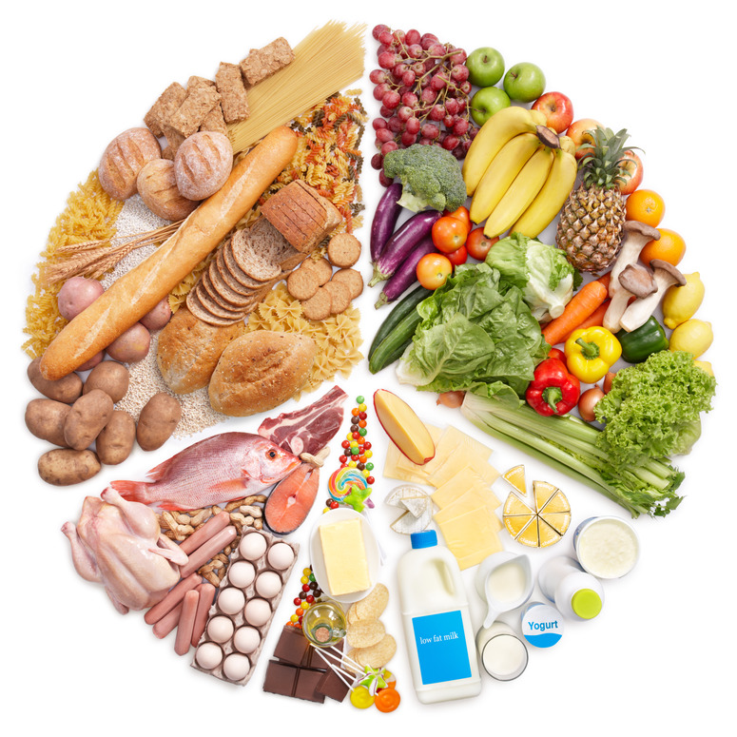
EATING STYLES
Vegetarian
Vegan
Kosher/Halal
Cultural
Health Concerns
Etc.!

Slide 32
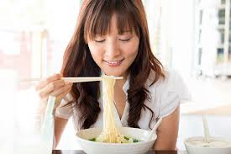
HOW MUCH
Remember to AIM
Attunement
Intention
Mindfulness
(from Beyond a Shadow of a Diet, 2nd edition, p. 108)

Slide 33
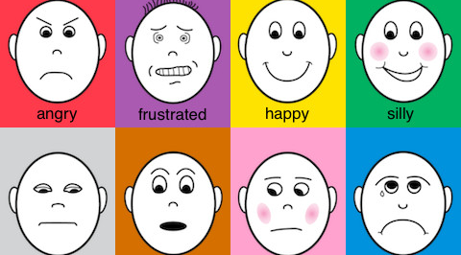
UNDERSTAND EMOTIONAL ASPECTS

Slide 34
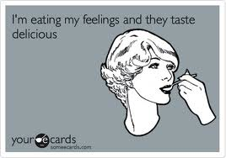
THE USE OF FOOD FOR AFFECT REGULATION
Soothing
Distracting
Comforting
Numbing
Calming

Slide 35
THE TRANSLATION OF FEELINGS
INTO THE LANGUAGE OF FOOD
It feels like this:
Anger------------------------eat
It happens like this:
Anger------➔unable to tolerate uncomfortable
feelings------➔eat------➔yell------➔resolve to lose weight

Slide 36
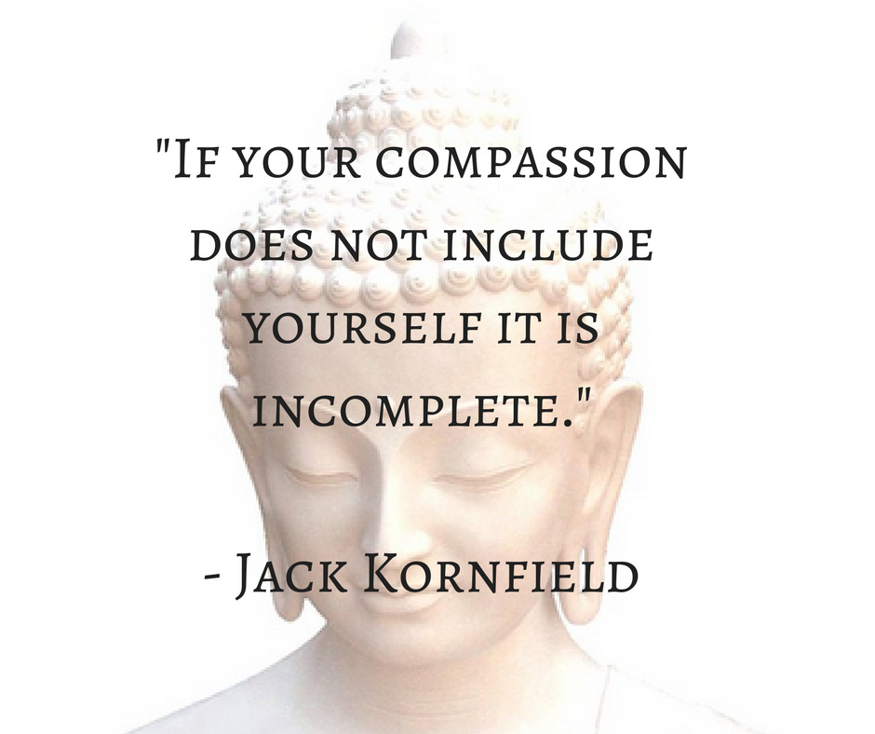
SELF-COMPASSION MATTERS!
Instead of yelling at yourself for turning to food, try this:
“I’m reaching for food and I’m not hungry. Something must be bothering me.”

Slide 37
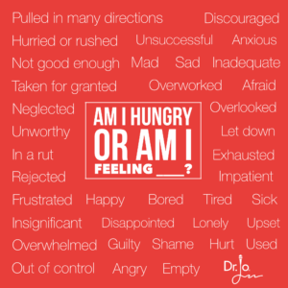
WHAT AM I REALLY HUNGRY FOR?
BUILDING STRATEGIES
IT’S NOT ABOUT CONTROL

Slide 38
FINDING SOLUTIONS

Slide 39
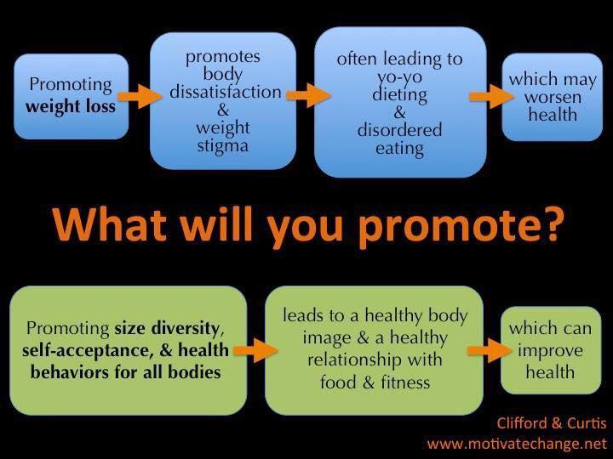
HOW CAN WE ENGAGE, SUPPORT, AND HELP CLIENTS TO TAKE CARE OF THEMSELVES?

Slide 40
EXAMINE YOUR OWN BELIEFS

Slide 41
THIN FAT
happy lazy
successful couch potato
sexy unhealthy
exercise stupid
healthy miserable
confident out of control
(from Beyond a Shadow of a Diet, 2nd edition, p. 303)

Slide 42
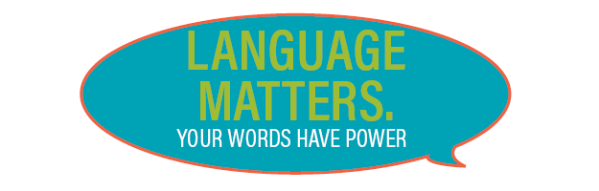
LANGUAGE MATTERS
Body Mass Index (BMI)
Obesity
Overweight
Higher Weight
Fat

Slide 43
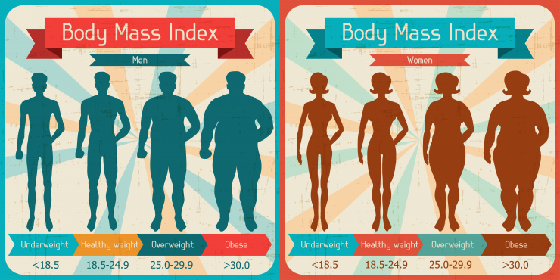
WEIGHT AND MORTALITY
“Overweight” – lowest mortality
“Normal” weight and lower end of “obesity” – same risk
“Obesity” – slightly higher
“Underweight” – highest mortality
Centers for Disease Control, 2013/Flegal, et. al. JAMA

Slide 44
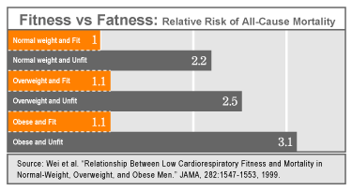
FIT AND FAT
Men who are fit/“obese” have half the death rate of men who are unfit/“thin.” (S. Blair, Cooper Institute 2001)

Slide 45
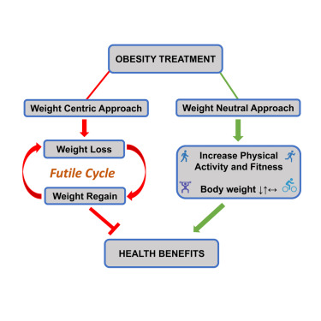
FIT AND FAT REVISITED
“Epidemiological studies show that CRF [cardiorespiratory fitness] and PA [physical activity] significantly attenuate, and sometimes eliminate, the increased mortality risk associated with obesity. More importantly, increasing PA or CRF is consistently associated with greater reduction in risk of all-cause and CVD mortality than intentional weight loss.” (Obesity treatment: Weight loss versus increasing fitness and physical activity for reducing health risks, Glenn Gaesser 2021).

Slide 46
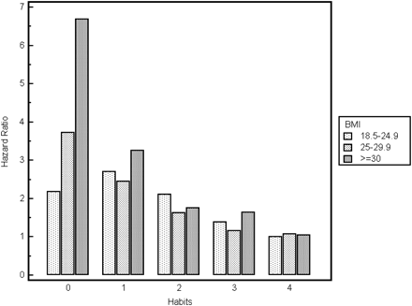
WEIGHT AND HEALTH RESEARCH
Behaviors Versus BMI
5 or more fruits and vegetables daily
Regular exercise
Alcohol in moderation
Not smoking
“Healthy lifestyle habits are associated with a significant decrease in mortality regardless of baseline body mass index. (Healthy lifestyle habits and mortality in overweight and obese individuals, Matheson, E., et al. )

Slide 47
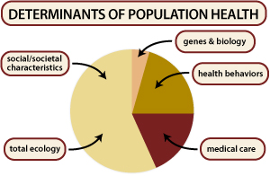
SOCIAL DETERMINANTS OF HEALTH
Tarlov, A.R. (1999) Public Policy Frameworks for Improving Population Health
“What if your zip code has more of an effect on your health than your weight?” (Powell, T. et. al. 2015, Journal of Preventive Medicine)

Slide 48
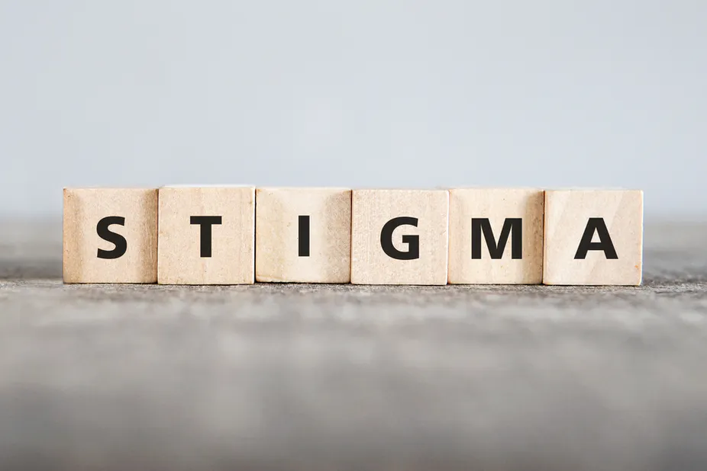
EXPOSURE TO WEIGHT STIGMA
Increased allostatic load: cumulative effect of chronic stressors on multiple systems in the body, e.g. cardiovascular system, sympathetic and parasympathetic nervous systems, and metabolism.
Impact of exposure to weight stigma: doctors, physical activity, weight cycling, etc.
“Weight stigma has been shown to pose a greater risk to your health than what you eat.”
(Christy Harrison, Anti-Diet, 2019)

Slide 49
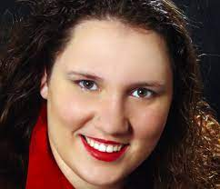
WEIGHT NEUTRAL HEALTH CARE
“...weight-neutral is care in which people of all sizes who have the same symptoms/diagnoses etc. are given the same interventions, and weight loss is not utilized as a healthcare intervention. It is, essentially, achievable now. We stop calculating BMIs, stop pathologizing higher weight bodies, stop prescribing weight loss diets/drugs/surgeries, and give fat people the interventions we could give thin people with the same symptoms.
Ragen Chastain, Weight and Healthcare Newsletter

Slide 50
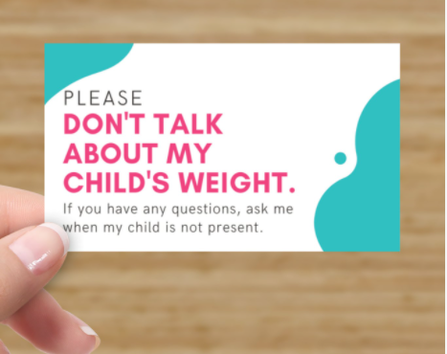
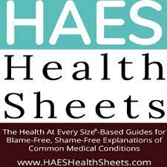
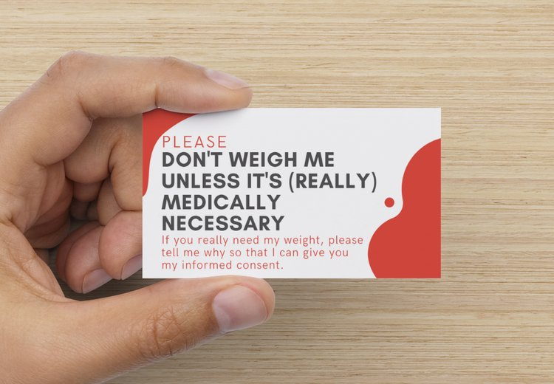
ADVOCATING FOR WEIGHT NEUTRAL CARE: RESOURCES
1) implicit.harvard.edu – offers an implicit weight bias test
2) HAES Health Sheets: blame-free, shame-free explanations of common medical conditions (haeshealthsheets.com)
3) Don’t Weight Me Cards (more-love.org)

Slide 51

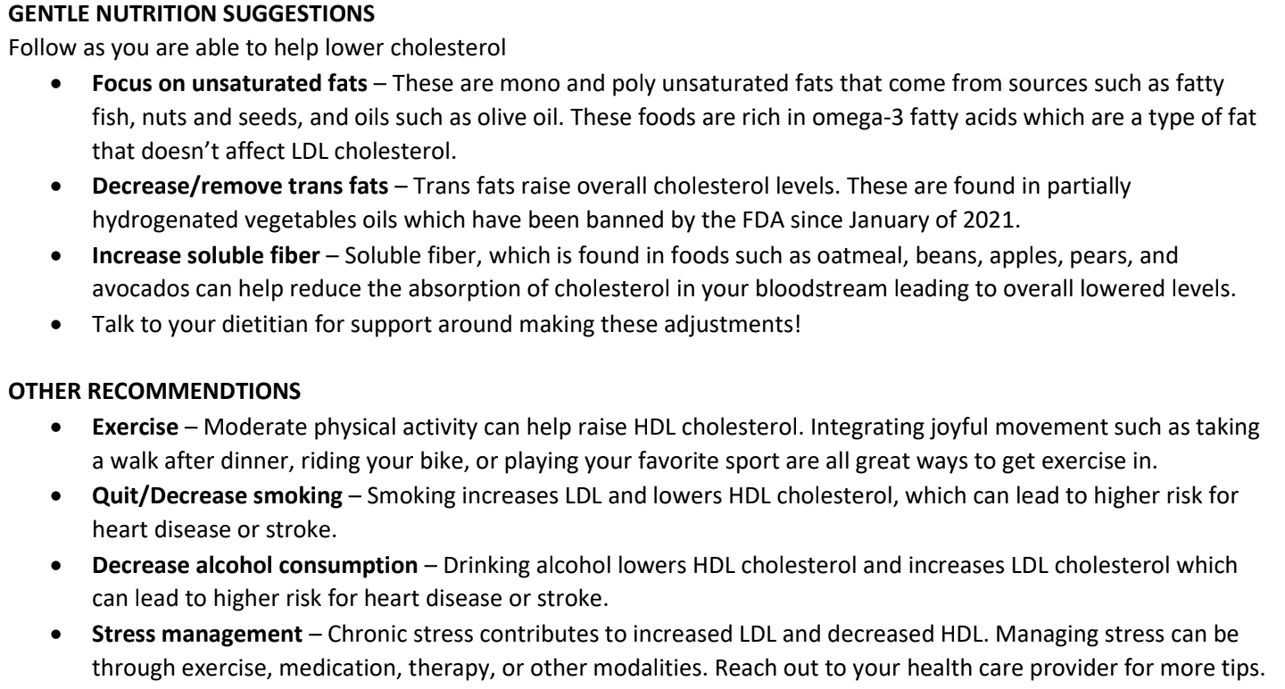
MEDICAL NUTRITION THERAPY
Weight eutral MNT Guidelines from Megan Cichy, RD

Slide 52
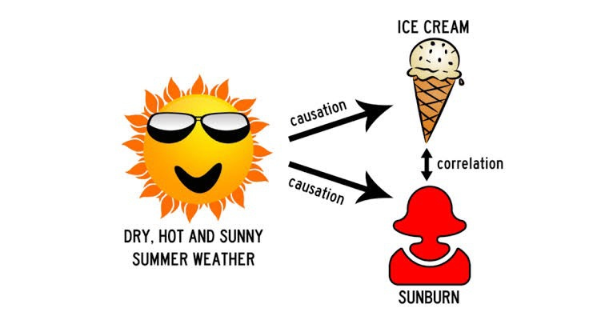
CORRELATION VS. CAUSATION
How can we separate the effects of fat tissue from exposure to weight stigma?
Why do we assume that a higher weight person who loses weight will have the same health outcomes as someone who has always been at a lower, steady weight?
How can we research this question when we don’t have people who are able to sustain weight loss long enough to become part of a study?
“Until all research can control for weight cycling and weight stigma, we can’t say that being at the higher end of the BMI spectrum causes any health conditions—even if higher weights are associated with these health conditions. Remember the golden rule: Correlation doesn’t equal causation. Moreover; even if weight did have some causal effect on people’s health (which is possible—but again, we can’t know until we control for weight stigma and weight cycling), we don’t have a known way for more than a tiny fraction of people to lose weight and keep it off permanently.” (Christy Harrison, Anti-Diet, 2019)

Slide 53
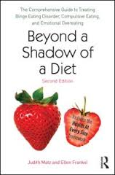
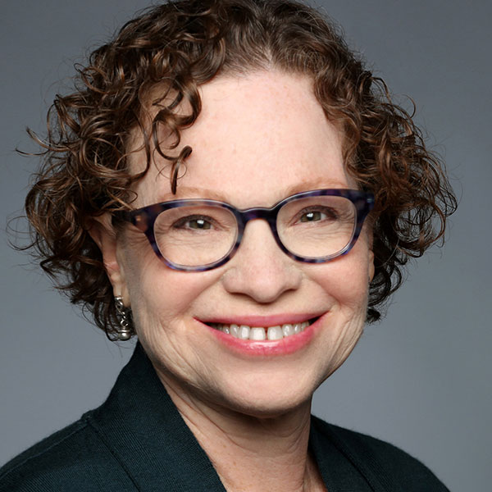
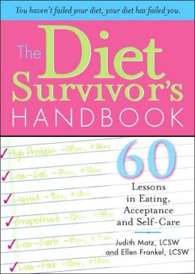


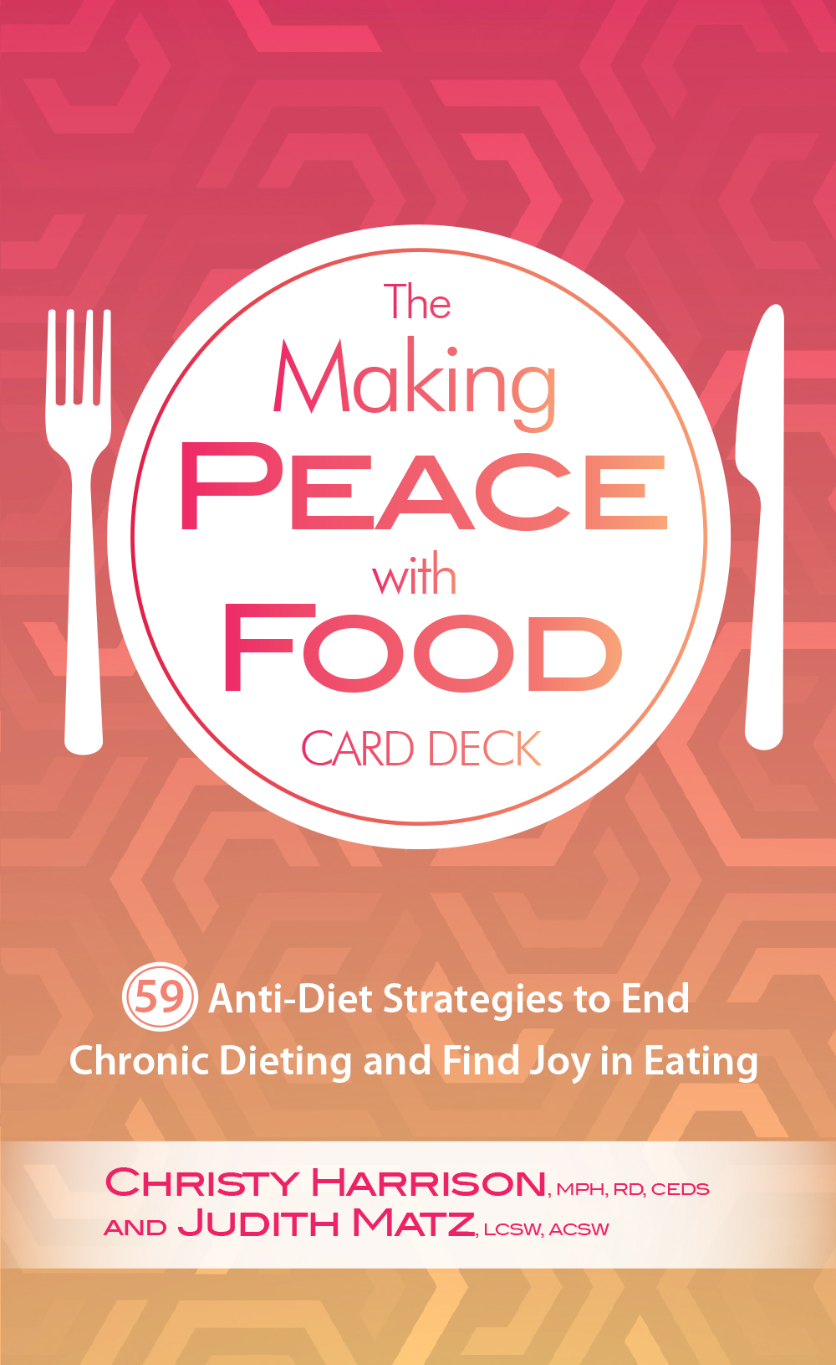
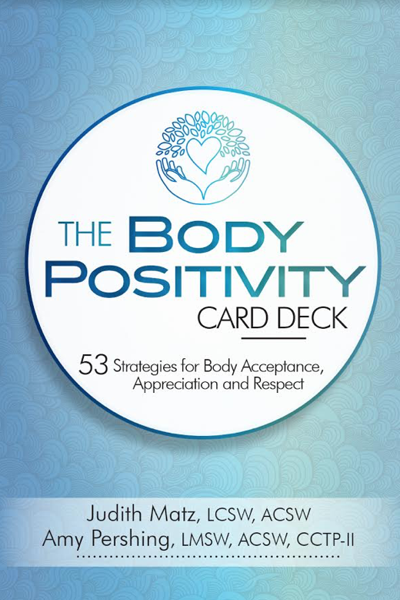

MY RESOURCES
www.judithmatz.com
The Diet Survivors Group Newsletter
Instagram @judmatz
Facebook: Deit Survivors Group Page
Food Psych Podcast: #151 & #256
Psychotherapy Networker Articles
Workbook coming soon!

Slide 54




















FINDING COMMUNITY/
SHARING RESOURCES

Slide 55

RETHINKING DIET CULTURE
AND OUR OWN ATTITUDES
When it comes to dieting, food and weight, what we say, what we do, and even what we think affects what we communicate to our clients, our peers, and our children.
Be gentle with yourself. Stay compassionate. But don’t stay complicit. Do the work—for your clients, you children, yourself.

Slide 56

AN INVITATION
PRACTICE COMPASSION
FOLLOW THE SCIENCE
EMBRACE THE OPPORTUNITIES
“Do the best you can until you know
better. Then when you know better, do
better.” ---Maya Angelou

Slide 57

BEYOND THE CLINICAL
YOU are the pebble that creates the ripples…

