Slide 1
NAND 2023 Annual Conference The Meatless Movement

Slide 2
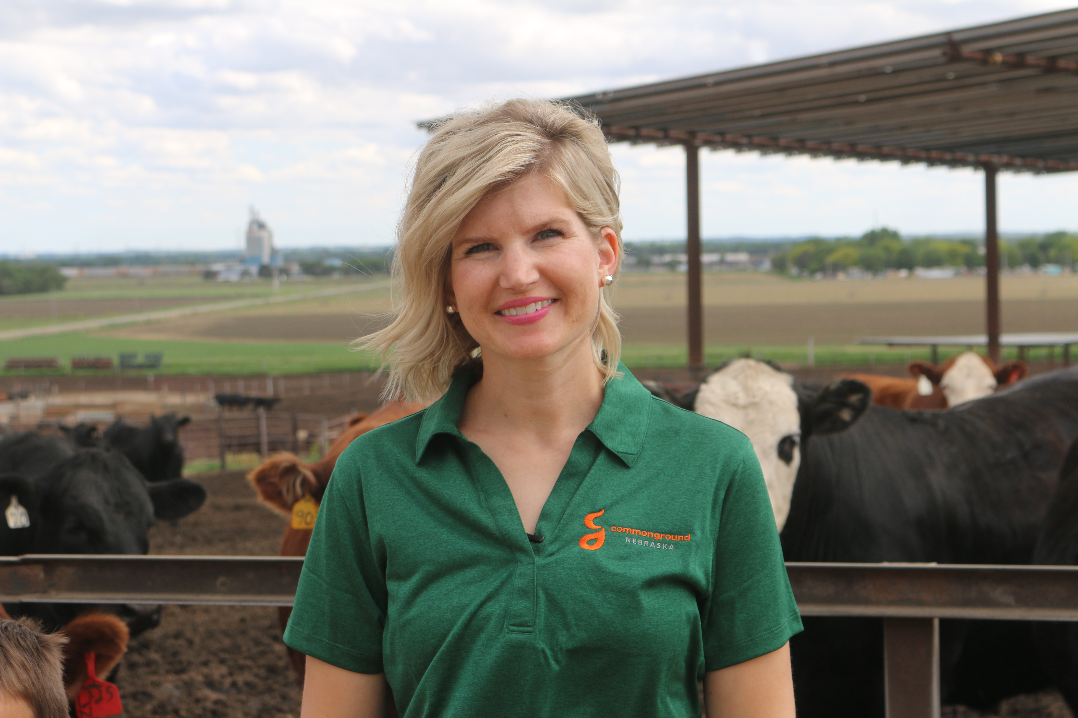
Presenters
Joan Ruskamp - Dodge, NE
Cattle Feeder, Wife, Mother, Grandmother
Crystal Klug - Columbus, NE
Farmer, Wife and Mother

Slide 3
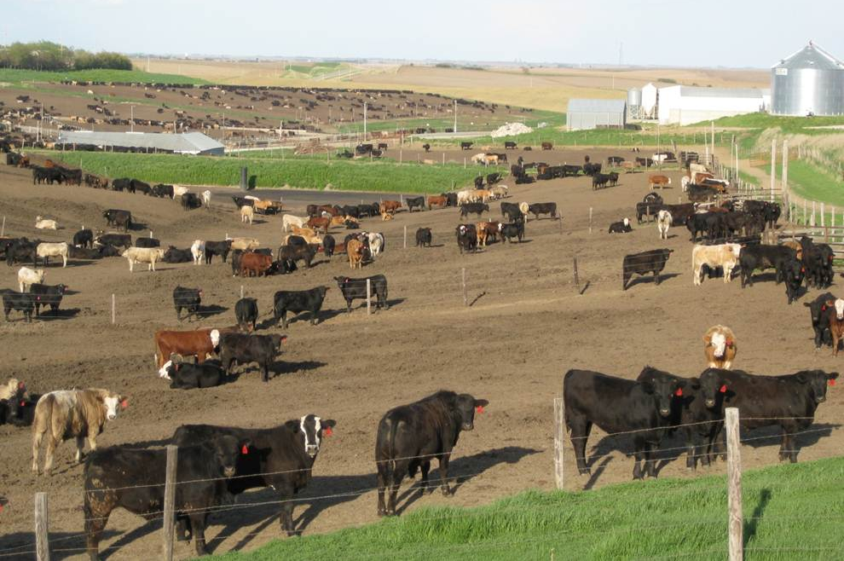
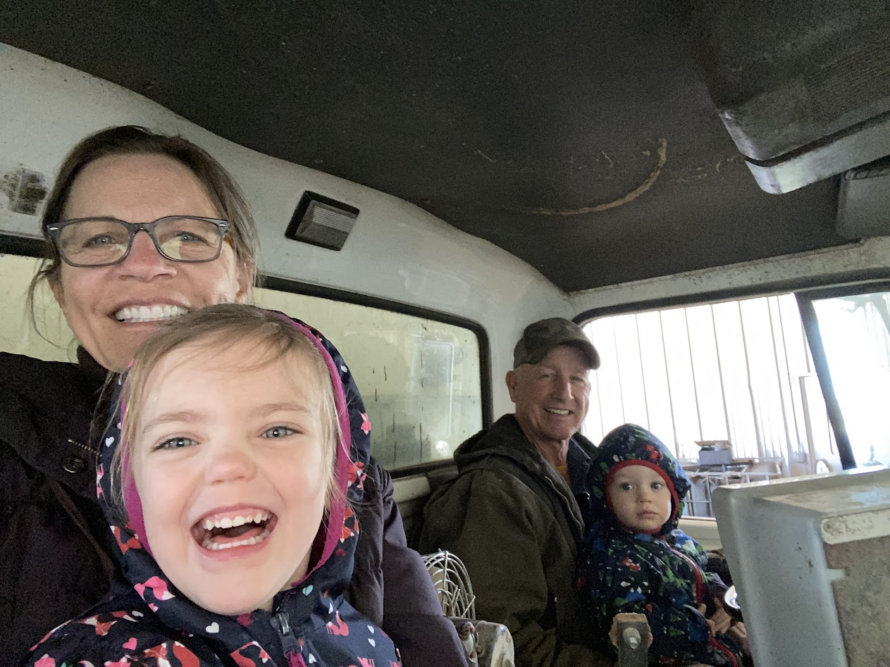
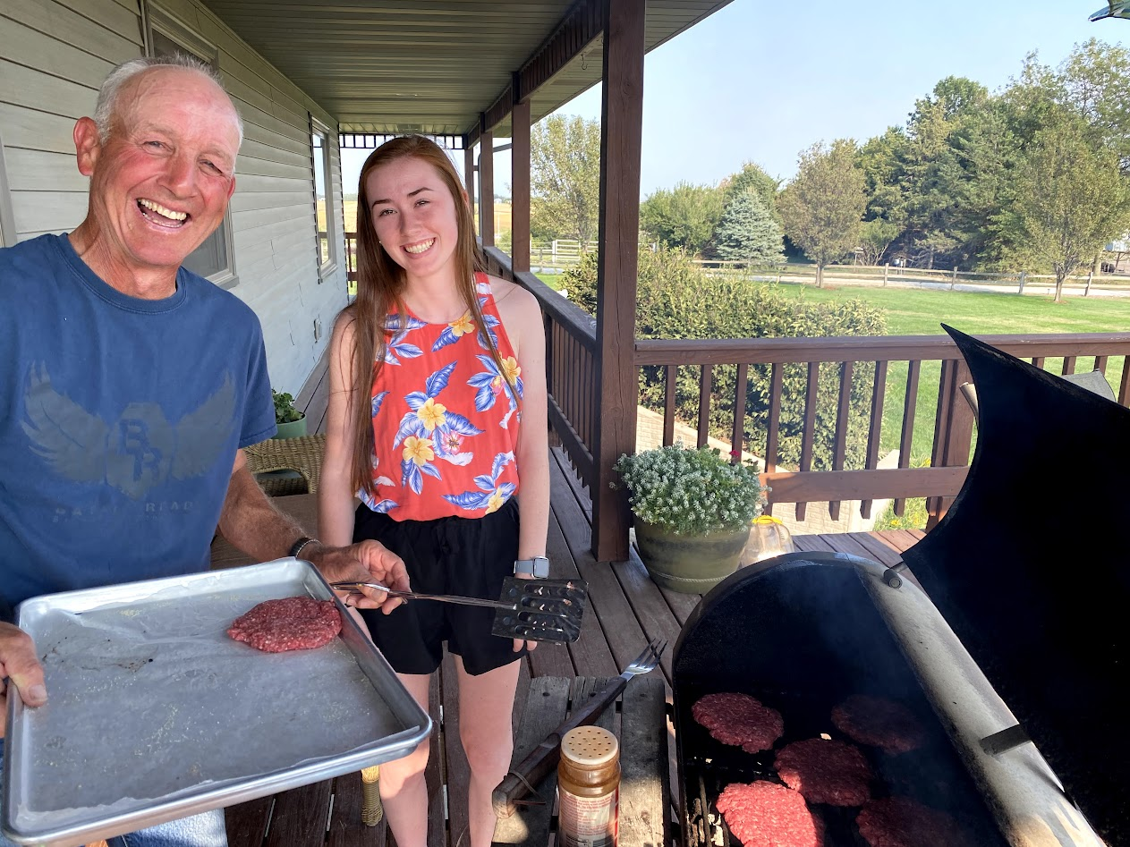
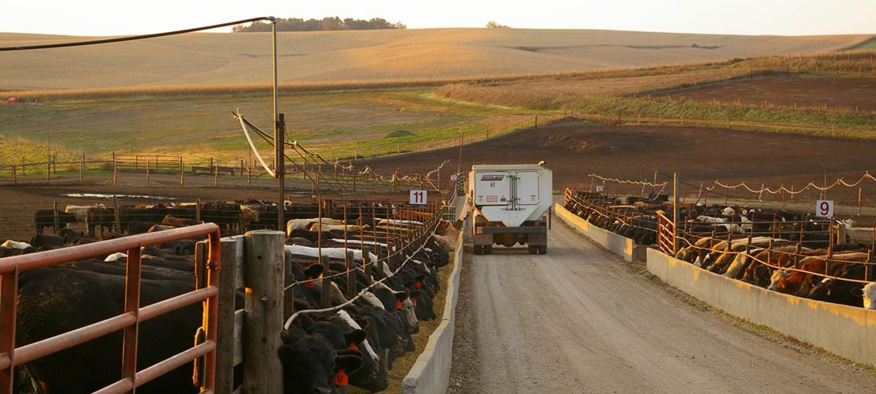
Welcome to our Farms

Slide 4
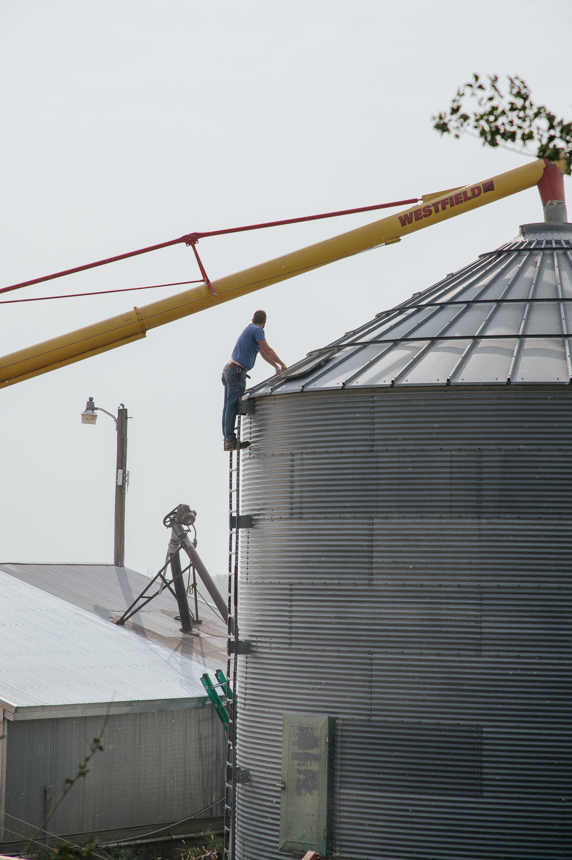
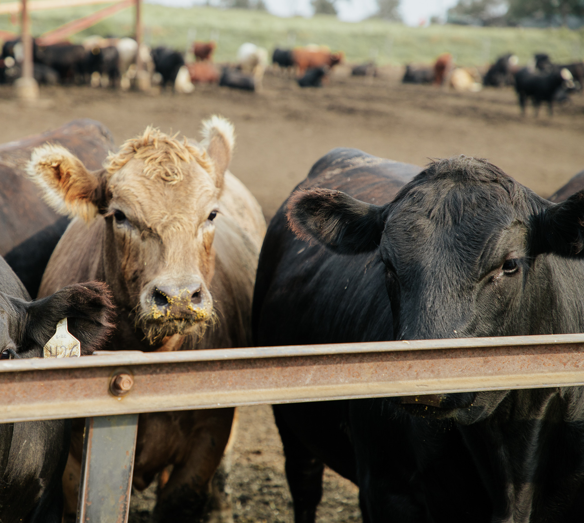
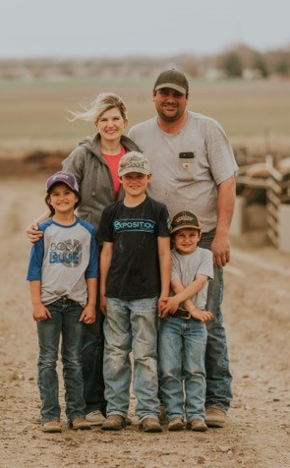
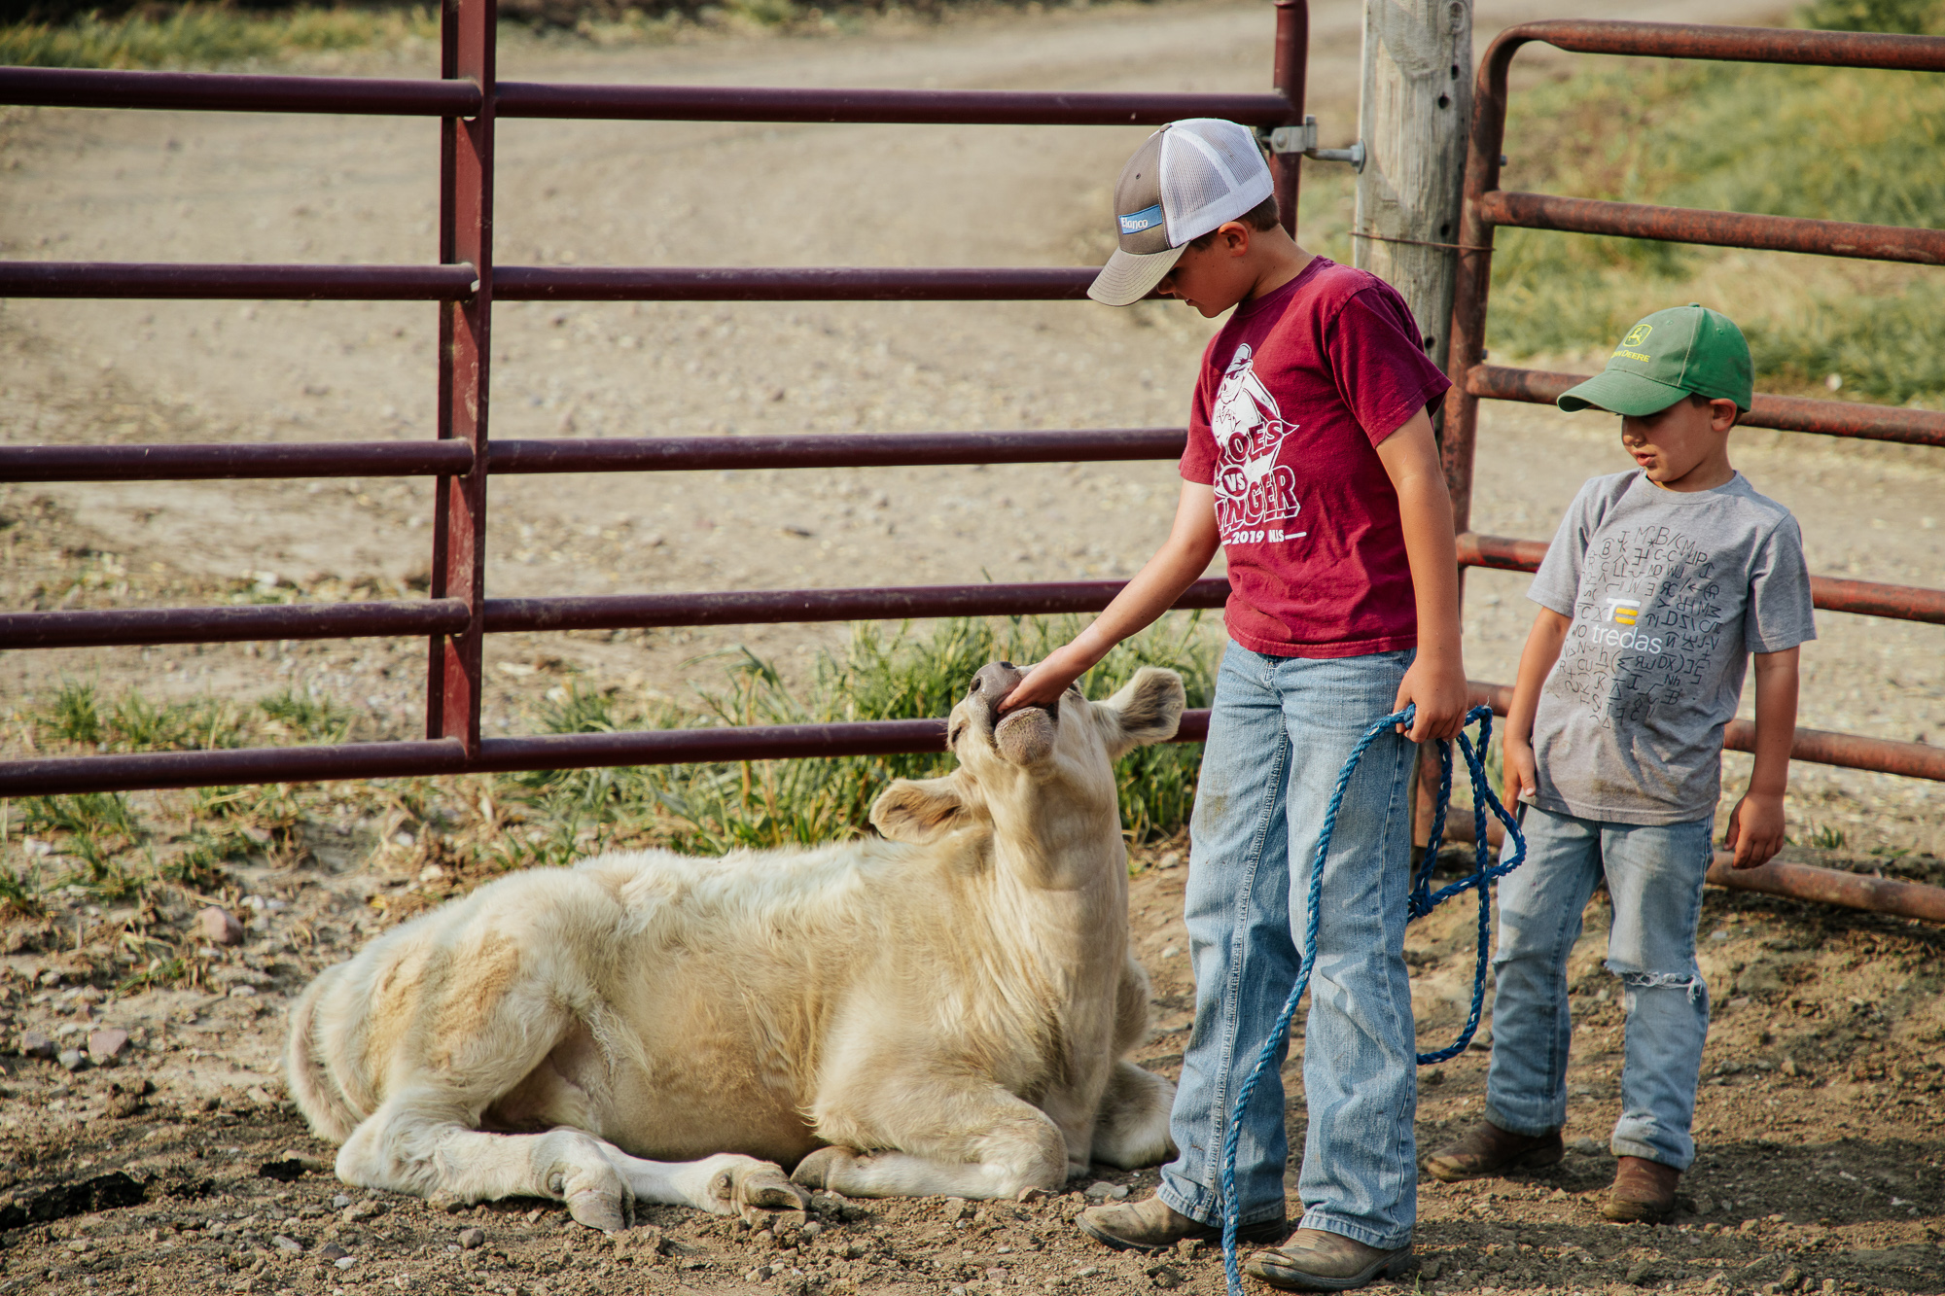
Welcome to our Farms

Slide 5
Meatless Meat Movement
What and Who are behind this movement?
Meatless Mondays
Should I eat less meat
Is going meatless better for the environment
Is a Vegetarian & Vegan lifestyle better for my health

Slide 6
Drivers
Health | Environment | Diet | Animal Care
Health Halo ↓ Cholesterol ↑ Sodium | Carbon footprint Water use | Vegan (3%) Vegetarian (5%) Flexitarian (9%) | Fewer animals raised

Slide 7
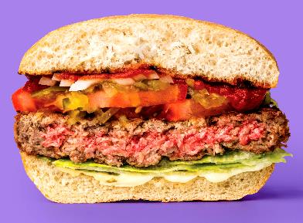
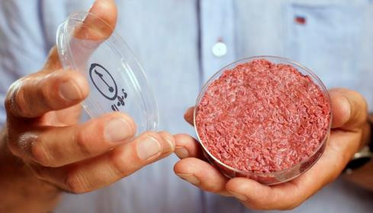
Two Types:
Plant-based
Cell-cultured
Plant proteins processed to look
and feel like meat.
Soy, peas, mung beans, wheat protein which are widely available.
Meat produced (mostly) without raising livestock.
Animal tissue grown in a cell culture.
Too expensive for mass production.
Notes:
These are the companies that have (a) pulled in the most VC funding and (b) gotten the bulk of media attention. This does not include every startup. These are the prominent players. They tend to operate more like silicon valley companies than food companies.
These are the companies that have (a) pulled in the most VC funding and (b) gotten the bulk of media attention. This does not include every startup. These are the prominent players. They tend to operate more like silicon valley companies than food companies.
Plant-based
Beyond Meat
Impossible Foods
Just
Cell-cultured
Memphis Meats
Aleph Farms
Finless Foods

Slide 8
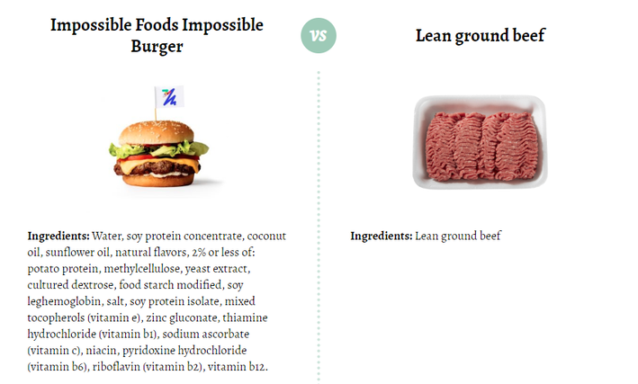

Slide 9
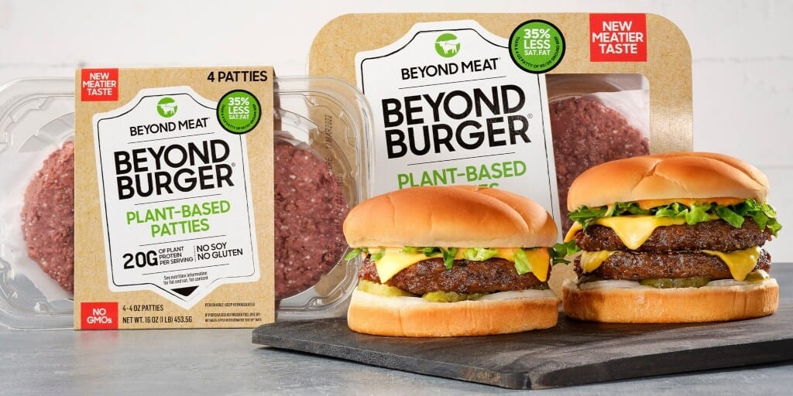
Price
Whole Foods Beyond Burger
$10.49/pound
Traditional Ground Beef
$6.49/pound

Slide 10
Nutrition: Real Beef vs. Plant-Based
93%Lean ground beef
Impossible Burger
170 calories
8 g fat (3.5 g saturated)
70 mg cholesterol
75 mg sodium
0 g carbohydrate
24 g protein
240 calories
14 g fat (8 g saturated)
0 g cholesterol
370 mg sodium
9 g carbohydrate
19 g protein
Notes:
The above numbers came from Beef Council – USDA Nutrient database
So – either way – you are not talking about much difference in calories.
Resource: Clean Eating Kitchen

Slide 11
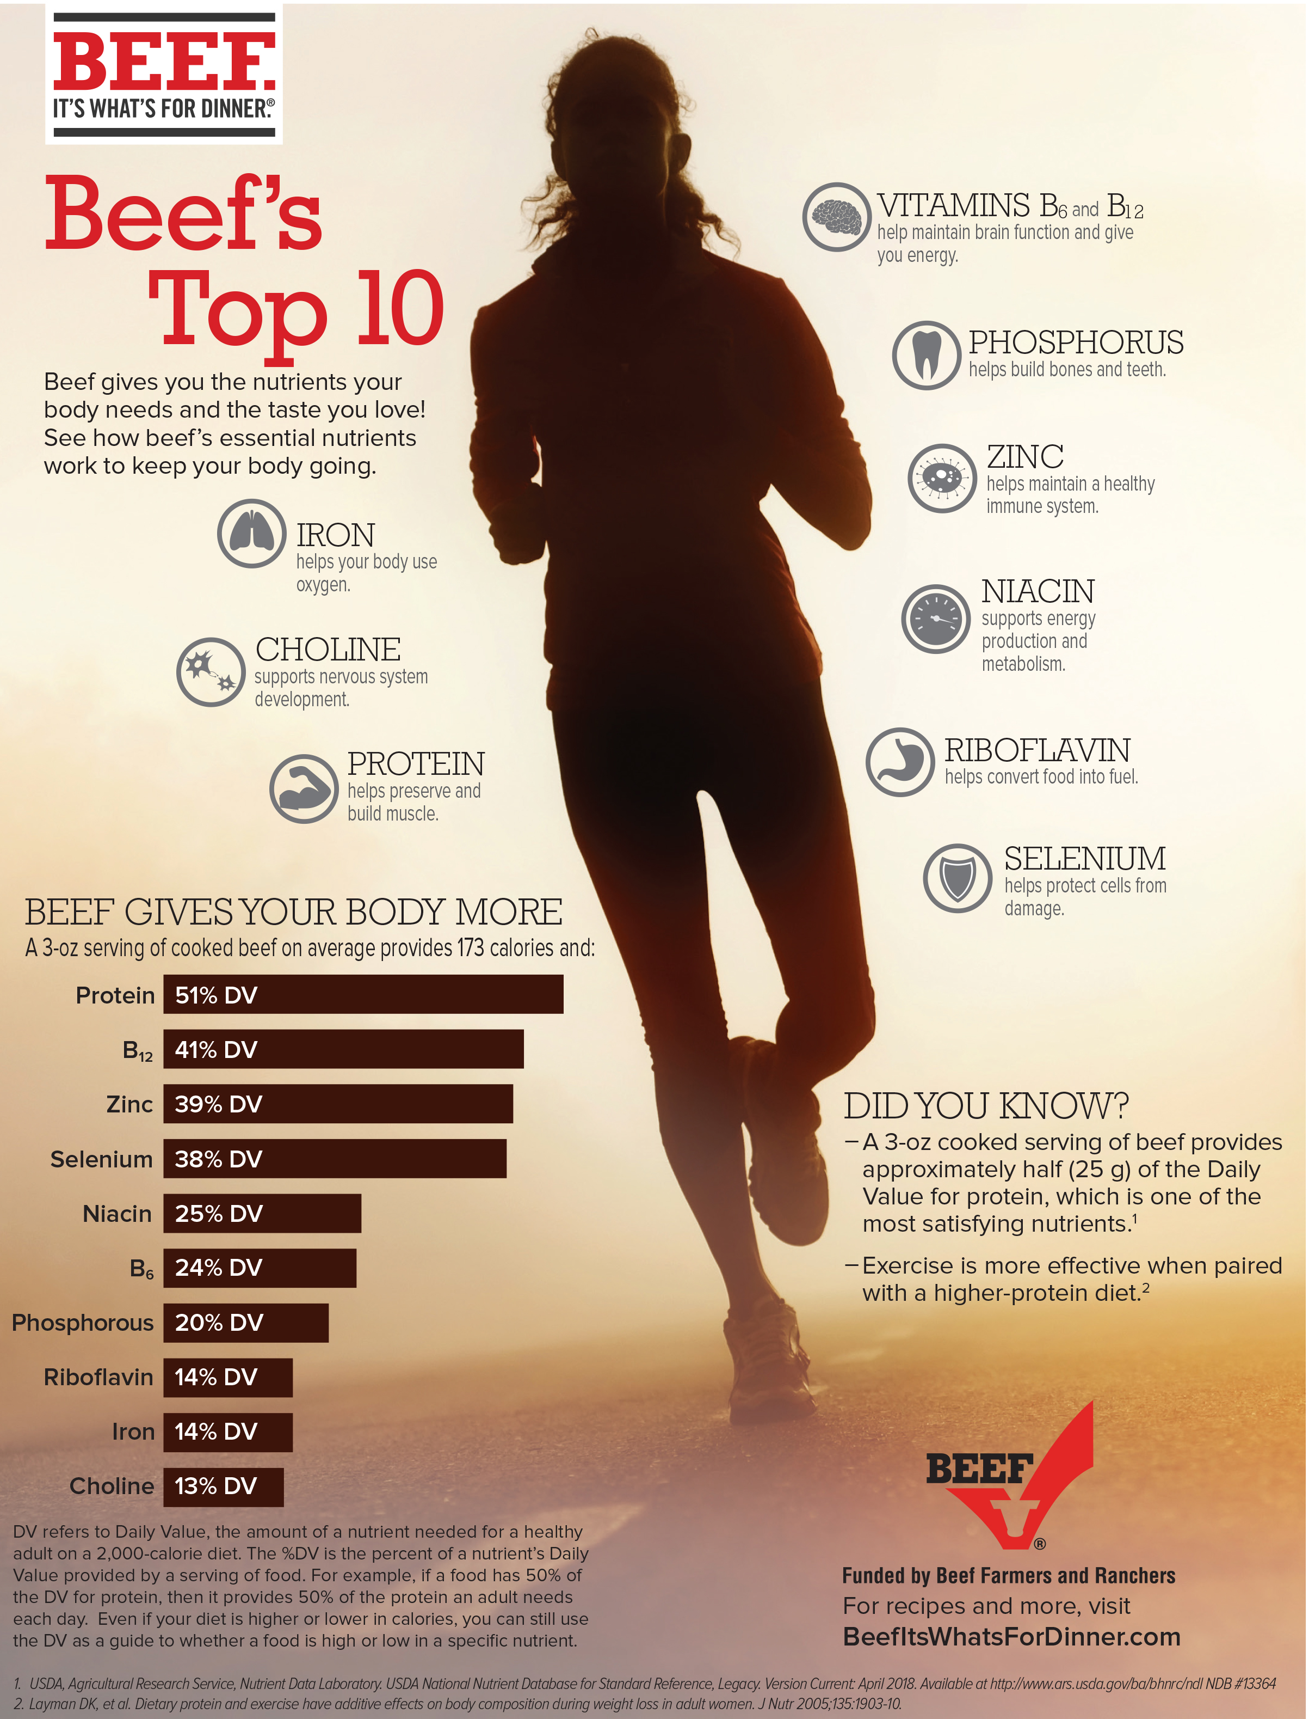
Notes:
Beef – gives you the nutrients your body needs and the taste you love.
A 3 oz serving of cooked beef on average provides 173 calories and 51% of the daily value of protein that you need for the day.

Slide 12
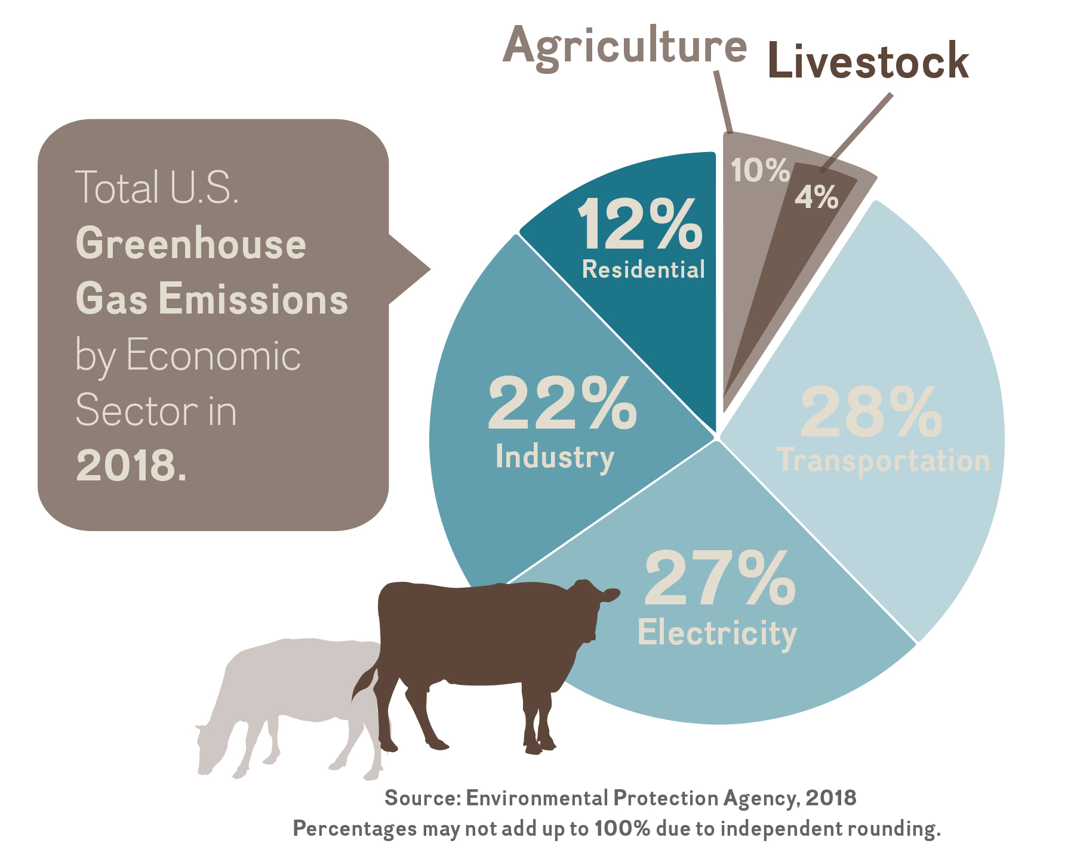
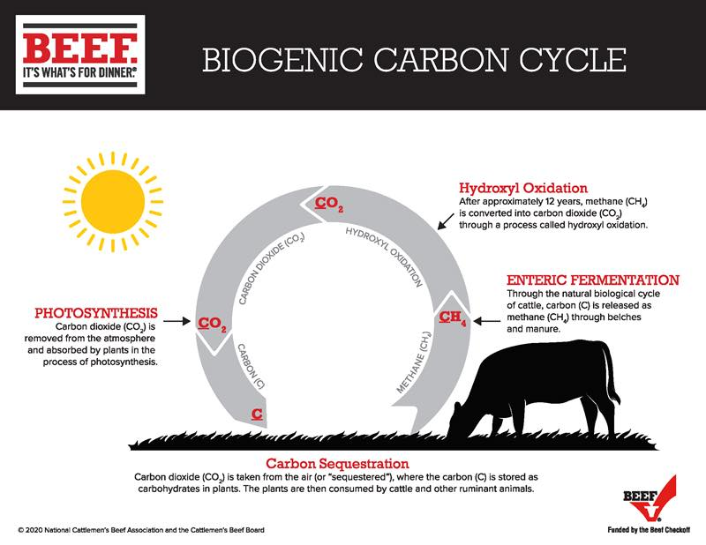
Environment
Notes:
There is a lot of marketing noise – packaging, signage and advertising
Whether you’re talking about veggie burger, vegan sausage, plant-based chicken or faux ground beef, fake meat is everywhere.
The food industry is $5.75 trilion
The alternative meat industry is $1.44 billion – expected to grow to $2.5 billion by 2023 *according to Euromonitor International market
This means that the alternative meat market is expected to make up 13% of the meat market, just like the alternative milks have taken 13% of the milk market.

Slide 13
Land Use For Growing Food

Slide 14
Land Use For Growing Food

Slide 15
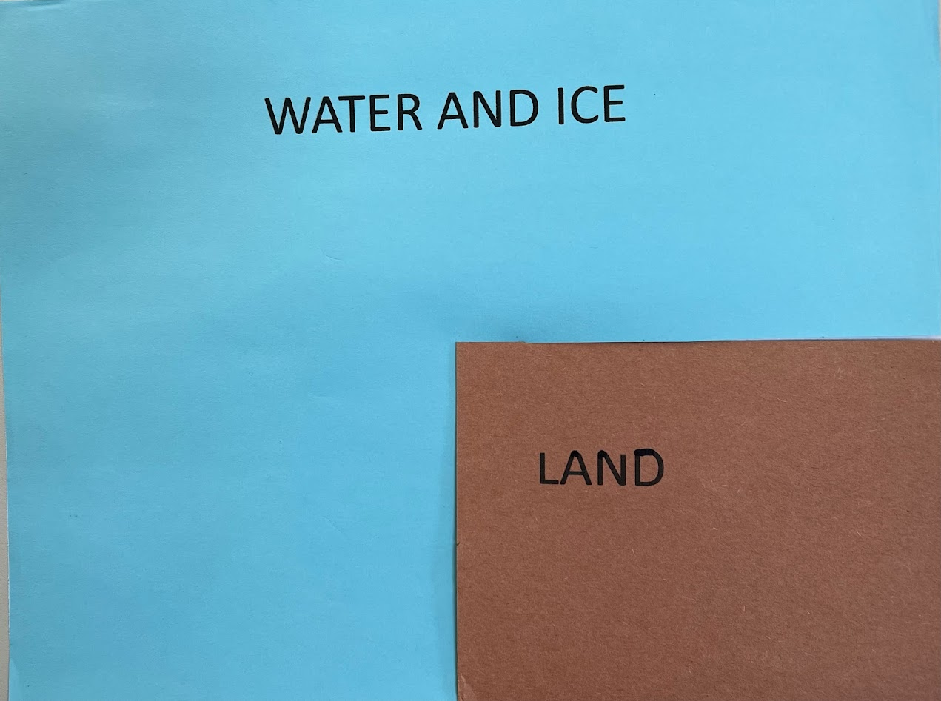
Land Use For Growing Food

Slide 16
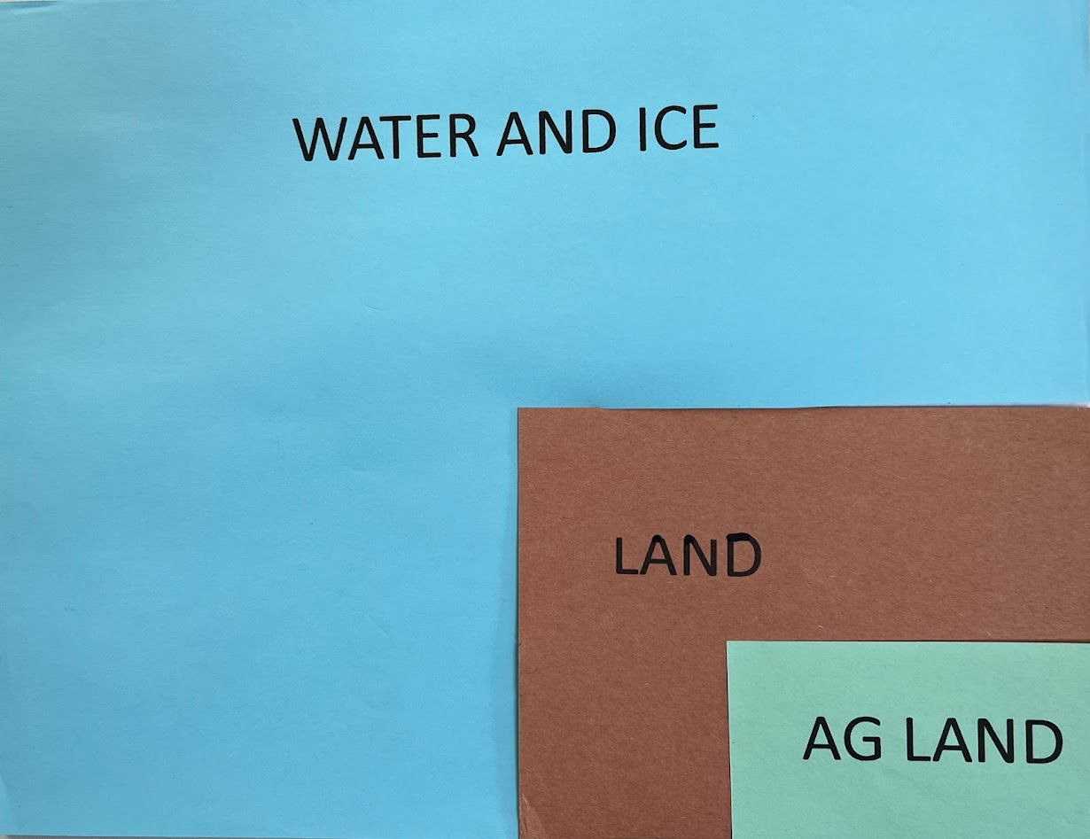
Land Use For Growing Food

Slide 17
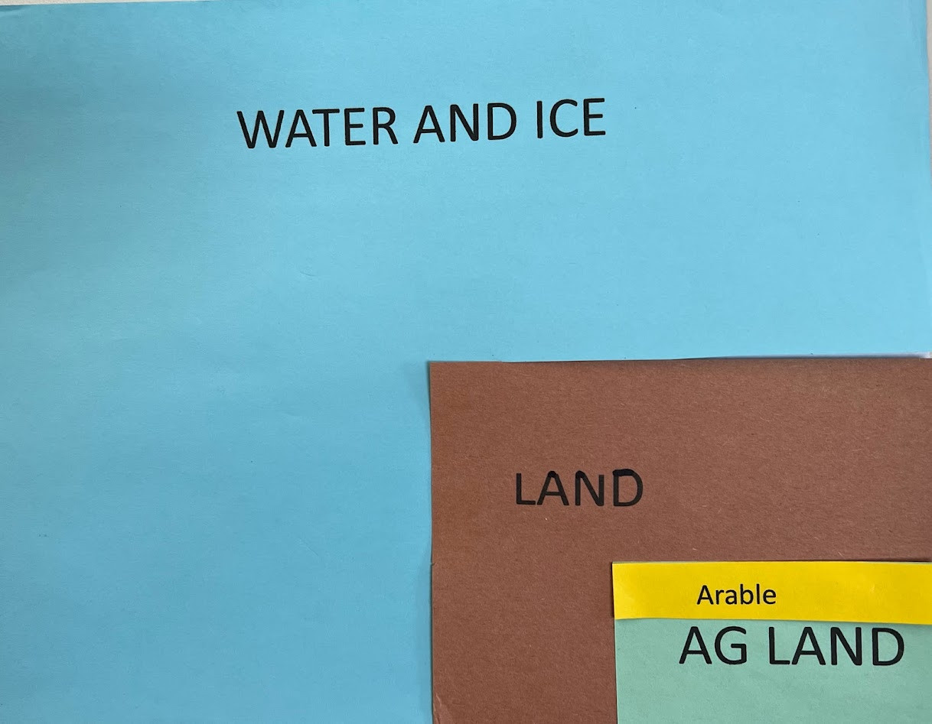
Land Use For Growing Food

Slide 18
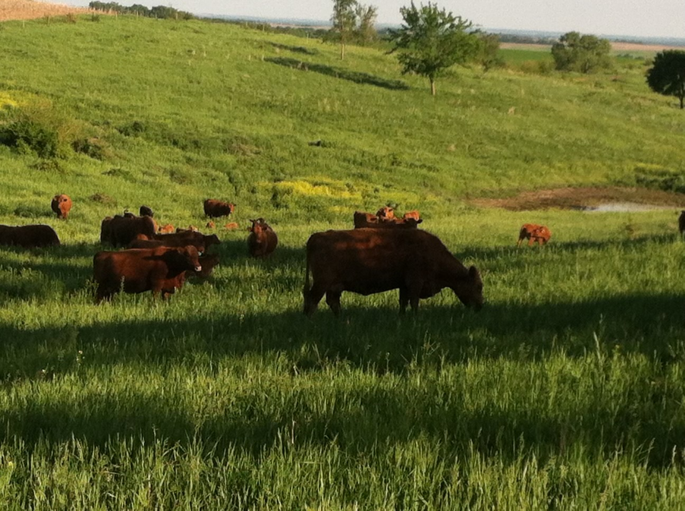
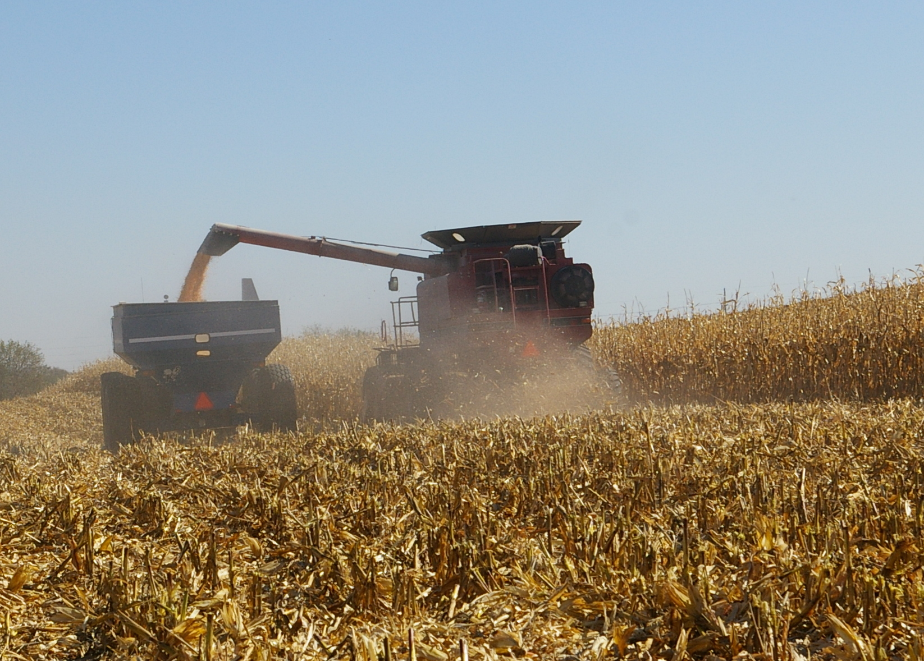
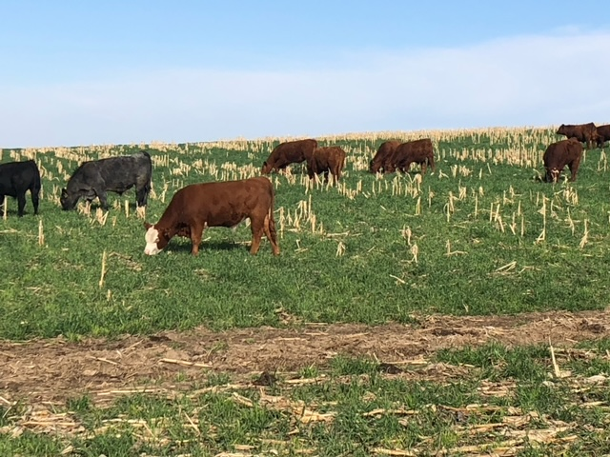
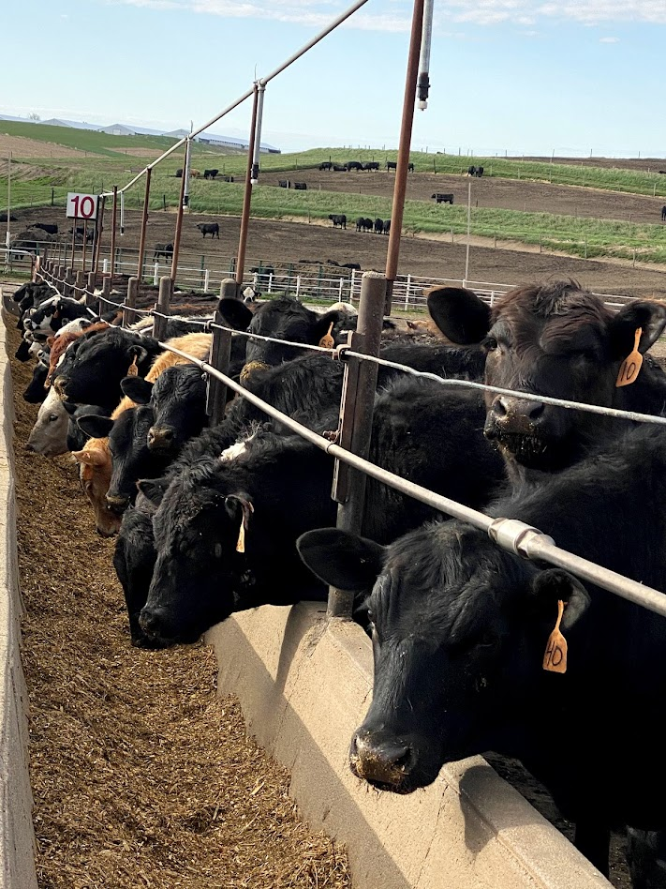
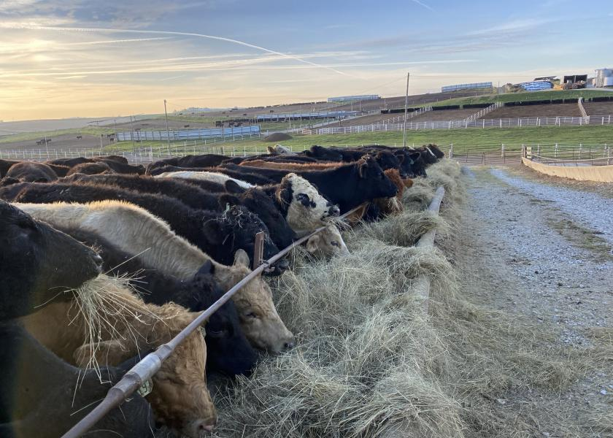
Grass and Grain

Slide 19
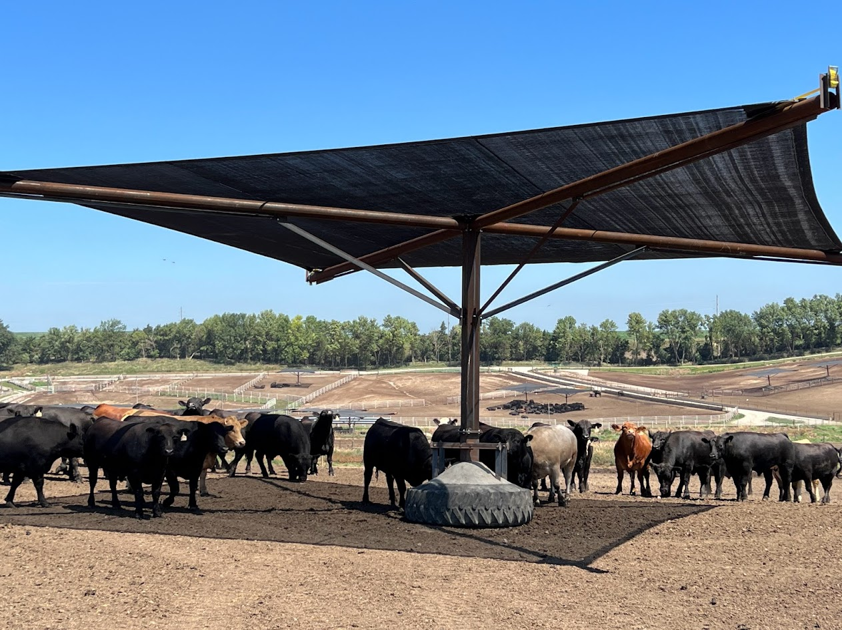
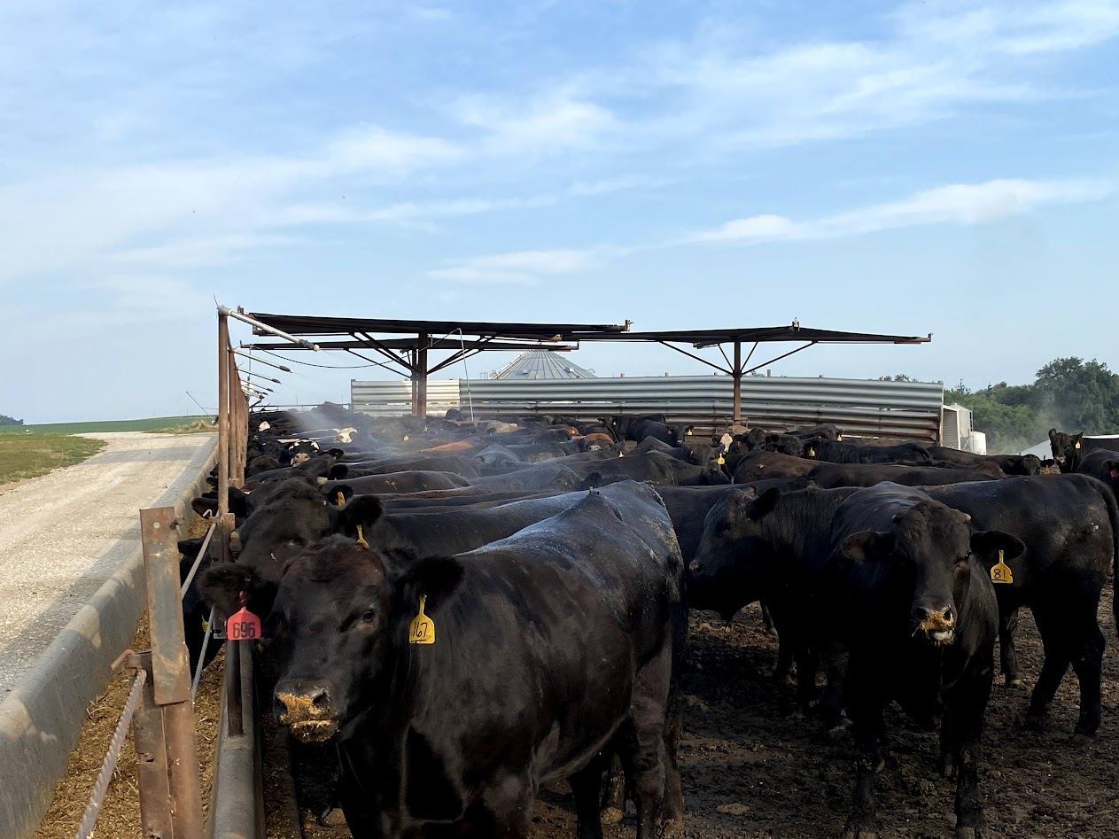
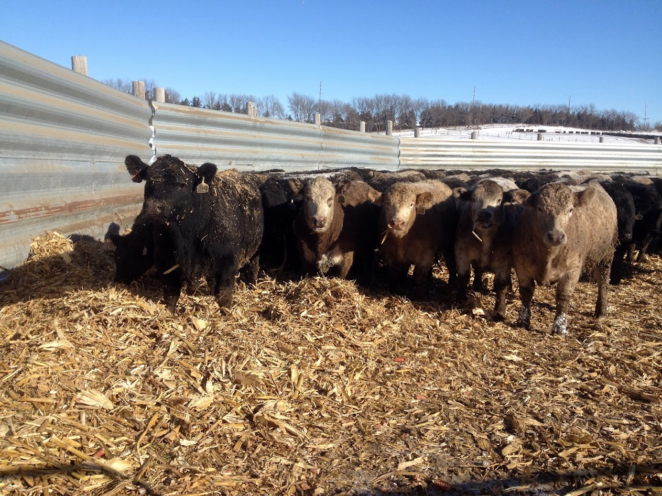
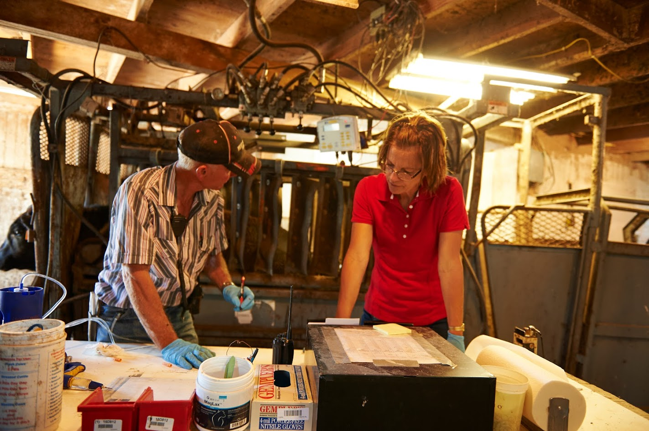
Caring for Cattle

Slide 20
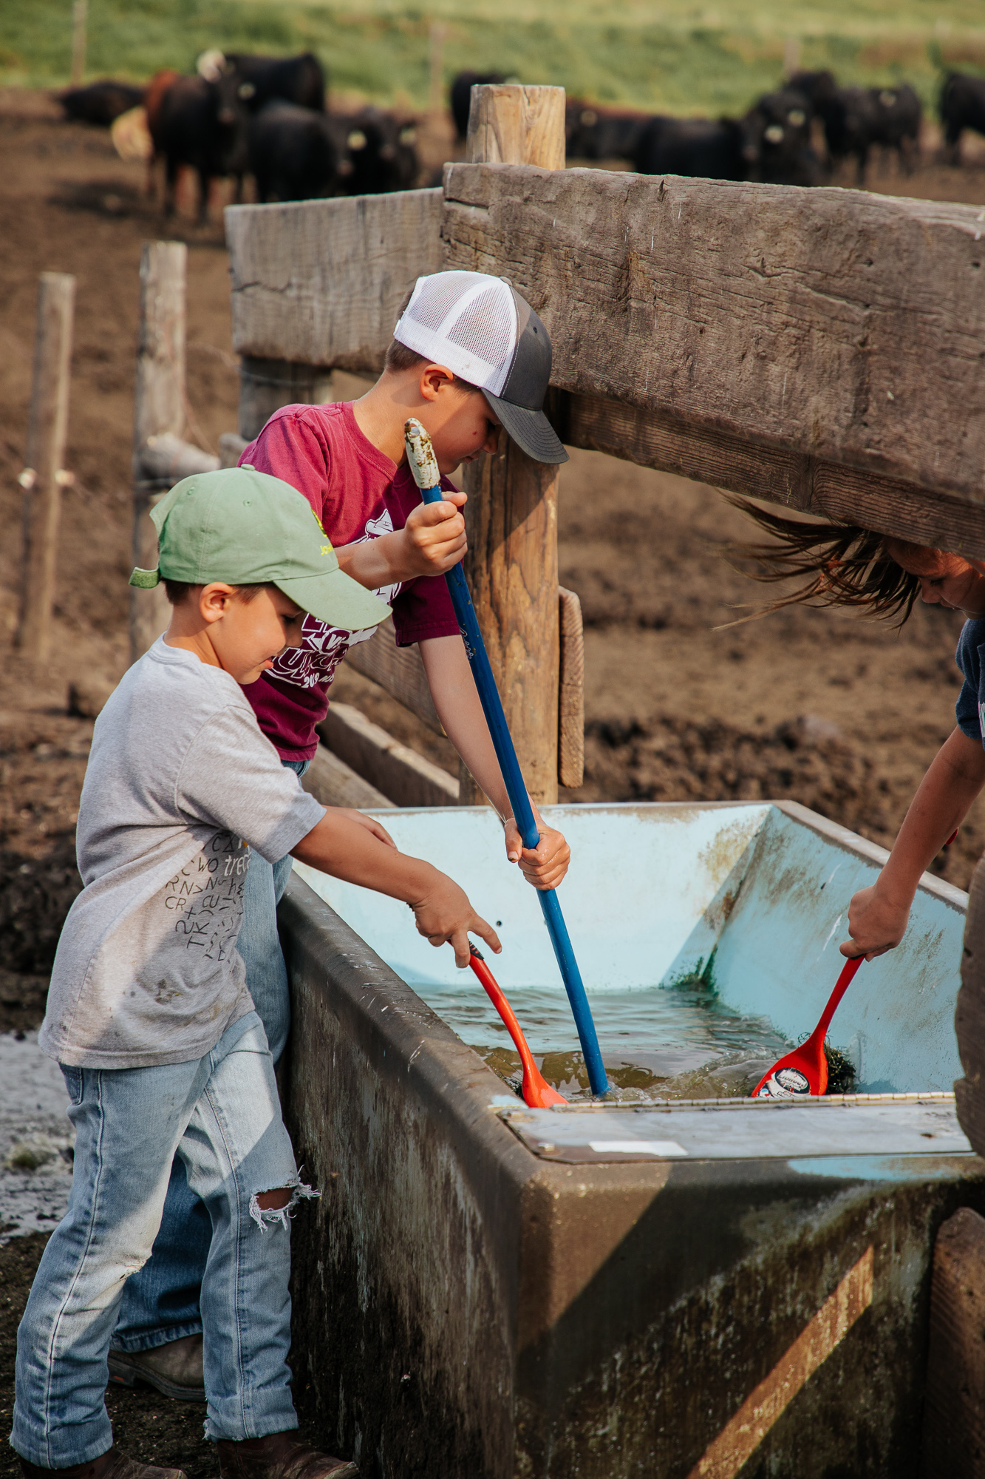
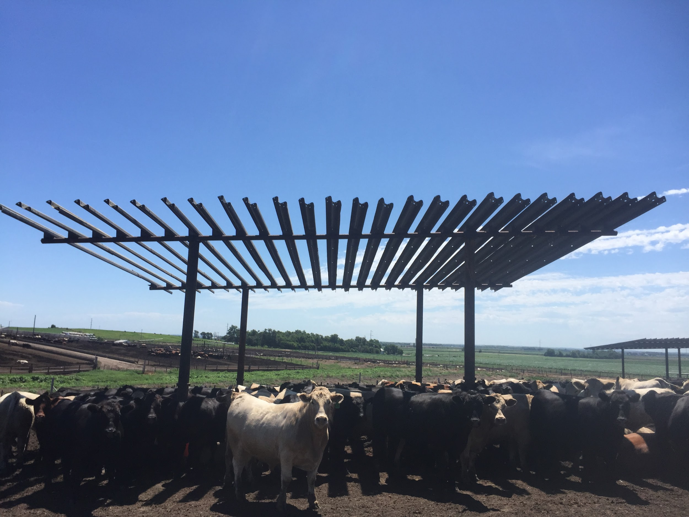
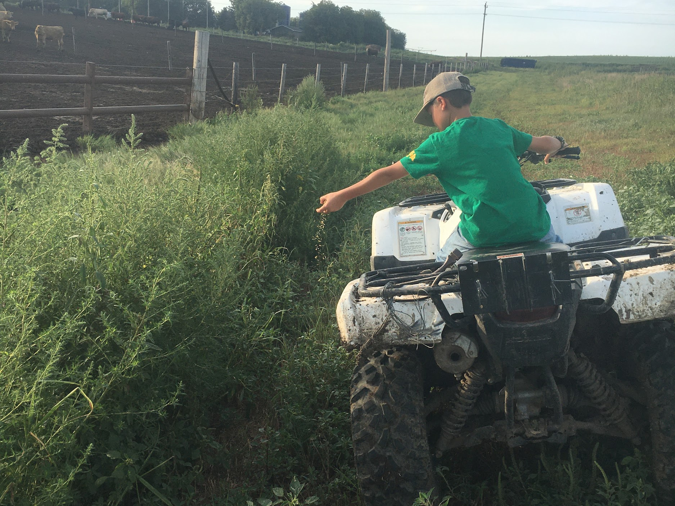
Caring for Cattle

Slide 21
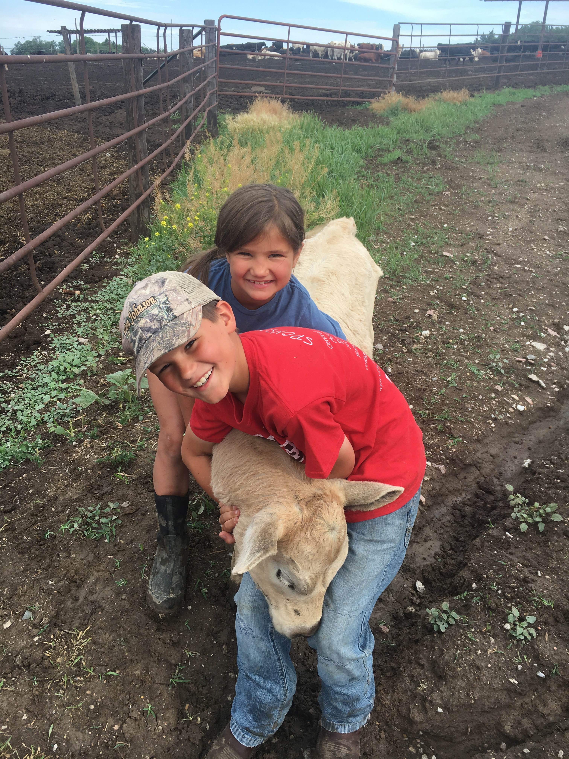
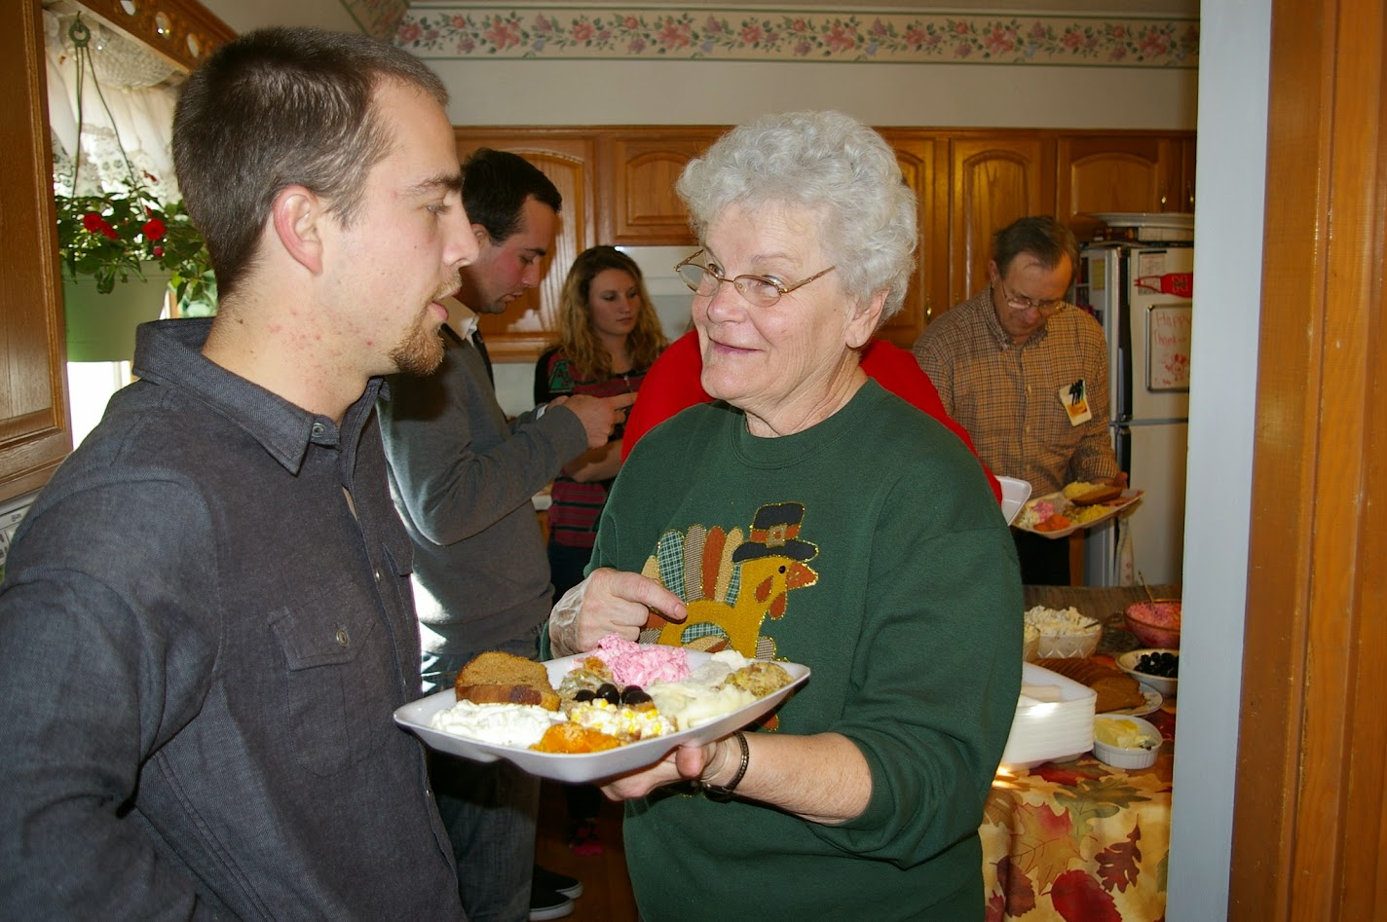
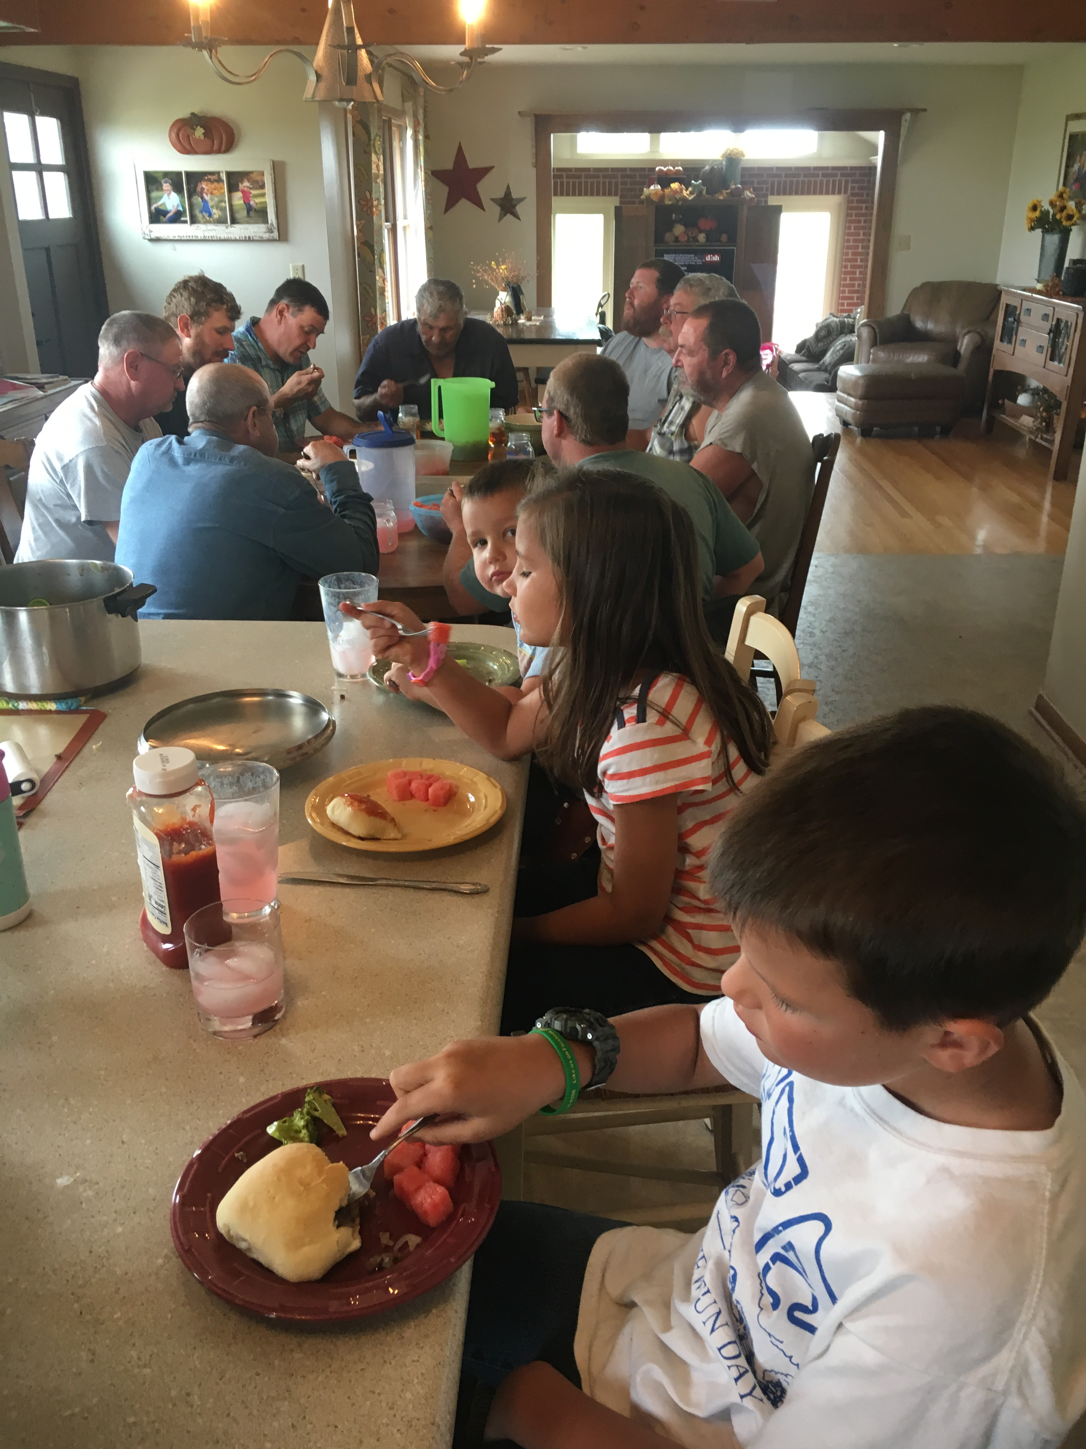
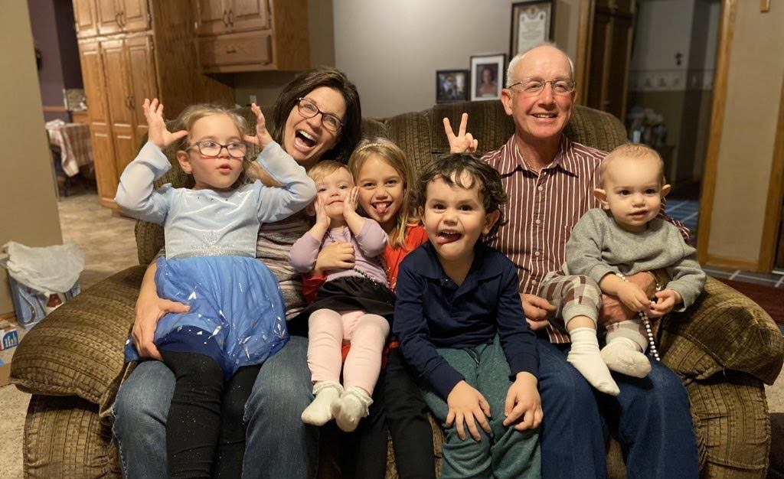
Caring for the Future

Slide 22
Notes:
Food choices are good – CommonGround wants to help consumers base their food decisions on facts not on fear.

Slide 23
Enjoy your Food!
Food choices – not food fights!
Your grocery store sells safe food
Consider the source of information when it comes to food and farming
Enjoy your food, family, and friends – whatever your food choice may be

Slide 24
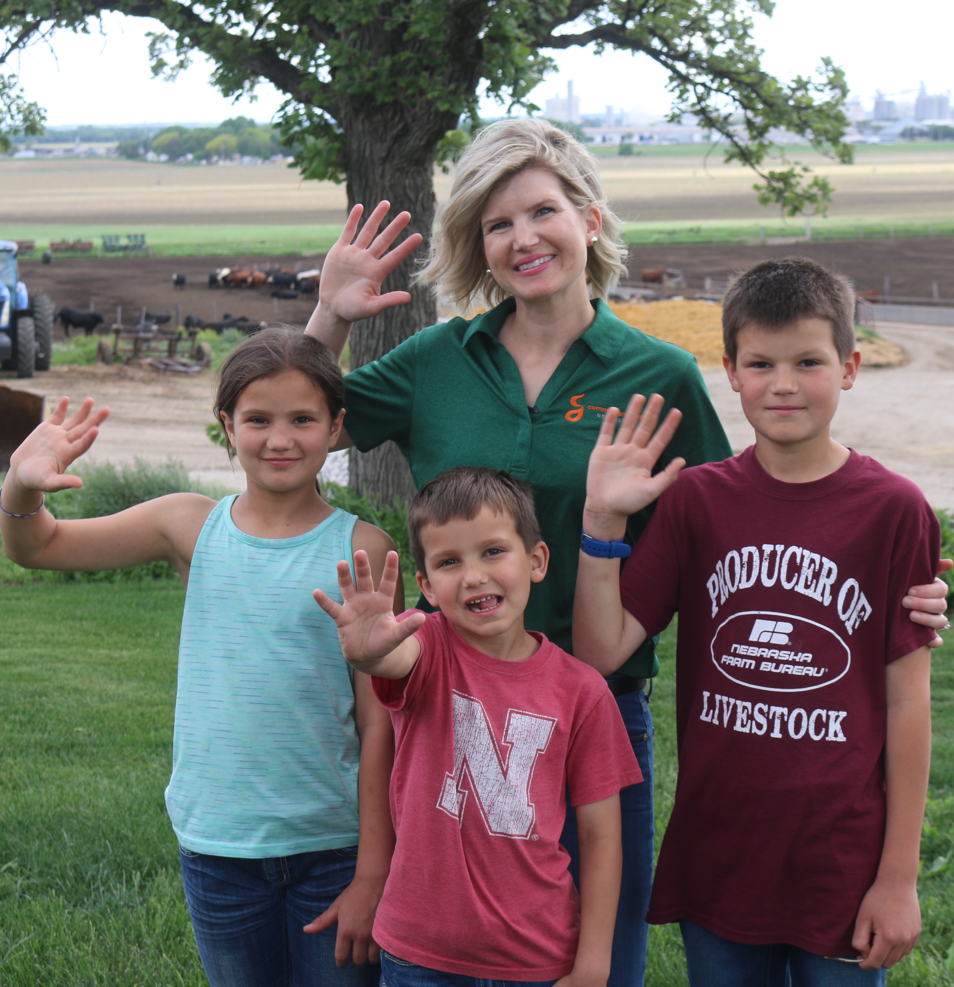
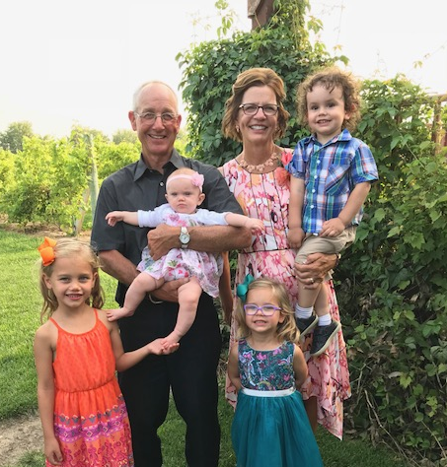
Thank you!

Slide 25
Questions
Learn more about CommonGround in Nebraska, as well as programs across the U.S. at:
CommonGround Nebraska Blog: www.CommonGroundNebraska.com
National CommonGroundwebsite: www.findourcommonground.com
Facebook: www.facebook.com/CommonGroundNebraska
Twitter: @CommonGroundNow Instagram: commongroundne
CFI Best Food Facts: www.bestfoodfacts.com

